Slide 1
Mindful Living for Team Players
Scott Goyette
Your Mindful Living Expert

Slide 2
You are Truly Limitless

Slide 4
Happy People They realize that having a consistently positive mindset in both their professional and personal lives is paramount to happiness.
Fulfilled People
They nurture their energy and take care of their needs first, so they are able to fulfill their life purpose and serves others as well.

Slide 5
TAKE CARE OF YOURSELF…FIRST!

Slide 6
How can I take better care of myself, allowing me to become a better person for all?
START WITH ACTION
- Become more self aware!
- Do things you enjoy that naturally energize you!
- Take care of your physical being!
- Decompress in a way that suits you and those around you!
- Realize that Laughter is the best medicine!
- Make your words positive, since they shape you!

Slide 7
What would you do differently?

Slide 8
An extra hour

Slide 9
Give a gift to those around you - decompress!
Rediscovering Your Natural State of Balance! - FREE

Slide 10
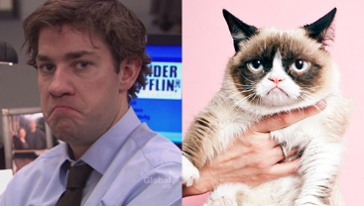

Slide 11
Study Results Brain Waves - Gamma, Beta, Alpha, Theta and Delta Laughter helped create a perfect mix of Alpha and Beta
We want a combination of Alpha and Beta.
Alpha waves are the bridge between our conscious and unconscious mind.
Too much Beta creates anxiety and an inability to focus and/or relax.

Slide 12
Manage Your Energy

Slide 13
THE SECRET SAUCE
In all parts of your life, be willing to
give and receive gracefully…and always
Connect with Your Heart

Slide 14
Use Positive Language
Do you speak positively of yourself and others? We often speak of others the same as ourselves.
Studies show we belittle ourselves over 800 times each day.
One million new cells produced daily. Give them a positive space in which to grow.
Having a sense of gratitude and appreciation helps to build the foundation for future joy and good health.

Slide 16
Practice Your
Positivity
Compliment Sandwich

Slide 17
Your Words Matter

Slide 18
WHY BE A PERSON WHO EMPOWERS OTHERS?
Three Rewarding Stories of Kindness

Slide 20
Alan

Slide 21
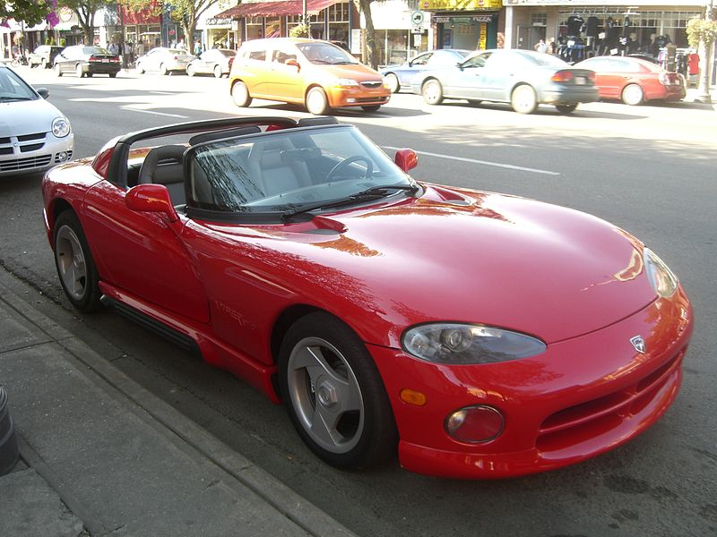

Slide 22
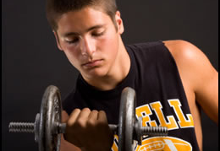

Slide 24
The Angel You Never Knew

Slide 25
Ten Positives

Slide 26
WE ARE ONLY HUMAN

Slide 27
THE MASTER IN THE ART OF LIVING The Master in the Art of Living makes little distinction between his work and his play, his labor and his leisure, his mind and his body, his education and his recreation, his love and his religion. He hardly knows which is which. He simply pursues his vision of excellence in whatever he does, leaving others to decide whether he is working or playing. To him, he is always doing both. James Michener
- Pulitzer Prize Winning Novelist

Slide 29
www.thedeedchain.com

Slide 30
Scott Goyette
512-748-0803
scott@scottgoyette.com
www.scottgoyette.com
www.facebook.com/existingmindfully
www.twitter.com/existmindfully

