Slide 1
Changes to Taxation of Amusement and Recreation Activities
John Wack
Department of Revenue
Tax Information Specialist

Slide 2
Topics
Overview of new law (HB 1550)
Municipal facilities providing fitness and recreational activities – community centers
General approach
Is it an AFF?
Rental of facilities to third party contractors
Questions and answers

Slide 3
What is DOR Providing for Guidance on HB 1550?
Web page – Retail recreational services and athletic and fitness facilities (current)
Web page – Municipal government providing fitness and recreational activities (current)
WACs 458-20-183 and 458-20-189 are being updated
Comments welcome

Slide 4
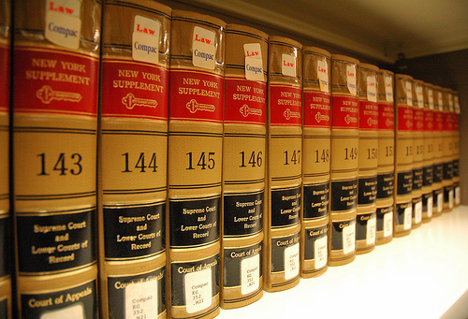
Overview of HB 1550

Slide 5
Overview of HB 1550
Effective January 1, 2016
Replaced two sections of RCW 82.04.050 that defines a retail sale
Amusement and recreation services
Physical fitness services
Added two new sections to RCW 82.04.050
Section 3(g) – Athletic or fitness facilities (AFF)
Section 15 – Retail recreational services

Slide 6
Overview of HB 1550
Athletic or fitness facilities (AFF) defined:
“… an indoor or outdoor facility or portion of a facility that is primarily used for: Exercise classes; strength and conditioning programs; personal training services; tennis, racquetball, handball, squash, or pickleball; yoga; boxing, kickboxing, wrestling, martial arts, or mixed martial arts training; or other activities requiring the use of exercise or strength training equipment, such as treadmills, elliptical machines, stair climbers, stationary cycles, rowing machines, pilates equipment, balls, climbing ropes, jump ropes, and weightlifting equipment.”

Slide 7
Overview of HB 1550
Physical fitness services (old) vs. AFF (new)
Physical fitness services were taxable based on the activity
An AFF is established based on the availability of:
Activities (such as, exercise classes, strength and conditioning programs)
Facilities (such as, tennis, racquet ball)
Equipment (such as, exercise equipment, strength training equipment, weight lifting equipment)

Slide 8
Overview of HB 1550
Characteristics of an AFF
An AFF is established when a facility or part of a facility is primarily (more than 50%) used for:
AFF activities (such as, exercise classes, strength and conditioning programs)
AFF facilities (such as, tennis, racquet ball)
AFF equipment (such as, exercise equipment, strength training equipment, weight lifting equipment)
When an AFF is established, all charges for use of the facility and associated charges are retail sales, including instructional lessons.

Slide 9
Overview of HB 1550
AFF exclusions from retail sales (subject to service and other B&O tax)
Separately stated charges for:
the use of an AFF where such use is primarily for a purpose other than engaging or receiving instruction in a physical fitness activity.
the use of a discrete portion of an AFF, other than a pool, where that portion of the facility does not by itself, meet the definition of an AFF.
services, such as advertising, massage, nutritional consulting that do not require the customer to engage in physical fitness activities to receive the service.
physical therapy provided by a physical therapist when performed pursuant to a referral from an authorized health care practitioner.

Slide 10
Overview of HB 1550
Retail recreational services
Subject to retail sales tax and retailing B&O tax
The new law adds a list of activities that are defined to be retail sales
Some of the activities are very specific while others are more general
There are some specific exclusions from retail sales
Web page called Recreational Services at a Glance

Slide 11
Overview of HB 1550
Retail recreational services – Categories
Amusement park, theme park, and water park facility
Air sports
Batting cages
Bowling
Bungee jumping, zip lining, and riding inside a ball, inflatable or otherwise
Climbing on artificial climbing structures (both indoor and outdoor)
Day trips for sightseeing purposes
Fishing
Go-karting, bumper cars, and other motorized activities
Golf
Continued -

Slide 12
Overview of HB 1550
Retail recreational services – Categories (continued)
Horseback riding
Hunting
Paintball and airsoft activities
Playground activities, indoor and outdoor
Shooting sports and shooting activities
Skating
Snow sports and activities (with or without snow)
Swimming – recreational and fitness swimming that is open to the public
Table games
Water sports and activities

Slide 13
Overview of HB 1550
Non-retail recreational services – Categories
Dancing
Day camps
Gymnastics
Running, triathlon, and bicycling events
Sports leagues
Sports venues – not including an athletic or fitness facility
Video game/arcade game trucks
Yoga, tai chi, chi gong

Slide 14
Overview of HB 1550
Non-retail recreational services – At an AFF
Physical fitness activities provided at an AFF are retail sales
Includes the following non-retail recreational services:
Dancing
Gymnastics
Running, triathlon, and bicycling events
Sports leagues
Charges for space by an AFF to a 3rd party that will provide physical fitness activities are retail sales

Slide 15
Overview of HB 1550
Local government physical fitness classes
Retail sales tax exemption under RCW 82.08.0291 for physical fitness classes provided by local governments was unchanged (retailing B&O tax still applies)
AFF classes may qualify for exemption
Retail recreational services do not qualify
Web site for Local government physical fitness classes has more information

Slide 16
Overview of HB 1550
Opportunity to dance
Temporary exemption was made permanent
Not subject to retail sales tax
Income is subject to service and other B&O tax
Web site on Opportunity to Dance has more information

Slide 17
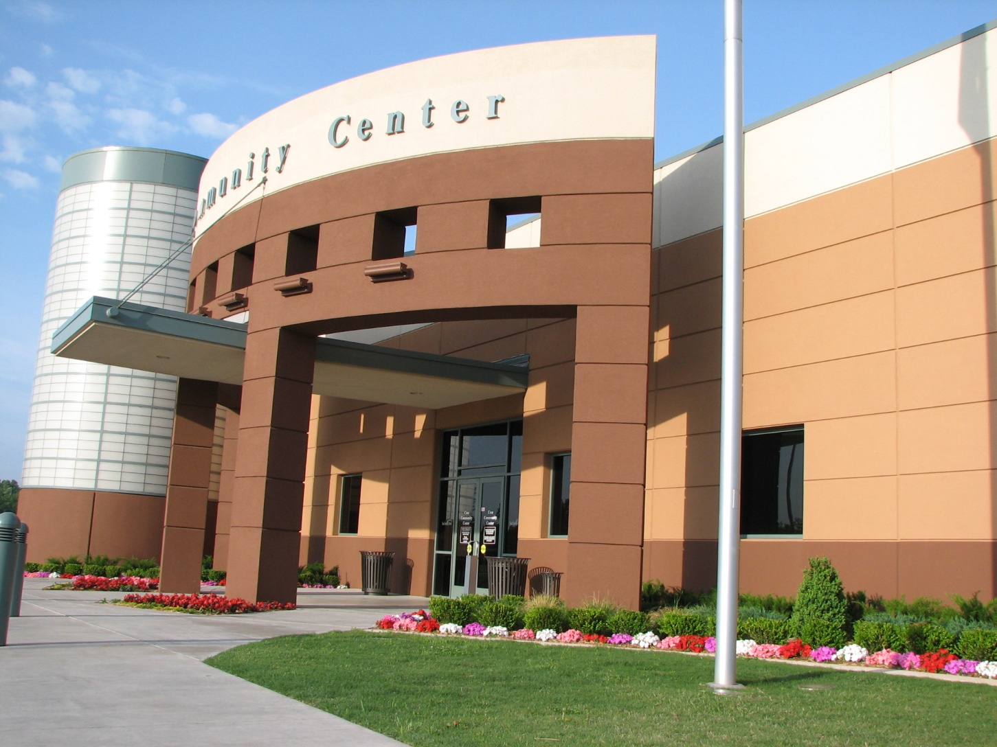
Municipal Facilities Providing Fitness and Recreational Services - Community Centers

Slide 18
General Approach - Community Centers
Is the community center an AFF?
This is a two part test:
AFF as a whole
The entire community center is treated as an AFF
Associated physical fitness activities are retail sales
AFF in part
A part of the community center is treated as an AFF
Associated physical fitness activities are retail sales that occur in the AFF

Slide 19
AFF as a Whole
The Department will presume that the entire community center is an AFF if:
More than 50% of the revenues are from AFF activities and facilities
A community center has a substantial fitness center and/or racquet center
Result: Charges by the community center for “physical fitness activities” will be considered retail sales unless an exclusion applies.

Slide 20
AFF as a Whole
Physical fitness activities
Activities that involve physical exertion for the purpose of improving or maintaining the general fitness, strength, flexibility, conditioning, or health of the participant.

Slide 21
AFF as a Whole
Exclusions from retail sales at an AFF
Must be a separately stated charge
Not subject to retail sales tax
Subject to service and other B&O tax

Slide 22
AFF as a Whole
Exclusions from retail sales at an AFF
Use of the community center for a purpose other than engaging or receiving instruction in a physical fitness activity. For example, a couple holds their wedding at the facility.
Use of a discrete portion of the community center, other than a pool, where that portion of the facility does not by itself, meet the definition of an athletic or fitness facility. Examples include use of the kitchen, auditorium, theaters, meeting areas, etc.
Continued -

Slide 23
AFF as a Whole
Exclusions from retail sales at an AFF (continued)
Use of the facility for advertising, massage, or nutritional consulting that does not require the customer to engage in physical fitness activities to receive the service. This exclusion does not include personal training services or instruction in a physical fitness activity.
Physical therapy provided by a licensed physical therapist when prescribed by an authorized health care practitioner.
Cover charges for dances. For example, a middle school holds a dance where there is a charge to attend. (See our web page on Opportunity to Dance.)

Slide 24
AFF as a Whole
Exemption from retail sales tax
Physical fitness classes provided by a community center
Characteristics of a physical fitness class
Group exercise (not one-on-one)
Group instructor or leader provided
Set days and times
Limited number of participants
Registration is in advance or before beginning class
See web page for examples

Slide 25
AFF in Part
When a community center:
Has revenues from AFF activities and facilities that are 50% or less of total revenues, and
Does not have a substantial fitness center and/or racquet center
The Department will presume that the community center as a whole is not an AFF.
However, the community center must determine if a portion of the facility is an AFF.

Slide 26
AFF in Part
Two part test
1. Is there a separate / discrete area (e.g., a room) that is “primarily used” (> 50%) as an AFF?
Examples: Weight rooms, cardio rooms, rooms dedicated to martial arts, kickboxing, or yoga classes, racquet/hand ball courts, and tennis courts (both indoor and outdoor).

Slide 27
AFF in Part
Two part test
2. Is there a separate/discrete charge for the use of this (room) area?
If the answer to 1 and 2 is yes, then the separate room (or area) is an AFF and any charges to use the AFF are considered retail sales.
If the answer to 1 or 2 is no, then no portion of the community center is an AFF.

Slide 28
AFF in Part
Two part test – Assumptions
In buildings, we will look at the entire room (area) to determine if a separate area should be considered an AFF and we will not split up rooms.
Example: City A has a neighborhood community center that is not an AFF as a whole. One room in the community center has a couple stationary bicycles in a corner. There is no charge for the use of the stationary bikes. The remainder of the room has no exercise equipment and is primarily used for dance classes and meetings. The Department will not view this room to be an AFF when there is no separate charge for use the exercise equipment.
Continued -

Slide 29
AFF in Part
Two part test – Assumptions
For outdoor areas, we will look at the primary activity performed to determine if an outdoor area qualifies as an AFF
Example: City X has a community center with an outdoor tennis court, an outdoor basketball court, and a softball field that are side by side. The use of any of the outdoor areas requires the payment of a fee. In this situation each area is a distinct area. The tennis court is an AFF; while the softball field and the basketball court are not AFFs.
Continued -

Slide 30
AFF in Part
Two part test – Assumptions (continued)
The Department presumes that the following rooms within a community center are not AFFs when the facility as a whole is not an AFF:
Gymnasiums
Multi-purpose rooms
Classrooms
Meeting rooms
Pools
Outdoor basketball courts
Outdoor ball fields (soccer, football, baseball, etc.)
Continued -

Slide 31
AFF in Part
Two part test – Assumptions (continued)
The term “primarily used” means more than 50%. To determine if an area (room) is “primarily used” as an AFF, the schedule of room use for a charge will determine whether it is primarily used as an AFF. Idle or unscheduled time will not be a part of the calculation.

Slide 32
AFF in Part
Application of taxes
When a room (or area) at a community center is determined to be an AFF then:
Any charges to use that room for physical fitness activities are considered to be a retail sales unless an exclusion applies
All charges to engage in or receive instruction in physical fitness activities in the AFF portion of the community center are retail sales (the exemption from retail sales tax for physical fitness classes may apply)

Slide 33
Community Center is not an AFF
Recreational services
Retail recreational services are subject to retail sales tax and the income from such charges is subject to B&O tax under the Retailing classification.
Non-retail recreational services are subject to B&O tax under the service and other classification. Retail sales tax does not apply on the charges to participants. This includes charges for activities that would otherwise be treated as AFF activities, such as Pilates, fitness classes, martial arts classes, etc., except that no portion of the community center is an AFF.

Slide 34
Rental of Rooms/Facilities to 3rd Party Contractors
AFF facility rental
The community center must collect retail sales tax from the third party contractor renting an AFF facility that will be used for a physical fitness activity. Income received by the community center is subject to B&O tax under the retailing classification.

Slide 35
Rental of Rooms/Facilities to 3rd Party Contractors
AFF facility rental – examples
Example 1: A rock climbing instructor not employed by the community center reserves two hours each week on the community center’s climbing wall to teach a class on climbing techniques. The community center must collect retail sales tax from the instructor because the class is considered a physical fitness activity.
Example 2: An art instructor rents a room to hold an art class. The community center does not have to collect retail sales tax from the instructor because the art class is not a physical fitness activity.
Example 3: A volleyball instructor rents the gymnasium at the community center for a volleyball class. The community center must collect retail sales tax from the instructor because the class is considered a physical fitness activity.

Slide 36
Rental of Rooms/Facilities to 3rd Party Contractors
Non-AFF facility rental
The community center does not have to collect retail sales tax. In this case, the income received by the community center is subject to B&O tax under the service and other classification.

Slide 37
Rental of Rooms/Facilities to 3rd Party Contractors
Non-AFF facility rental – examples
Example 1: A rock climbing instructor not employed by the community center reserves two hours each week on the community center’s climbing wall to teach a class on climbing techniques. The community center does not have to collect retail sales tax from the instructor because climbing wall is not considered part of an AFF.
Example 2: A dance instructor rents the gymnasium at the community center for a ballroom dance class. The community center does not have to collect retail sales tax from the instructor because the gymnasium is not an AFF.

