Slide 1

Local Government Performance Center
How auditors can help local government work better and cost less
Puget Sound Finance Officer‘s Association
March 13, 2013
Larisa Benson, Director of Performance Audit

Slide 2
Bad economic news stimulates demand
Governments dependent on tax revenues see their tax base shrinking
in a down economy.
Voters, also feeling the pressures of the economy, demonstrate strong anti-tax sentiments.
Meanwhile, rising caseloads actually increase the demand for
government services.
Unprecedented levels of fiscal austerity cause leaders to ask: Have we
cut all we can? What do we do now? Is it possible to do more with less?
How can we do less with less – what choices and tradeoffs must be made?
Using performance data to inform tough budget decisions sounds like a good route . . . but it’s not as easy as it sounds.
Could the tools and techniques that performance auditors use help local government leaders make more informed decisions and use the opportunity in the crisis to improve government services?

Slide 3

Why the State Auditor’s Office?
As performance auditors, we conduct research and use tools that, if shared more broadly, could help many local governments reduce their costs and improve performance.
Sometimes an independent perspective and expertise from outside the organization can help you see and do things differently.
We believe that by sharing what we know through this project, we can reach more governments faster and cheaper than by doing one local government audit at a time.
Notes:
We didn’t come up with this idea all by ourselves. A few local government leaders who know that “business as usual” can’t continue said they would welcome help from the Auditor’s Office. (Yes, they have actually invited the auditors to come in!) Early pilot projects have received very favorable responses.

Slide 4
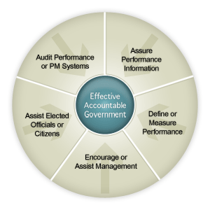
Auditor roles in Performance Management
Audit performance or performance management systems
Assess performance information and reports
Define or measure performance
Encourage or assist management
Assist elected officials or citizens
Source: Framework of Auditor Roles and Practices, www.auditorroles.org (Paul Epstein, Stuart Grifel, Stephen Morgan)

Slide 5
Improved government performance: A shared goal
The Local Government Performance Center within the State Auditor’s Office offers tools and training to help local leaders who want their governments to work better, cost less, and improve the value of their services to citizens.
  An online resource center with tools and examples.
  Training on how to improve government services.
  Customized on-site training sessions (on request and within available resources).
Our goal: better results for citizens and customers at lower cost to government and taxpayers

Slide 6
Leadership & technical experts group membership
Leadership Group
Name | Affiliation | Name | Affiliation
Mike Doherty | Clallam County | Charlie Bush | City of Issaquah
Helen Price Johnson | Island County | Stacy Wenzl | Spokane County
Kim Krause | City of Burien | Randy Beehler | City of Yakima
Sheila Gall | Assoc. WA Cities | Iwen Wang | City of Renton
Cheryl Grant | City of Chelan | Kevin Phelps | Pierce County
Marie Mosley | City of Kennewick | Larry Keeton | Kitsap County
Doug Schulze | City of Bainbridge Island | Lloyd Tyler | City of Vancouver
Kent Cash | Cowlitz County | Chuck Johnson | Councilmember
Henry Hash | Skagit County | Dean Maxwell | City of Anacortes
Bud Hover | Okanogan County
Technical Experts Group
Name | Affiliation | Name | Affiliation
Mike Bailey | City of Redmond | Patrick Jones | Eastern Washington University
Ken Smith | University of Washington | Rich Siegel | City of Bellevue
Gavin Cooley | City of Spokane | Tom Nosack | Clark County
Robin Campbell | Thurston County | Steve Gorcester | Transportation Improvement Board
Michael Jacobson | King County | Jim McIntire | Clallam County

Slide 7
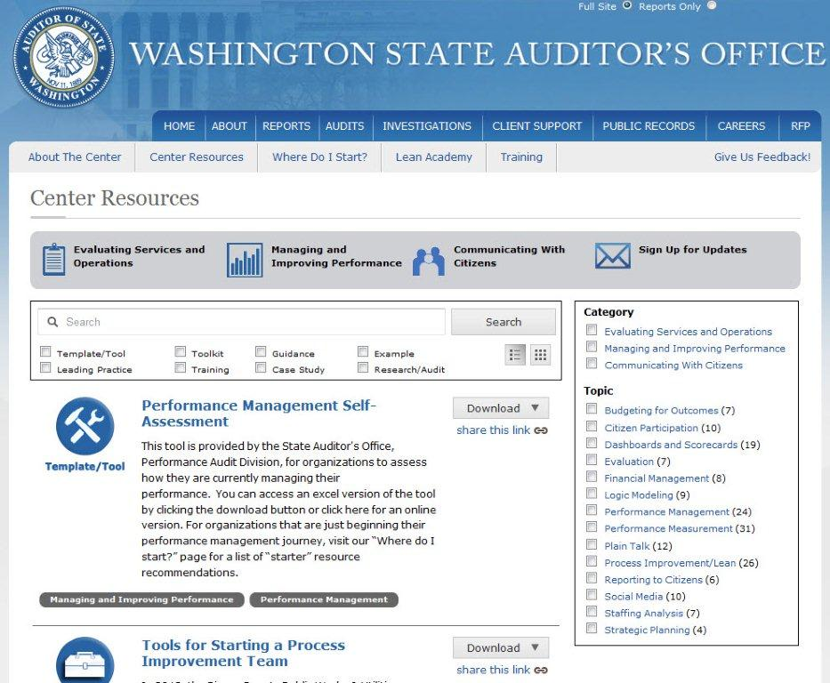
Where to find us on the website
www.sao.wa.gov/performancecenter

Slide 8
Five examples of what we’re doing
1) Staff analysis training and tools
Help government leaders evaluate costs of overtime versus adding staff.
Training formats include classroom style, webinar, and on-site.
2) Turning a completed audit into a management tool
Sharing lessons learned from a recent state audit in a checklist format helps governments save money on cell phone costs.
3) Citizen engagement tools and resources
Pilot citizen survey project with Walla Walla, creating a model.
Training on how to engage citizens and increase transparency.
4) Performance measure training and assessments
Training on performance measures plus auditor assessments of how local governments use performance data and ways they can improve.
5) Demystifying tools like “lean management”
Training plus creating a peer-support network to help governments learn and use process improvement methods to develop faster, cheaper delivery systems.
“Lean Academy” with Clark, Island, Whatcom, and Douglas Counties

Slide 9
Example 1: Staffing analysis tools & training
Questions local government leaders ask:
How do we know if we have the right number of staff to cover a post on a 24/7 schedule?
  Calculating an appropriate relief factor
  Anticipating and budgeting for hidden costs
How do we know if we’re paying too much in overtime?
  Analyzing overtime data: who is using it, and why?
  Correctly calculate and compare the costs of overtime vs adding another full or part-time employee
  Tips for monitoring and managing overtime pay

Slide 10
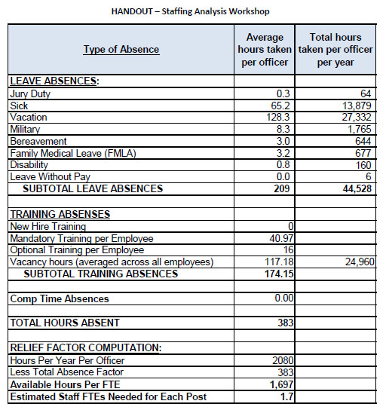
Example 1: Staffing analysis tools
Determining coverage
In our workshops, we review ways to calculate leave to factor into evaluation.
Downloadable template
This example uses the average leave per law enforcement officer to calculate how many FTEs are required.
Using available data
These tools use data governments already have.

Slide 11
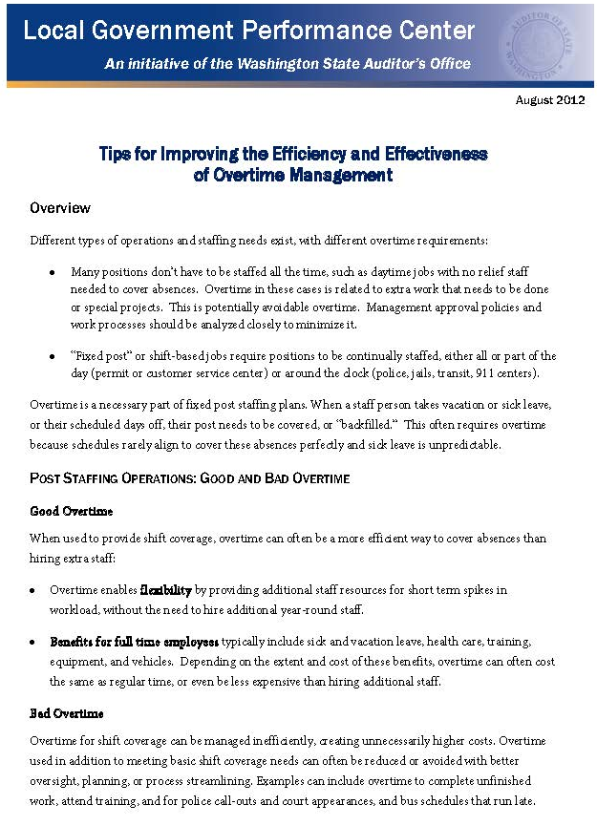
Example 1: Staffing analysis – Overtime management
Reevaluating overtime
Managing overtime is important for assessing staffing levels and needs.
Two page online tool highlights the difference between “good” and “bad” overtime use.
Elected official audience
The format is designed to help elected officials and decision makers ask the right questions.

Slide 12
Example 2: From the audit comes the analytic tool
  Our November 2011 performance audit helped the state save $1.7 million, or almost 20% of its total cell phone bill.
We summarized and translated our methodology and recommendations into a downloadable tool others can use(“short form”):
  Compare actual usage to current rate plans
  Consider using pre-paid phones vs. calling plans
  Consider joining purchasing cooperatives
  Negotiate with cell phone providers
  Evaluate the pro’s and con’s of using an employee stipend policy
Local governments used our idea to get better results:
  Pierce County discovered most phones were rarely used, but the county was paying for higher-use plans: the average phone used 67 minutes and covered for 600 minutes.
  The county is now using this information to negotiate better plans and lower costs.
  Other governments are using the tool to evaluate their cell phone spending.

Slide 13
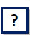
Example 2: Translating auditor insights into “plain talk”
Can your jurisdiction save money on cell phones? Start by asking three questions:
How many phones are we paying for? How much are we paying for these phones?
Why do we need the phones? Do the phones justify the cost? Do employees need a land line and a cell?
How many different phones or plans can our employees choose from? What are the key differences between the available plans? Do we need them all?
How many minutes are we actually using? Would other plans better fit our current use patterns?
Are there any phones we aren’t using very much? Why? Should these phones be turned in?
Are there any suspiciously high use patterns?
Can our employees use their personal phones for their work? Are stipends an option?
Is our demand changing? Has the number or type of devices or their use increased or decreased over time?
How can we explain the change? Do we need a new plan to better fit our needs?
“Every dollar saved now is a dollar that can be used for more important priorities.”
The November 2011 State Auditor’s Office report.

Slide 14
Example 3: Helping governments engage citizens
We provide tools and training that help cities and other organizations communicate with their residents.
Training on citizen engagement strategies:
  Citizen-driven prioritization of resource allocation and process improvement efforts help governments focus on “what matters most.”
Citizen surveys:
  Helping the City of Walla Walla develop and analyze a
  citizen survey.
  Developing a survey template other governments can use.
  Guidance using the results to inform decisions.

Slide 15
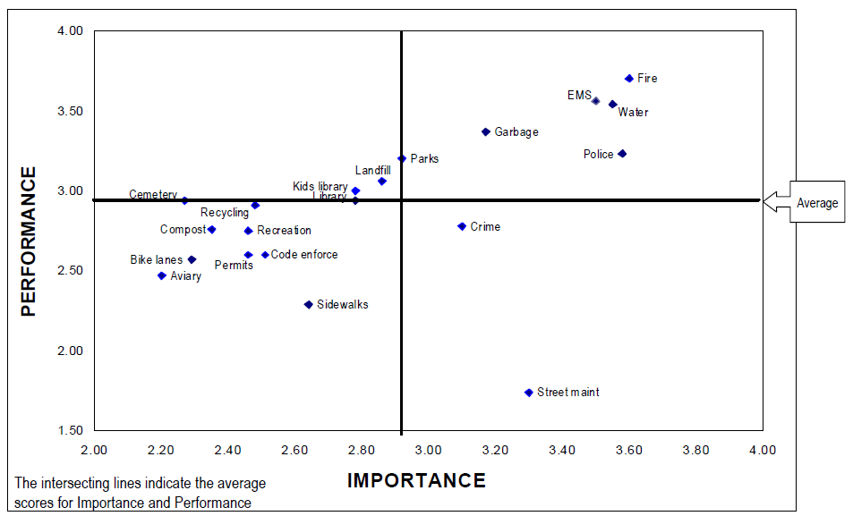
Example 3: Engaging citizens in setting priorities
City of Walla Walla services: Importance by performance
Source: Elway Research, Inc.

Slide 16
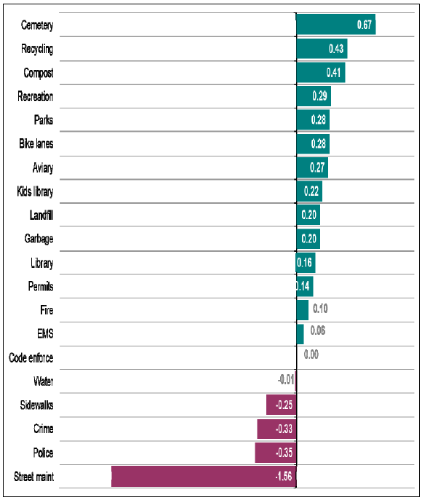
Example 3: What matters most to citizens?
City of Walla Walla:
Relative gaps between importance and performance
Source: Elway Research, Inc.

Slide 17
Example 4: Performance measure assessments
Cities and counties have asked the Local Government Performance Center to review how they use performance measures and offer guidance.
We provide on-site training to help managers and analysts improve performance-based strategies.
Recently completed assessments for the City of DuPont, the Thurston County Sheriff’s Office, and Pierce County are available on our website.

Slide 18
Example 4: County Sheriff’s Office Assessment
Before
?

Slide 19
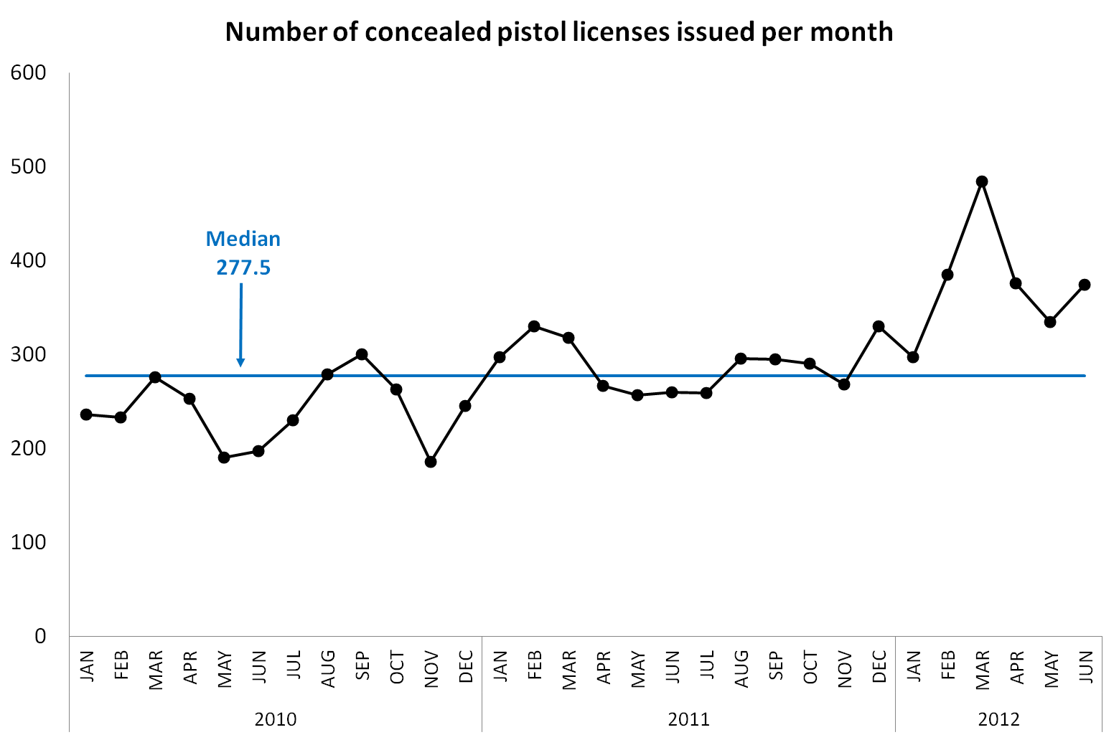
Example 4: Front desk data presented another way
After

Slide 20
Example 4: Burglaries per month by sector
Before

Slide 21
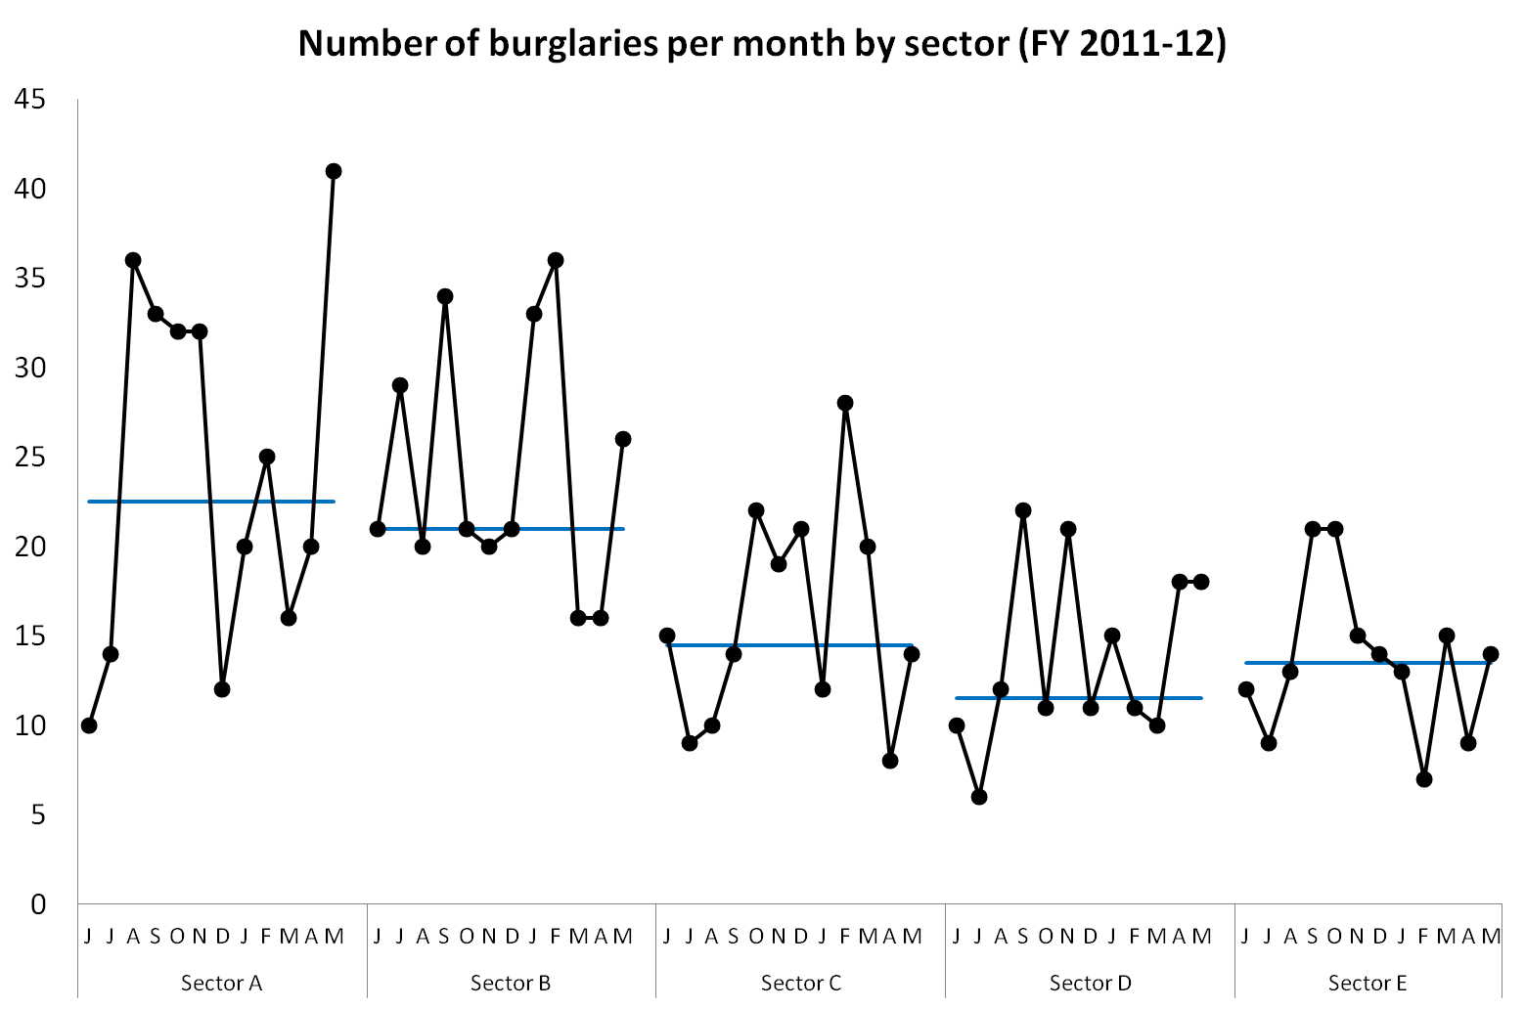
Example 4: Burglary data presented another way
After

Slide 22
Example 5: Using Lean principles
Kitsap County redesigned their permit process for Single Family Residences using lean management techniques.
  Front line employees involved in redesign effort
  Extensive on-site training assistance
  Their new process reduces the time it takes to make a permitting decision by 77% (down to 6 days)
Clark and Island Counties have now completed our “Lean Academy” to help streamline their permitting offices and Whatcom and Douglas are beginning this month.
Case studies, videos, and “how-to” tools will be posted on our website, and more training will be offered this year.

Slide 23
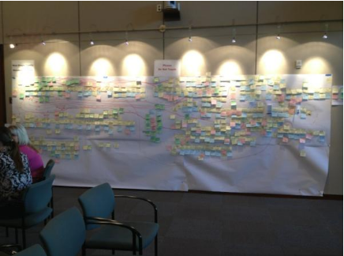
Example 5: Lean Academy in Kitsap County
Before

Slide 24
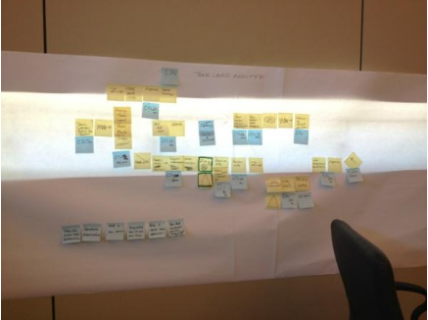
Example 5: Lean Academy in Kitsap County
After

Slide 25
Why should we do this?
Our vision is to create a place where government leaders who are committed to achieving cost savings and better results can learn from and support one another.
By participating, local governments can:
  Learn new ways to deliver better results and give citizens a better return on their tax dollars.
  Receive information and technical assistance from performance experts at no cost to their organization.
  Share ideas, challenges, and resources with other government leaders who face similar challenges.

Slide 26

What does it cost?
The Center is funded through the state performance audit program, which was established in the Auditor’s Office following voters’ approval of Initiative 900 in 2005.
A small fraction of the performance audit budget is dedicated to this effort.
There is no charge to governments.
This is a pilot effort – we will be evaluating whether it’s working or not, and whether we can meet demand.

Slide 27
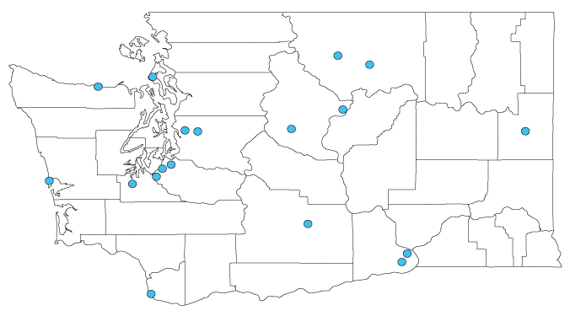
Local Government Performance Center trainings in 2012

Slide 28
Upcoming 2013 Performance Center Trainings
Training | Where | When
Lean Academy – Team Leader Training | Olympia | March 11, 12
Performance Measure Training | Bellevue City Hall | March 12
Understanding the Language of Performance Measures Training | Bellevue City Hall | March 21
Lean Overview Training | Renton City Hall | April 9
Communicating with Data | Bellevue City Hall | April - TBD
Understanding Data | Bellevue City Hall | April - TBD
Lean Academy | Whatcom County | April 15-19
Lean Academy | Douglas County | April 22-26

Slide 29
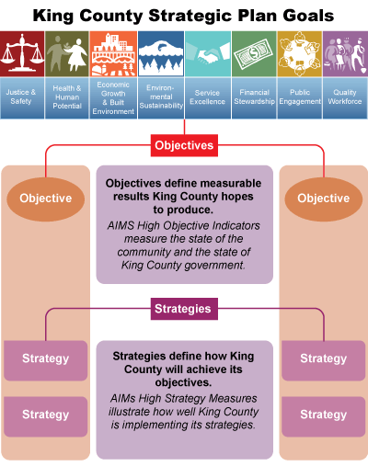
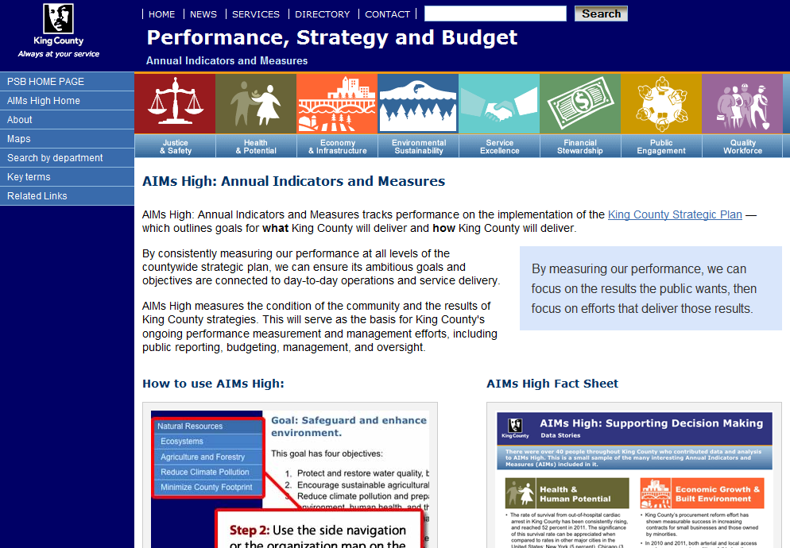
Other assistance we can provide: Dashboards

Slide 30
New roles bring new challenges
Maintaining our independence: We have developed an extensive intake procedure that evaluates any potential compromise of our independence.
We are scrupulously clear with local governments that we don’t do the work for them – we provide tools, training and technical assistance.
Auditors who work on assistance engagements do not audit those entities; but we do share information with the audit teams and they share information with us.

Slide 31

How can you stay informed?
Email performance@sao.wa.gov
Sheri Sawyer, Assistant Director (360) 725-9745
Get real-time updates – and offer your input – on Center development through @LocalGovPerform. (Twitter account facilitated by FLT Consulting.)

Slide 32
Contacts
Larisa Benson
Director of Performance Audit
(360) 725-9720
Larisa.Benson@sao.wa.gov
Sheri Sawyer
Assistant Director, Local Government Performance Center
(360) 725-9745
Sheri.Sawyer@sao.wa.gov
Roxanne Lowe
Project Coordinator
(360) 725-9722
Roxanne.Lowe@sao.wa.gov
Website: www.sao.wa.gov
Twitter: www.twitter.com/LocalGovPerform

