Slide 1
SAO GAAP and Cash BARS Update
Christie Cowgill, Assistant Audit Manager Olivia Crouch, CPA, CFE, Assistant Audit Manager
Notes:
Vivian

Slide 2
Agenda
01
BARS codes
02
Accounting& reporting
03
SBITA & PPP
04
Future updates
Updates and reminders
Arbitrage, election costs, loans and notes
Implementation of new accounting requirements
Accounting changes and compensated absences
Notes:
Vivian

Slide 3
BARS codes updates
311.30: Sale of Tax Property
Removed from the chart of accounts
Report property tax revenue to 311.10 property tax
Report excess proceeds to 369.20
341.48: Motor Vehicle License Fees
Restricted to counties only
Notes:
Vivian

Slide 4
BARS codes updates
345.81: Zoning and Subdivision Services
Both BARS codes 367 (Contributions and Donations from Nongovernmental Sources) and 345.81 referenced RCW 82.02.020.
Removed reference to RCW 82.02.020 from BARS 367
Voluntary agreements should be reported in BARS 345.81.
BARS codes updates
Notes:
Vivian

Slide 5
BARS codes updates
337.00: Local Grants, Entitlements, Tribal Government Distributions, and Other Payments
Added tribal governments to the title and description
Receipts from tribal governments (other than payments for services) are now coded to BARS 337.00.
Do not use BARS 367.00 (Contributions and Donations from Nongovernmental Sources)
Notes:
Vivian

Slide 6
BARS codes updates
524.60: Enforcement of codes and regulation
Clarified the description
Use for expenditures related to the enforcement of the local government's codes that are not related to health, law enforcement, fire, building, or protective inspection

Slide 7
BARS codes updates
New Department of Natural Resources codes
Codes for select counties only
335.03.34 DNR timber trust 1 and timber trust 77
335.03.35 DNR other trust 1 and other trust 77

Slide 8
Arbitrage Rebates
Cash: Added a new section
GAAP: Updated existing section
Arbitrage rebates are due to the federal government every 5 years and at maturity.
Report expenditure when paid
Report arbitrage liability on the Schedule of Liabilities, and update amount annually
Accounting and reporting

Slide 9
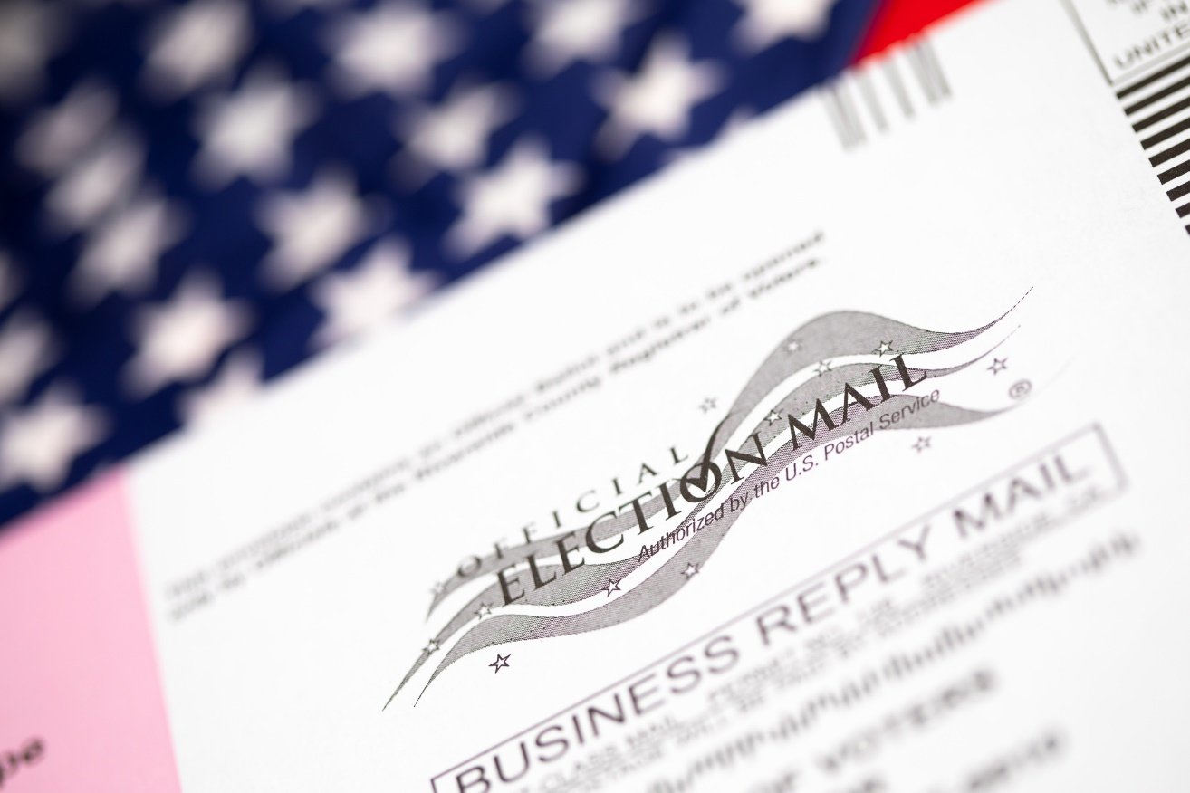
Accounting and reporting
3.8.12: Election Costs
Secretary of State (SOS) has authority over election costs.
BARS page will be updated to link directly to the SOS’s guidance.
3.4.7: Intergovernmental and Forgivable Loans
Accounting and reporting
Moved guidance on revolving loan accounting to this section
Notes:
Christie

Slide 10
3.3.10: Capital Asset Accounting
GAAP only: Added instructions for how to account for capital assets that have been fully depreciated
Notes to the Financial Statements
Accounting and reporting
Multi-year audits must submit a separate set of notes for each year.
GAAP only: Notes should only be combined for comparative year presentations.

Slide 11
Note X – Property Taxes
Cash only: Clarified that tax levy for the reporting year should be disclosed
Note X – Long-term Debt
Cash only: Updated to include installment purchases
Accounting and reporting
Notes:
Christie -

Slide 12
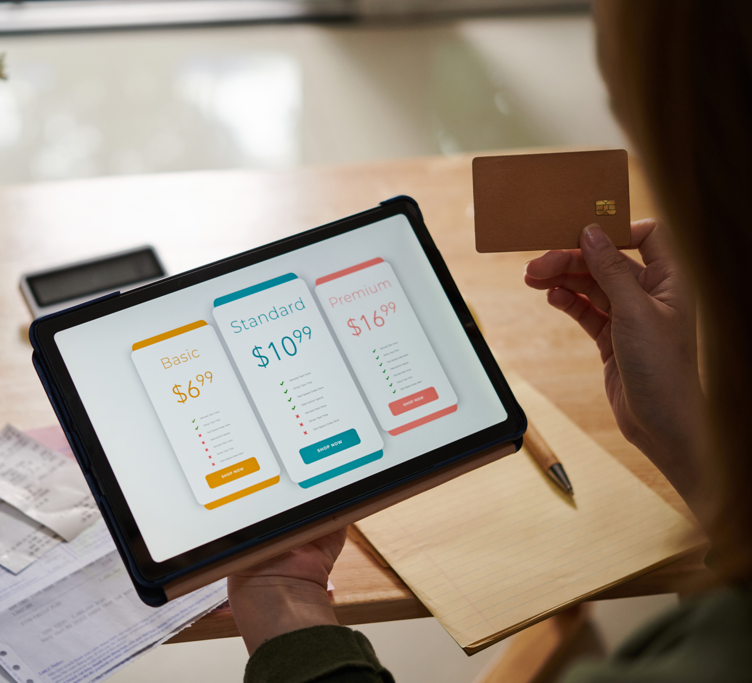
SBITA: Subscription-based information technology arrangements
Notes:
Now we are going to spend some time on SBITA, or subscription based information technology arrangements.

Slide 13
SBITA definition
What is a SBITA?
“A contract that conveys control of the right to use another party’s (a SBITA vendor’s) IT software, alone or in combination with tangible capital assets (the underlying IT assets), as specified in the contract for a period of time in an exchange or exchange-like transaction.”
Notes:
Now what is a SBITA? Here is the definition.
Read definition.
This should sound familiar because it is almost exactly the definition of a lease. The difference here is that it is specific for IT software. Basically, if you are paying someone else to use their software you may have a SBITA.

Slide 14
Potential examples
Cloud computing arrangements
Software as a Service (SaaS)
Platform as a Service (PaaS)
Infrastructure as a Service (IaaS)
Cloud-based Enterprise Resource Planning (ERP) systems
Online conferencing
Email, calendar, office tools
Online payment tools
Budgeting software
Notes:
Here are a few things to look for when you are trying to identify all of your SBITA contracts. Look at all of your cloud-based arrangements. This includes software as a service, platform as a service, and infrastructure as a service. I highly recommend involving your IT department in the process for identifying your SBITAs. You should also look at any cloud-based ERPs, other online items like conferencing, email and payment tools, and budgeting software.

Slide 15
More potential examples
911 or emergency dispatch systems
Meter reading and capital asset software
Remote learning platforms in schools
Data backup and storage for tax and appraisal records
DocuSign
Laserfiche
Open Gov
Zoom
Microsoft Office 365
Notes:
Here are a few more ideas of examples to consider looking at: 911 or emergency dispatch systems, meter reading and capital asset software, remote learning platforms, data backup/storage. Contracts for things like DocuSign, Laserfiche, Open Gov, Zoom, Microsoft Office 365. Really any software that you pay for, you should add it to your list of contracts to evaluate.

Slide 16
Exclusions
Short-term SBITAs (paragraph 13)
Have a maximum possible term of 12 months or less, including any options to extend, regardless of the probability of being exercised
IT software is insignificant to the tangible IT asset
IT support services
Software acquired through perpetual licensing agreements
Notes:
Now that we’ve covered a few things that might be included, let’s talk about what is not included.
The first one here is Short Term SBITAs. Thankfully, the definition of a short-term SBITA is the exact same as a short-term lease. As a reminder, it is short term is the MAXIMUM possible term is 12 months or less. And this includes all options to extend the contract regardless of whether you think those options will be exercised or not.
What that means, is if your government has a contract for an online conferencing tool, such as Zoom or Teams or Skype, but your contract is just a year-to year or month-to-month agreement and you and the SBITA vendor can choose to stop at any time, then it would be a short term SBITA and not subject to this accounting and reporting. However, if the contract is for longer than one year, it would be considered a SBITA for accounting and reporting. You’ll need to look at your individual contracts to determine whether you signed a year-to-year contract or whether your committed to a longer term.
The next exclusion is if you have a situation where your contract is for a tangible asset that also has software and that software is insignificant to the overall asset. An example of that would be leasing a smart copier where there is the tangible capital asset, the copier, that also has the IT software component. But really in this case, the IT component is very minor. In this case your can report the entire contract like a lease – you do not try and separate out the software portion to report it as a separate SBITA.
If your contract is for IT support services only, and not the right to use underlying IT software, then that would not be a SBITA. An example of this would be paying for training for your employees, or if you’re paying for troubleshooting or helpdesk services.
We are going to spend some time talking about perpetual licensing agreements, because there has been a little bit of confusion about what these actually are. First of all, perpetual licensing agreements are not SBITAs. Remember the definition of the SBITA says it must be for a period of time. However, a perpetual license gives you access to the software indefinitely.

Slide 17
What is a perpetual license?
This is the older model for software companies, and many are moving away from it in favor of subscription-based models.
The software is downloaded directly onto your computer or servers.
You have access to the software forever (perpetually).
Ask yourself: Can I still log in and access the IT software after the agreement term ends?
Notes:
Perpetual licenses are the older model for software companies. Many companies are moving away from this to go towards subscription-based models.
A perpetual license is one where you downloaded the software directly onto your computer or servers. And then you have access to that software forever, or perpetually – hence why it is called a perpetual license.
One easy way to determine whether you have a SBITA or perpetual license is to ask yourself: Can I still log in and access the IT software after the agreement term ends?
If the answer is no, you probably have a SBITA. If the answer is yes, that would be a perpetual license. Let’s look at an example.

Slide 18
Perpetual license: Microsoft Office 2000
Subscription: Microsoft Office 365
One-time fee
Downloaded to your computer
Can use after expiration, but it will not get maintenance or security patches/updates
Annual or monthly renewal fee
Must renew for continued access
Cannot use after expiration
Notes:
One of the examples that most people would be familiar with are Microsoft office products.
The older versions of Microsoft office such as Microsoft Office 2000 were perpetual licenses. You paid a one-time fee and downloaded it directly onto your computer. You were still able to use the software after it expired. You couldn’t get updates or security patches past the expiration, but you still had access to it.
Now compare that with the newer model of Microsoft Office 365. You must pay an annual or monthly renewal fee. If you do not pay that fee, you stop receiving access to the software and you cannot use it after expiration. This is a subscription-based IT arrangement.

Slide 19
Example
Question
A government signs a contract for an online conferencing tool (e.g., Zoom). The initial contract is for 1 year, payments are made annually, and it renews automatically each year. The government intends to renew the contract indefinitely. Is this a perpetual license?
Answer
No. This is still a subscription. If the government does not make the annual payment, it will lose access to the software.
Notes:
Let’s test our knowledge now.
A government signs a contract for an online conferencing tool, like Zoom. The initial contract is for 1 year. Payments are made annually, and the contract renews automatically each year. The government intends to renew the contract indefinitely. Is this a perpetual license?
No!! This is still a subscription. Remember to ask yourself: “Can I still log in and access the IT software after the agreement term ends?” The answer to that would be “no.” If you don’t pay Zoom their annual fee, they will cut off your access to their software. That means you do not have a perpetual license.

Slide 20
Example
Question
Same scenario. What’s the SBITA term?
Answer
Only 1 year. *Typically, at each renewal date, both the SBITA vendor and government have the option to cancel the contract. That means the periods past the initial one-year contract are cancellable and excluded from the maximum possible term.
*You must review your contracts to determine if both parties can cancel at the renewal dates.
Notes:
Now for that same scenario where the contract is a 1-year term and renews indefinitely. What is the SBITA term? How do you calculate your term here?
The answer is easier than you might think. Your term here is only 1 year. At each renewal date, both parties have the option to cancel the contract. If you remember from a little earlier in the training, we said that periods where both parties can cancel the contract are not included in the SBITA term – these periods are also excluded from the maximum possible term when determining whether this is short term or not. That means the maximum possible term on these contracts is 1 year, so it is short term.
Again, I want to remind everyone to look at your individual contracts. If both parties do not have the option to cancel at the renewal date, that would be a different scenario. Also, if your government signed a contract for longer than one year, then it is NOT short term. You really have to look at your own contracts to determine this.

Slide 21
Cash accounting and reporting
Cash basis
Record a subscription liability on the Schedule of Liabilities
Measured at total amount of future payments
Use BARS code 591.XX.70 to record SBITA payments (XX = applicable function)
SBITA disclosure in notes to the financial statements
Notes:
Now let’s talk about the accounting and reporting which is really similar to the lease accounting rules. For our regular SBITAs, meaning they are not short-term, you will record a subscription liability on the Schedule of Liabilities. This will be measured at the total amount of future payments. When you make payments on you SBITA contracts, you will use BARS code 591 with object code 70. The two XX’s in that BARS code are placeholders and those will correspond to what function of government the SBITA is supporting. For example if the SBITA is for water meter reading software, then the government would use BARS 591.34.70 – the 34 represents the water function. You will want to review your chart of accounts to pick the code most applicable to your situation.
You’ll also have a SBITA disclosure in the Notes to the Financial Statements.

Slide 22
Cash accounting example
Cash-basis scenario
The government’s fiscal year end is 12/31.
The government signs a 5-year contract for accounting software for 1/1/2022 to 12/31/2026.
The contract price is $10,000 per year, plus $820 in sales tax.
The government also pays $2,000 per year for technical support.
Notes:
We’re going to walk through an example of how to report these on the Schedule of Liabilities and in the Notes to the Financial Statements. Here is our scenario. The government signs a 5-year contract for their accounting software. They pay $10,000 per year plus sales tax. They also pay $2,000 a year in technical support.
First, let’s talk about what gets included in the SBITA liability. We definitely include the $10,000 contract price for the software. But what about sales tax? Nope. Sales tax is excluded from the liability. Taxes are considered a separate component and are reported separately.
Now what about that $2,000 for technical support? That also gets excluded. It is not a part of our liability. That technical support is a service. Your SBITA liability should only include amounts paid for the right-to-use the software. Both taxes and technical support are not for the right-to-use the software, so they are excluded.

Slide 23
Cash example: Schedule of Liabilities
Example City​
For the Year Ended December 31, 2023​
Debt Type​ | ID. No.​ | Description​ | Due Date​ | Beginning Balance​ | Additions​ | Reductions​ | Ending Balance​
Revenue Obligations​
​ | 263.57​ | Accounting Software | 12/31/2026 | $40,000 ​ | $0 | $10,000 ​ | $30,000 ​
The beginning balance is $40,000 = $10,000 annual payment * 4 years left on the contract as of 1/1/2023.
The reductions are $10,000 for the one payment made in 2023, which would be charged to BARS code 591.XX.70.
The payments for the sales tax and technical support would use the normal, functional BARS codes. In this case, likely BARS code 514.20.40.
Notes:
Let’s look at the Schedule of Liabilities, also called the Schedule 09. Remember SBITA accounting and reporting is applicable starting on 1/1/2023. In this example, this contract started in 2022, which means it existed before the SBITA accounting started. That means we have to report a beginning balance on the Schedule 09. The beginning balance is the amount due on the contract as of 1/1/2023. On 1/1/2023 the City had 4 payments left to make, the payment for 2023, 2024, 2025 & 2026. Each payment is $10,000 so the begging balance is $40,000.
The additions for this contract are $0. The reductions are the 1 payment of $10,000 made in 2023. The $10,000 would be coded to BARS 591 using object code 70.
The ending balance is then $30,000 which is beginning balance of $40,000 minus the reductions of $10,000.
Notice that we did not include sales tax or the technical support fee in any of those amounts. The payment for sales tax and technical support would be coded to the normal, function BARS codes, which means do not use the debt service 591 code. In this case, the City would use BARS 514.20 which is the Financial Service BARS code with object code 40 for the sales tax and tech support. You will want to review your chart of accounts to select the right code, or you can submit a helpdesk and we can help you.

Slide 24
Cash example: Financial statement note
During the fiscal year ended 12/31/2023, the city adopted guidance for the presentation and disclosure of SBITA, as required by the BARS Manual. This requirement resulted in the addition of a subscription liability reported on the Schedule of Liabilities. The city makes subscription payments of $10,000 per year for its accounting software. The SBITA contract started on 1/1/2022 and ends on 12/31/2026. The total amount paid in 2023 was $10,000. As of December 31, 2023, the future subscription payments are as follows:
Year Ended December 31 | Total Payments
2024 | $10,000
2025 | $10,000
2026 | $10,000
Total | $30,000
Notes:
Here is an example note to the financial statements. In the year of implementation, you should have these first two sentences that say that you adopted the new accounting guidance for SBITAs. This will only show up in 2023, in your 2024 and future notes, those two sentences should be removed.
Then you should also include a quick description of the contract. This does not have to be extremely detailed, just a general overview to give a reader an idea of the major points.
The final item you must include is a table of future subscription payments. The total amount reported here should tie to the SBITA liability reported on your Schedule of Liabilities. In this case our ending SBITA balance on the Schedule of Liabilities was $30,000 and in our Notes we are reporting total future payments of $30,000.

Slide 25
Cash example: Prepaid SBITA
Cash-basis scenario
The government signs a 3-year contract for budgeting software for 1/1/2023 to 12/31/2025. The government pays $30,000 for all three years at the beginning of the term. The government’s FYE is 12/31.
Accounting
Record $30,000 expenditure to BARS 594.XX.60 if above capital asset threshold
Otherwise use normal, functional BARS code
No liability on the Schedule of Liabilities
Notes:
With software, it is fairly common for governments to pre-pay for a couple years in advance, so I wanted to show you how to report that as well.
In this example we have a 3-year contract for budgeting software. The government pays $30,000 upfront to cover all three years of the contract.
To account for this, you would record a normal, functional expenditure when you make the payment. Do not use the 591 debt service codes for pre-paid SBITAs. There is also nothing to report on the Schedule of Liabilities. In this case you made the entire payment upfront, so you do not owe the SBITA vendor any additional payments. Since you don’t owe anyone, there is no liability to report.

Slide 26
GAAP accounting and reporting
GAAP basis
Record a subscription liability
Measured at PV of subscription payments
Liability reduced as government makes payments
Record a right-to-use subscription asset
Measured at liability + payments to vendor + capitalizable costs - incentives
Amortized over subscription term
Notes:
Hopefully now you have a little bit better understanding of what is a SBITA, so let’s talk about what to do with them. For the most part, the accounting for SBITAs is the same as leases.
That means we’ll record a subscription liability and a right to use subscription asset. The liability is measured at the PV of subscription payments and is reduced as you make those subscription payments.
The right-to-use subscription asset includes a few things: you start with the subscription liability amount + payments made to the vendor before the subscription term starts + capitalizable implementation costs (which are specifically defined in GASB 96) – any incentives received from the SBITA vendor before the subscription term starts.
The asset is amortized over the subscription term. Similar to lease assets, you get to choose your amortization method for the SBITA asset. You can go with straight line or the interest method. Whichever one you pick it just needs to be systematical and rational and you should be consistent. That means pick one method and apply it to all SBITAs and use the same method from year-to-year.

Slide 27
GAAP accounting example
GAAP-basis scenario
The government signs a 3-year contract for accounting software for 7/1/2023 to 6/30/2026.
The contract price is $10,000 per year, plus $820 in sales tax.
The government also pays $2,000 per year for technical support.
The first payment is made on 7/1/2023.
The government’s FYE is 6/30.
Notes:
Now let’s walk through an example and look at how to calculate these and look at the journal entries. Here is our scenario. The government signs a 3-year contract for their accounting software. They must pay $10,000 per year plus sales tax. They also pay $2,000 a year in technical support.
The first payment is on July 1 2023 and the governments FYE is 6/30.
Let’s talk about what gets included in the SBITA liability. We definitely include the $10,000 contract price for the software. But what about sales tax? Nope. Sales tax is excluded from the liability. Taxes are considered a separate component and are reported separately.
Now what about that $2,000 for technical support? That also gets excluded. It is not a part of our liability. That technical support is a service. Your SBITA liability should only include amounts paid for the right-to-use the software. Both taxes and technical support are not for the right-to-use the software, so they are excluded.

Slide 28
GAAP accounting example
Step 1: Calculate present value
Payment # | Amount | Present Value
1 | $10,000 | $10,000
2 | $10,000 | $9,709*
3 | $10,000 | $9,426*
Total | $30,000 | $29,135*
*We used a 3% discount rate.
Notes:
Now that we know only the $10,000 is included, we can calculate the present value. We take our 3 payments and discount them back to the start of the subscription term. Notice the first payment is the full $10,000 because it is made on 7/1/2023 which is the start of the contract, so no time has passed.
In this example I used a discount rate of 3%. You will need to determine the discount rate appropriate for your government.
That gives a total present value of $29,135.

Slide 29
GAAP accounting example
Step 2: Prepare amortization schedule for SBITA liability
Payment | Principal | Interest | Liability balance
1 | $10,000 | $0 | $19,135
2 | $9,426 | $574 | $9,709
3 | $9,709 | $291 | $0
Total | $29,135 | $865 | $0
Notes:
Now that we know the PV of the SBITA payments, we can prepare the amortization schedule for the SBITA liability. The first payment goes 100% to principal since it was made on the first day of the SBITA term, so no interest had accrued because no time has passed. We subtract that principal payment from the total present value, to get a remaining liability balance of $19,135. Then we calculate the principal and interest amounts for the next two payments.
We will use this amortization schedule to help prepare our journal entries in a minute.

Slide 30
GAAP accounting example
Step 3: Prepare amortization schedule for SBITA asset
Year | Amortization | Asset balance
1 | $9,712 | $19,423
2 | $9,712 | $9,712
3 | $9,712 | $0
Total | $29,135 | $0
Notes:
But first we are going to prepare the amortization schedule for the SBITA asset. For simplicity I assumed that there were no other capitalizable implementation costs. You might have additional capitalizable implementation costs, which you would add to your SBITA asset before creating the amortization table.
I also used straight-line amortization for this example, so we amortize the exact same amount each year.

Slide 31
Journal entries – Full accrual
7/1/23: Implementation
Account | Debit | Credit
SBITA Asset | $29,135
SBITA Liability |  | $29,135
7/1/23: 1st payment – software
Account | Debit | Credit
SBITA Liability | $10,000
Interest Expense | $0
Cash |  | $10,000
Notes:
Now let’s look at the journal entries. We will start with the full accrual accounting which is applicable to government-wide financial statements and to your proprietary funds (your enterprise and internal service funds).
We start by recording the SBITA asset and SBITA liability at the start of the subscription term which is on 7/1/23 in our example. Again, in our case the SBITA asset and SBITA liability are the same amount of $29,135 which is the present value of the subscription payments.
Also, on 7/1/23 the first payment is made. Since the payment is due at the start of the subscription term, 100% of it is applied to the principal. The amounts in this journal entry come from our amortization table for the SBITA liability that we looked at in step 2.

Slide 32
Journal entries – Full accrual
7/1/23: 1st payment – taxes
Account | Debit | Credit
Expense | $820
Cash |  | $820
7/1/23: 1st payment – technical support
Account | Debit | Credit
Expense | $2,000
Cash |  | $2,000
Notes:
In our example we had to pay $820 for taxes and $2,000 for technical support. These are not a part of the SBITA liability/asset calculations, but instead are reported as expenses when the payments are due. It’s recorded like any other expense, debit expense, and credit cash or accounts payable. In this example, I am assuming the government made the payment on 7/1 when it was due.
These payments would be made in the 2nd and 3rd years as well, but I will only show you the journal entries for these payments this one time because it’ll be the exact same for the remaining two payments.

Slide 33
Journal entries – Full accrual
6/30/24: Year 1 asset amortization
Account | Debit | Credit
Amortization Expense | $9,712
Accumulated Amortization |  | $9,712
7/1/24: 2nd payment
Account | Debit | Credit
SBITA Liability | $9,426
Interest Expense | $574
Cash |  | $10,000
Notes:
Then the whole year goes by and at the end of the first year, it is time to record the amortization on the SBITA asset. At FYE which is 6/30/24 we are going to record amortization expense and accumulated amortization of $9,712. That amount is from the SBITA asset amortization table that we created earlier in step 3.
The next SBITA payment is due on 7/1/24 so we will reduce our SBITA liability. Notice this time the payment is split between principal and interest. These amounts come from our amortization table that we created in step 2. The principal portion of $9,426 will reduce our SBITA liability and the remaining amount of the payment is $574 which is recorded as interest expense. Our total payment and credit to cash is $10,000.
At this point you would also record an expense of $820 for the taxes and another expense of $2,000 for the annual technical support: debit the expense and credit cash.

Slide 34
Journal entries – Full accrual
6/30/25: Year 2 asset amortization
Account | Debit | Credit
Amortization Expense | $9,712
Accumulated Amortization |  | $9,712
7/1/25: 3rd payment
Account | Debit | Credit
SBITA Liability | $9,709
Interest Expense | $291
Cash |  | $10,000
Notes:
Then at the end of year 2, we record the year 2 SBITA asset amortization. It’s $9,712 again because we are using straight-line amortization.
Then at the start of year 3 we have to make our last payment. The principal portion of $9,709 reduces the SBITA liability and the remaining portion of $291 is interest expense. At this point our SBITA liability is reduced to $0 because we have made all 3 payments and do not owe on the contract anymore.
Of course, you would also record your expenses for taxes and tech support here.

Slide 35
Journal entries – Full accrual
6/30/26: Year 3 asset amortization
Account | Debit | Credit
Amortization Expense | $9,712
Accumulated Amortization |  | $9,712
6/30/26: Remove SBITA asset
Account | Debit | Credit
Accumulated Amortization | $29,135
SBITA asset |  | $29,135
Notes:
Now we are almost done! At the end of the 3rd year, you would record the SBITA asset amortization, which is the same amount of $9,712.
At this point, the accumulated amortization is the exact same amount as your SBITA asset. It is time to remove both from your books because by the end of year 3 you have “used up” the entire asset and it no longer exists. You do that by debiting accumulated amortization and crediting SBITA asset.

Slide 36
Journal entries – Modified accrual
7/1/23: Implementation
Account | Debit | Credit
Capital Outlay | $29,135
Other Financing Source |  | $29,135
7/1/23: 1st payment – software
Account | Debit | Credit
Debt Service – Principal | $10,000
Debt Service – Interest | $0
Cash |  | $10,000
Notes:
Now let’s look at modified accrual. This is the basis of accounting used in our governmental funds which are the general fund, special revenue, debt service, capital project and permanent funds.
In governmental funds we do not record capital assets or long-term debt, which means we cannot use the SBITA asset or SBITA liability accounts. In the governmental funds, we are going to record a capital outlay instead of a SBITA asset and we will record an Other Financing Source instead of a SBITA liability. The amounts we calculated for full-accrual are the same, we are just using different accounts now.
The first payment is due at the start of the subscription term, so we must also record the payment. This time we did not record a SBITA liability, so we have no liability account to reduce. Instead, we will use debt service accounts. For the first payment all $10,000 is applied to principal and there is no interest expense. Again, the amounts in this journal entry come from our amortization table for the SBITA liability in step 2, we are just using different accounts for the modified accrual funds.

Slide 37
Journal entries – Modified accrual
7/1/23: 1st payment – taxes
Account | Debit | Credit
Expenditure | $820
Cash |  | $820
7/1/23: 1st payment – technical support
Account | Debit | Credit
Expenditure | $2,000
Cash |  | $2,000
Notes:
The taxes and technical support payments are pretty much the same in our modified accrual journal entries. We record an expenditure and credit cash for the amount paid.

Slide 38
Journal entries – Modified accrual
7/1/24: 2nd payment
Account | Debit | Credit
Debt Service – Principal | $9,426
Debt Service – Interest | $574
Cash |  | $10,000
7/1/25: 3rd payment
Account | Debit | Credit
Debt Service – Principal | $9,709
Debt Service – Interest | $291
Cash |  | $10,000
Notes:
Unlike full-accrual, we did not record a SBITA asset in the modified accrual funds, so we have nothing to amortize. Our next journal entry will not be made until the 2nd payment. We split the payment between debt service principal and debt service interest using the amortization table from step 2. When the 2nd payment is made the government would also record the taxes and tech support expenditures, but I am not showing those JE because they are the exact same as the previous slide.
Finally, the government makes the last payment and records debt service principal and interest expenditures. That’s it for the modified accrual accounting.

Slide 39
GAAP accounting example: Prepaid SBITA
GAAP-basis scenario
The government signs a 3-year contract for budgeting software for 7/1/2023 to 6/30/2026. The government pays $30,000 for all three years at the beginning of the term. The government’s FYE is 6/30.
Notes:
Our next example is for how to record a prepaid SBITA. I have received a few questions about pre-paid SBITAs, so I thought it would be helpful to walk through an example. Here we have a 3-year contract but this time instead of paying $10,000 per year, the government just pays all $30,000 up front. How you account for that?

Slide 40
Prepaid SBITA – Full accrual
7/1/23: Implementation & full payment
Account | Debit | Credit
SBITA Asset | $30,000
Cash |  | $30,000
6/30/24: Year 1 asset amortization
Account | Debit | Credit
Amortization Expense | $10,000
Accumulated Amortization |  | $10,000
Notes:
Here are the journal entries for the prepayment. On the date the government makes the payment, which is 7/1/23 in our example, they record a SBITA asset for the full $30,000 and the credit is to cash since they paid cash.
In the past you probably called this a pre-paid asset, but now they are SBITA assets.
After recording the prepaid SBITA asset, you are just going to amortize it over the subscription term. I am using straight line here. Since the total asset was $30,000 and the contract is for 3 years, then each year $10,000 gets recorded as amortization expense.

Slide 41
Prepaid SBITA – Full accrual
6/30/25: Year 2 asset amortization
Account | Debit | Credit
Amortization Expense | $10,000
Accumulated Amortization |  | $10,000
6/30/26: Year 3 asset amortization
Account | Debit | Credit
Amortization Expense | $10,000
Accumulated Amortization |  | $10,000
Notes:
The last two years are also pretty straight-forward. You would record $10,000 amortization expense and accumulated amortization at the end of each year. Again the amount is $10,000 because we used the straight-line amortization method.

Slide 42
Prepaid SBITA – Full accrual
6/30/26: Remove SBITA asset
Account | Debit | Credit
Accumulated Amortization | $30,000
SBITA Asset |  | $30,000
Notes:
At the end of the third year the accumulated amortization will equal the SBITA asset and you would remove both from your books. Since the contract is over, you no longer have that right-to-use that software, so you have to remove the old asset and related accumulated amortization.

Slide 43
Prepaid SBITA – Modified accrual
7/1/23: Implementation & full payment
Account | Debit | Credit
Capital Outlay | $30,000
Cash |  | $30,000
Notes:
Now what about modified accrual? The prepaid SBITA asset will be a capital outlay and a credit to cash and then you're done.

Slide 44
PPPs: Public-private & public-public partnerships
Notes:
That's it for SBITA. Now we are going to talk about a related topic: Public-Private and Public-Public Partnerships, also known as PPPs.

Slide 45
PPP Definition
What is a PPP?
“An arrangement in which a government (the transferor) contracts with an operator to provide public services by conveying control of the right to operate or use a nonfinancial asset, such as infrastructure or other capital asset (the underlying PPP asset), for a period of time in an exchange or exchange-like transaction.”
Definition: PPP
Notes:
A PPP is … READ DEFINITION. That probably sounds pretty familiar because of how similar it is to the lease definition. This time, in addition to a tangible asset being leased, there is a public service being provided by the operator.

Slide 46
Visualization of PPP
Government (transferor)
Government or non-government (operator)
Public asset
Right to operate the public asset
Terms
Agree to provide public services
Notes:
Hopefully this visual makes it a little easier to understand. On one side, we have the government transferor. In order for this to be a PPP, the transferor must be a government. On the other side we have the operator. The operator can be another government, in which case this would be a public-public partnership, or the operator can be a non-government entity, in which case it would be a public-private partnership.
In a PPP, the transferor is giving the operator the right to use a public asset. And the operator is agreeing to provide a public service. The transferor pays the operator to provide the public service and the operator pays the transferor for the right to use the public asset.
You can think of the transferor like the lessor, they own the public asset and are letting the operator use it for a fee. You can think of the operator like a lessee, they are paying to use the governments public asset. The main difference between this and a lease is that the operator also must now provide a public service (which is not true for lease).

Slide 47
PPP Definition
Service Concession Arrangement (SCA)
A special type of PPP that meets these criteria:
The transferor receives significant consideration.
The operator is paid by third parties.
The transferor decides which services are provided, who they are provided to, and the prices/rates that can be charged.
The transferor is entitled to significant residual interest in the underlying PPP asset.
Definition: SCA
Notes:
In addition to the PPP, there is a Service Concession Arrangement, also called SCA. This is a special type of PPP. It must meet all of the following criteria:
The transferor receives significant consideration. This can be a large cash payment from the operator. Or the operator can construct a new asset that the transferor will ultimately own. Or the operator can fix up the transferor’s existing asset.
In an SCA the operator is going to be paid by 3rd parties, the people that they are providing services to, rather than being paid by the transferor.
The transferor also gets significant control over the public services and gets to decide what services are provided, who they are provided to and the prices/rates that can be charged to the users.
The transferor would also be entitled to significant residual interest in the underlying PPP asset. That just means the asset belongs to them at the end of the arrangement, and it will have some useful life left in it.

Slide 48
Visualization of SCAs
Government (transferor)
Public asset
Someone else (operator)
Right to operate the public asset
Users
Terms
Agree to provide public services
Fee / toll revenue
Significant consideration given
Notes:
Here is a visual of SCAs. You’ll notice a couple things are the same as the PPP slide. The transferor is still giving the right to operate the public asset to the operator and the operator is still agreeing to provide the public service.
What’s different here is that the operator is giving significant consideration to the transferor. The operator is being paid by those third-party users to provide that public service, rather than being paid by the transferor.
An example of an SCA might be a toll bridge. Let’s say the government has a toll bridge that needs significant updates/repairs. The operator agrees to perform those repairs and the transferor continues to own the toll bridge. The operator paying for those big repairs would be the significant consideration they give to the transferor. The transferor is giving the operator the right to use the toll bridge, which is a public asset. The operator is agreeing to run the toll bridge, which is providing the public service. The operator is also going to be compensated by the people using the toll bridge, rather than the government paying them for their services. In an SCA the government would also be able to set the prices the operator charges for the tolls and determine who the operator is required to provide those services to.

Slide 49
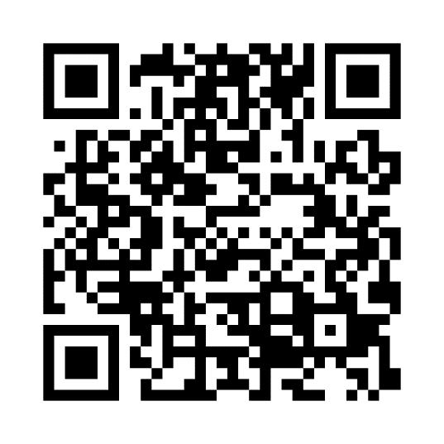
SAO’s PPP & SBITA resources
Scan the QR code
Notes:
We also have a project page called Coming in Fiscal Year 2023 with information on PPPs & SBITAs. This page has a recorded training, which includes most of what we talked about today and it has the draft BARS pages and note template that will go into BARS. Now I am going to pass it over to Vivian.

Slide 50
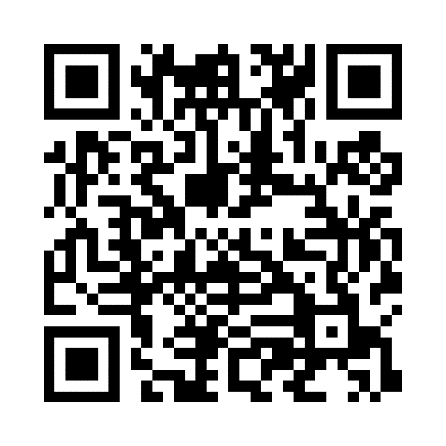
Future updates
Prior period adjustments, accounting changes, and error corrections
Clarifies accounting and reporting for these items. Also includes updated note disclosures.
388.30/588.30 – Error Correction
388.40/588.40 – Change in Reporting Entity
388.50/588.50 – Cumulative Effect of Changes in Accounting Principle
Scan QR code for training!

Slide 51
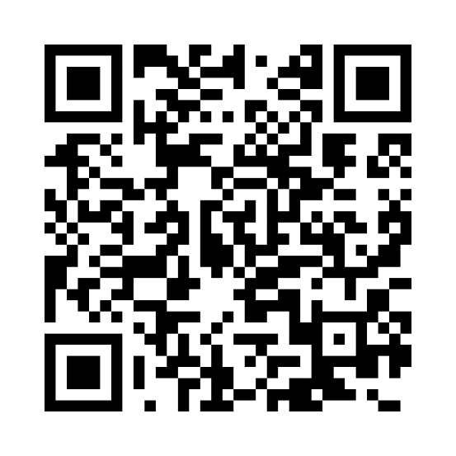
Future updates: Fiscal year 2024
Compensated absences
Provides clearer definitions of the types of absences and the requirements for the accounting and financial reporting
For more information, please see the Introduction to Compensated Absences training on our YouTube page.
New BARS sections will be added.
Recommend reviewing compensated absences policy
Scan QR code for training!

Slide 52
Questions?

Slide 53
Information
LCGSFeedback@sao.wa.gov
Or submit a HelpDesk
ticket!
Website: www.sao.wa.gov
Twitter: www.twitter.com/WaStateAuditor
Facebook: www.facebook.com/WaStateAuditorsOffice

