Slide 1
Revenue Options for Cities
TIF and Other Tools
February 8, 2023
Puget Sound Finance Officers Ass’n
Stacey Lewis
Pacifica Law Group LLP
Toni Call
City of Bothell

Slide 2
Revenue Options for Cities
Introductions
Revenue Landscape
Trends
Considerations
New Tools
Tax Increment Financing Statute
Other Tools to Keep in Mind
Property taxes: levy lid lifts, special purpose taxes
Sales and other excise taxes
Other tools: local improvement districts, transportation benefit districts, metropolitan park districts

Slide 3
Revenue Landscape

Slide 4
Trends, Considerations
Washington local governments rely more and more on excise taxes and user charges, as property tax revenues have been constrained by the 101% limitation. As levy rates decline, the constitutional 1% limit and the statutory $5.90 limits are less relevant. More “room” under these limits on levy rates has allowed the Legislature to add new junior taxing districts, and new “special” regular property taxes that are outside the $5.90 statutory limit. Legislature also has added new special sales taxes.
Property taxes as declining share of local government budgets
Increased reliance on excise taxes, particularly sales taxes, and user charges
Increased reliance on special districts
Implications for local government

Slide 5
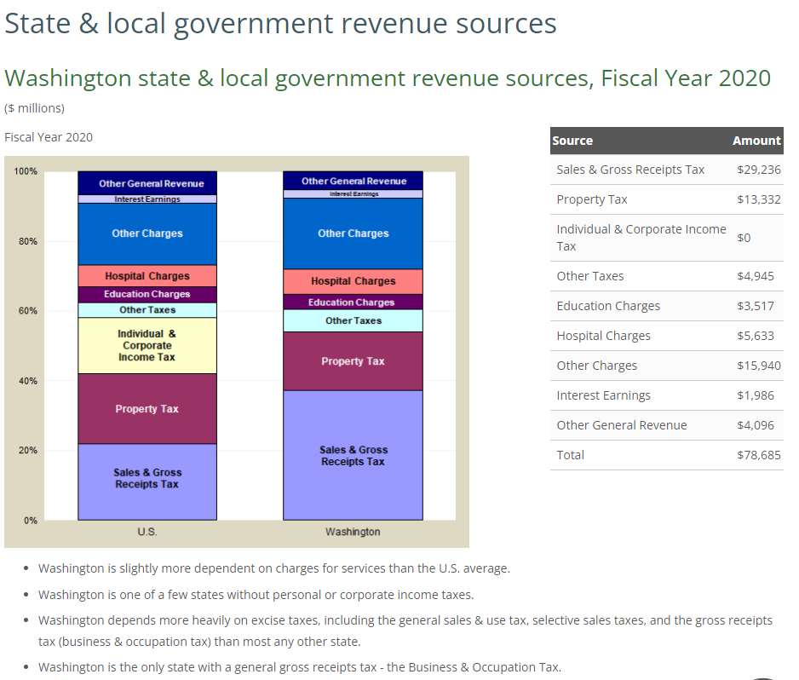
State Profile

Slide 6
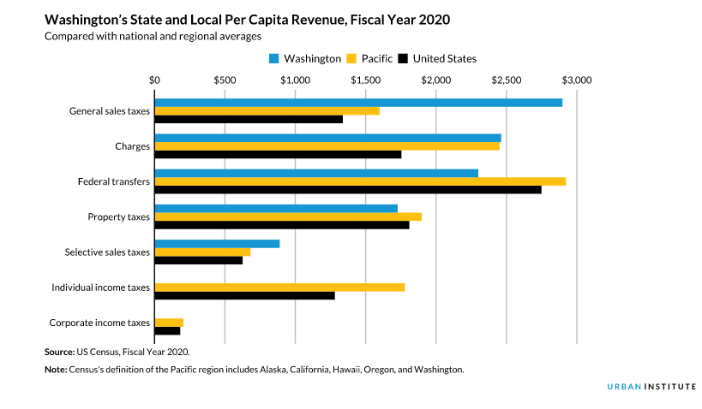
Washington State and Local Revenue Profile

Slide 7
Building resilient revenues
Components of a diverse set of revenue options. Property taxes, excise taxes and other revenue sources perform differently in different economic conditions.
Three legged stool
Property taxes
Excise taxes
User fees and charges

Slide 8
Some differing experiences
Differences in tax reliance
Although the general trend is towards increased reliance on excise taxes, Washington counties and cities differ in terms of dependence on sales versus property tax revenues.
https://public.tableau.com/profile/mrsc#!/vizhome/SalesandPropertyTaxDependence_0/Dashboard1
MRSC mapping tool showing each city’s relative reliance on sales or property taxes
Significant variation from city to city

Slide 9
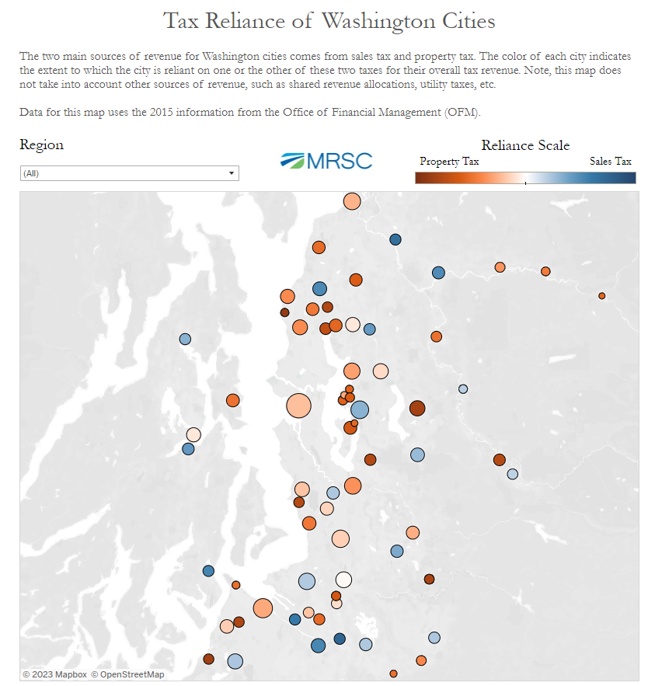
Varying reliance
MRSC Resources
Examples:
Sammamish
pop. 61,250
Property Tax: $22,927,954
Sales Tax: $4,200,799
Lacey
pop. 47,540
Property Tax: $1,449,952
Sales Tax: $9,406,468
Seattle
pop. 686,800
Property Tax: $253,645,687
Sales Tax: $200,596,110
MRSC mapping, from 2015 OFM data

Slide 10
Property tax impacts
Property taxes in a downturn and recovery
Washington State property taxes are subject to legal limitations that may slow the effects of a downturn but may place a drag on recovery.
Effect of legal limitations in a downturn
Sudden decline in assessed valuations does not translate into reduced property tax revenues
Unless a county or city is already near or at its statutory rate per thousand
Some lag in collections as county treasurers provided extensions in state of emergency (RCW 84.56.020(10))
Effect of legal limitations during a recovery
Limited ability to translate increased property values into increased property tax revenues
Except for bumps for new construction, and exceptions to the 101% (such as TIF)
Compare, however, to boom/bust sales taxes
Notes:
In 1970 property taxes accounted for 86.5 percent of local tax revenues; by 2007 that percentage had declined to 57.8 percent. DOR Washington Tax History

Slide 11
Sales and property tax changes in Great Recession
Take-away: Sales tax revenues declined more quickly and more deeply than property tax revenues, but also recovered more quickly.
Note: this pattern likely exaggerated in Washington by state law restrictions on property taxes (Chap. 84.55 RCW)
Note: the blue line shows personal income tax revenues, not relevant in Washington.

Slide 12
Some differing experiences
Different jurisdictions’ experiences with a downturn and recovery
The experience of Washington counties and cities during the Great Recession varied from jurisdiction to jurisdiction, depending on among other things how dependent a jurisdiction was on sales versus property tax revenues.
Depending on the level of reliance on sales v. property tax revenues, cities and counties had differing experiences.
Sales tax-dependent jurisdictions experienced sharper decline but more robust recovery
Property tax-dependent jurisdictions experienced more stability but capped/slow recovery
Sales taxes for specific purposes follow sales tax trend line but with concentrated impacts within certain sectors.
What about user charges?

Slide 13
User Fees and Charges
Fee for service revenues; user charges. Revenues generated through the provision of services or other goods (or “bads”).
Revenue tied to service or good provided, or burden mitigated
Types
Commodity charges
Burden offset charges, including impact fees
Regulatory fees
Special assessments?
Narrow base; trends during pandemic and recovery

Slide 14
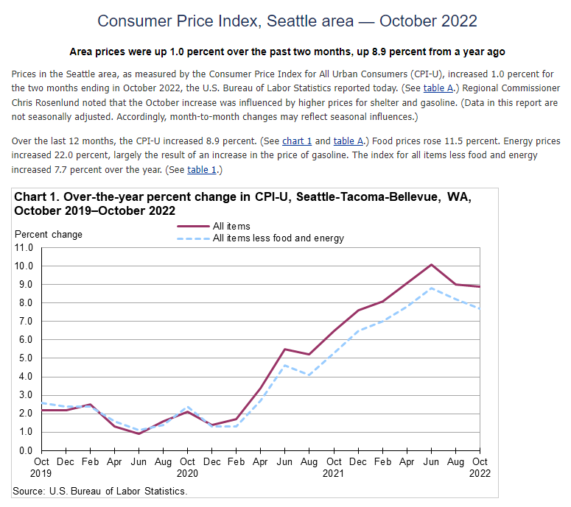
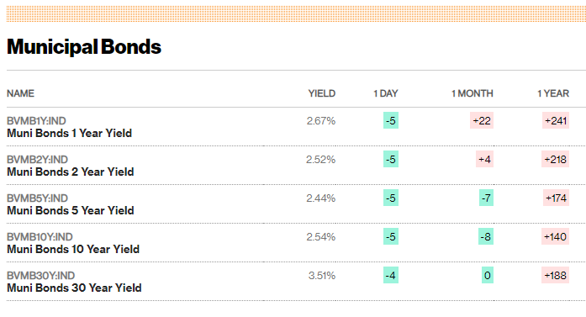
Recent trends, considerations
Inflation, rising interest rates, state tools.
Inflation, Fed raising interest rates
Legislative trends:
special purpose taxes (narrow taxes, such as REET)
new taxing districts (may have narrow tax base)

Slide 15
Building resilient revenues
Components of a diverse set of revenue options. In considering a new revenue source, consider its interaction with other sources in various economic times.
Evaluating new revenue tools
Considerations
Revenue-producing potential
Sustainability/stability of the revenue
Benefit/burden alignment
Other equity considerations
Interaction with existing revenues

Slide 16
New Tools: Tax Increment Financing Statute

Slide 17
TIF: Capturing Increased Property Value
Tax increment financing, or “TIF,” is a traditional public financing method that has been used in countries, including the United States, for almost 70 years.
TIF is a “value capture” approach to financing public improvements
TIF bonds are issued to finance public improvements. The bonds are paid from increased property taxes (the captured value) in the TIF area generated by rising property value resulting from public improvements.
TIF is similar to another traditional value capture public financing method: local improvement districts or “LIDS.”
LID bonds are issued to finance public improvements that increase nearby property values, but are paid from assessments on the specially benefitted property rather than property taxes.

Slide 18
Tax-increment Financing: A form of “value capture.”
Bonds Infrastructure
Supports Development
Increases Property Values
Generates “Tax Increment”
P&I

Slide 19
The TIF Act
The Washington Legislature adopted a new TIF statute that attempts to address state law limitations. (ESHB 1189, the “TIF Act,” codified at Chap. 39.114 RCW)
Prior TIF statutes constrained by constitutional requirement that state property taxes be dedicated to the support of the common schools, and the 101% limitation on the aggregate dollar amount of property taxes that disrupts the value capture mechanism.
The TIF Act excludes state property taxes (as well as excess levies and port and public utility district levies for debt service) from the TIF value capture mechanism.
The TIF Act amends the 101% limitation to allow capture of local property taxes resulting from increased property values within the increment area.
Specifically, the TIF Act amends RCW 84.55.010 to add an exception from the 101% limitation for any increase in the assessed value of real property within an increment area, provided that such increase is not included elsewhere under another exception (such as the exception for new construction).

Slide 20
The TIF Act
The TIF Act allows counties, cities and port districts (or any combination of the three) to form increment areas, and allocates regular property taxes of overlapping local taxing districts generated by increased property tax values within the increment area to the sponsoring entity to finance public improvement costs.
Public improvements eligible for TIF financing include street and sidewalk improvements, utility improvements, parking, terminal, and dock facilities, park and ride facilities or other transit facilities, park and community facilities and recreational areas, brownfield mitigation.
Other eligible costs include energy efficiency projects, affordable housing, childcare facilities, maintenance and security, and historic preservation costs.

Slide 21
Sponsoring Jurisdictions
Any sponsoring jurisdiction will receive property taxes on the increment value.
Once the increment area has been formed, the county treasurer is directed to distribute receipts from regular property taxes imposed on real property located in the increment area.
Tax allocation base value -- to each taxing district.
Increment value – to the sponsoring jurisdiction.
Amount derived from the regular property taxes levied by or for each taxing district upon the “increment value” (the increase in property values in the increment area after formation of the increment area)
Used to pay or repay costs directly associated with the public improvements
Sponsoring jurisdiction may agree to receive less than the full amount as long as bond debt service, reserve, and other bond covenant requirements are satisfied, in which case the balance of the additional tax receipts are to be allocated to the taxing districts that imposed regular property taxes

Slide 22
Forming an Increment Areas
The TIF Act includes procedural requirements for, and limitations on, the formation of increment areas.
A sponsoring jurisdiction is able to create only two, non-overlapping increment areas
The increment area (or both areas if there are two) may not have an assessed valuation of more than $200 million or more than 20 percent of the sponsoring jurisdiction's total assessed valuation.
The increment areas are subject to a 25 year sunset date.
The sponsoring jurisdiction must satisfy a number of procedural requirements:
Make specific findings regarding the private investment expected to be generated by the public improvements
Complete an analysis that includes an assessment of impacts to – and necessary mitigation of – affordable and low-income housing as well as the local business community, school district and fire service.
If the increment area will impact at least 20 percent of the AV in a fire protection district or regional fire protection service authority or the fire service agency’s annual report demonstrates an increased level of service directly related to the increment area, a mitigation plan is required to be negotiated
Submit project analysis to OST for 90-day review; consider OST comments

Slide 23
Considerations
The TIF Act represents the Legislature’s effort to authorize as close to a traditional TIF value-capture public financing method as is permitted under the Washington State Constitution.
The TIF Act authorizes increment areas that are limited in size and amount to serve, in effect, as a TIF pilot program.
Washington’s budget-based property tax system already is complex as a result of the various limitations on both total dollar amount and levy rate.
As sponsoring jurisdictions proceed under the TIF Act it will be important to work with the county assessor, county treasurer and the other overlapping taxing districts in the increment area.
It will be important to model TIF capacity, impacts on other jurisdictions, and communicate early
Department of Revenue has updated its interpretation of the statute.
See https://dor.wa.gov/sites/default/files/2022-07/sn_22_LegislativeChangesTaxIncrementFinancing.pdf
Legislative fixes proposed for session

Slide 24
Examples
Port/City of Pasco
TIA consisting of 150-acre parcel
Infrastructure improvements
Supports development of $500 million milk processing facility
Other proposed TIAs

Slide 25
Other tools

Slide 26
Revenue Tools
Considerations. Washington cities are authorized to impose a number of voted and nonvoted revenue sources. Taxes require express statutory authority, and so state law framework largely dictates tools in the revenue tool box.
Statutory framework
Voted or councilmanic
Project suited to voter approval?
Prioritizing voter “asks,” preserving capacity
How tool interacts with revenue trends
How tool aligns (or misaligns) benefit and burden
General v. special benefit
Impact on particular taxpayers
Narrow or broad tax base
Interactions with other revenue sources
Other equity considerations

Slide 27
Voted Property Taxes: Levy Lid Lift
Exceed 101% limit with a levy lid lift, to restore levy up to maximum statutory rate per thousand
Simple majority voter approval
Single year v. multi-year (up to 6 years, added in 2003)
Temporary v. permanent
Limited purpose or any purpose
If purpose is payment of debt service then limited to no more than 9 years (25 in Thurston County)
EPIC v. King County
Specify whether the base year is to be used for future calculations
Exemptions for qualifying seniors and persons with disabilities under RCW 84.36.381
Interaction with banked capacity
Broad tax base + either broad or narrow purpose

Slide 28
Voted Property Taxes: Affordable Housing Levy
Voter Approved Regular Property Tax Levy (RCW 84.52.105)
Up to $0.50 per $1,000 of AV in each year for 10 consecutive years
Revenue may be used to finance affordable housing
Statute amended in 2020: to finance affordable housing for very low-income households, and affordable homeownership, owner-occupied home repair, and foreclosure prevention programs for low-income households,
Requirements
Simple majority voter approval
No validation requirements
Before imposing levy, city must adopt an affordable housing finance plan for the expenditure of the levy funds to be raised
Subject to $10 constitutional limit and 101% levy lid, but not $5.90 statutory limit.
Counties have similar authority, and combined city/county levy rate may not exceed the allowable $0.50 per $1,000 of AV
Broad tax base + narrow, statutorily dictated purpose

Slide 29
Voted Property Taxes: EMS Levy
Voter Approved Regular Property Tax Levy (RCW 84.52.069)
Up to $0.50 per $1,000 of AV
May be imposed for six years, 10 years or permanently
Revenue may be used to provide emergency medical care or emergency medical services, including related personnel costs, training for such personnel, and related equipment, supplies, vehicles and structures needed for the provision of emergency medical care or emergency medical services
Requirements
For permanent EMS levies, and for the initial imposition of a six or 10 year levy, the ballot measure must be approved by supermajority (60%) of voters, plus validation requirements
Subsequent approvals of six or 10 year levy require majority voter approval, no validation requirements
Considerations for overlapping taxing districts imposing the same levy
Subject to $10 constitutional limit and 101% levy lid, but not $5.90 statutory limit.
Broad tax base + narrow, statutorily dictated purpose

Slide 30
Voted Property Taxes: Excess Levy (Operations and Maintenance)
Voter Approved Excess Property Tax Levy (RCW 84.52.052, .054)
Excess levy, no levy rate limit
May be imposed for one year
Can be imposed for any lawful governmental purpose; must be stated in ballot measure
Best used for temporary funding gaps (with exception for some jurisdictions that have used one year O&M levies for general operations)
Excess levy – not subject to $5.90 or $10 constitutional property tax limit
Requirements
Requires supermajority (60%) voter approval, plus validation requirements
Broad tax base + broad purpose

Slide 31
Voted Property Taxes: Excess Levy (Bonds for Capital Projects)
Voter Approved Excess Property Tax Levy
Excess levy, no levy rate limit
Used to pay debt service on unlimited tax general obligation (“UTGO”) bonds
Can only be issued for capital projects, not the replacement of equipment
Voters approve the UTGO bonds to finance certain specified projects described in the ballot measure, and the accompanying excess property tax revenue stream to repay the bonds
Levy set at rate to pay debt service
Levy ceases once UTGO bonds are no longer outstanding
Consumes UTGO debt capacity
While levy rate is not limited, the amount of UTGO bonds that can be issued is subject to statutory and constitutional debt capacity limitations
2.5% of AV in the year that the bonds are issued for cities
Broad tax base + specific capital project (could have broad or narrow benefits)

Slide 32
Sales and Use Taxes
Basic sales and use taxes for general purposes
City may impose nonvoted 1.0% sales and use tax (portion to County)
Special purpose sales and use taxes
New affordable housing sales tax credit (RCW 82.14.540)
SHB 1406 (effective 2019), available to cities and counties that adopted an ordinance no later than July 27, 2020, 20 year nonvoted tax
New housing and related services sales tax (RCW: 82.14.530)
Since 2020 voter approval is optional; now councilmanic option
Cities may impose, as long as county has not imposed this sales tax first
Other special purpose sales and use taxes, examples
Voted 0.1% cultural access sales tax (RCW 82.14.525, Chapter 36.160)
Voted 0.1% public safety sales tax, available to cities if county has not imposed 0.3% public safety sales tax (RCW 82.14.450)
Other sales/excise taxes: admissions, B&O taxes, utility taxes, real estate excise taxes, lodging taxes

Slide 33
Assessments v. Taxes
Purpose
General good (tax) v. localized benefit (assessment)
E.g. police station v. sidewalk
Uniformity
Property taxes must be uniform.
Assessments vary according to benefit, from parcel to parcel. See Berglund v. Tacoma, 70 Wash. 2d 475, 477, 423 P.2d 922, 923 (1967) (“Special assessments ... are not deemed taxes" for purposes of "uniformity provisions of the state constitution")
Property Tax Limitations
Assessments not subject to 1% and other limitations on property taxes
Debt Limitations
Assessment bonds paid from assessments deposited to a special fund are not “debt” subject to limitations on taxpayer supported debt. See Smith v. City of Seattle, 25 Wash. 300, 315, 65 P. 612, 617 (1901) (holding that special assessment bonds do not count against a municipality's limit on bonds payable from taxes).

Slide 34
Local Improvement Districts
Special benefit v. general benefit. Prof. Trautman: No concept has created more problems of construction and interpretation than the apparently simple concept of "special benefits.“
RCW 35.43-35.56: City local and utility improvement districts
See also first class city statute (RCW 35.22.280(10)), providing power to provide for making local improvements, and to levy and collect special assessments on property benefited thereby, and for paying for the same or any portion thereof.
Assessment based on special benefit to property owners
Assessment cannot substantially exceed the amount of the special benefit
Property cannot be assessed more than its proportional benefit
Benefit is the increase in fair market property value immediately after improvements compared to before benefit accrued.
Must provide actual (not merely speculative) benefit to the property to be assessed. Heavens v. Rural Library Dist., 66 Wn.2d 558 (1965)
.

Slide 35
Other considerations
Public relations. The success or failure of an LID financing may turn more on the quality of the municipality’s communications with the community than on the legal work.
Considerations in forming LID
Number and type of property owners
One motivated developer v. nonaligned group of property owners
Public relations/communications plan
Communicating with property owners
Communicating with mayor and city council
Other interested parties
Considerations in assessing properties
Timing delay between formation and assessment
Considerations in finalizing financing
Changes in scope, changes in use, cost overruns

Slide 36
Transportation Benefit Districts
Formed by cities, counties (Chap. 36.73 RCW)
Acquiring, constructing, improving, providing, and funding transportation improvements
Separate quasi-municipal corporation or authority assumed by forming city or county
Revenue Authority
Voted and nonvoted sources
Vehicle license fees
Sales and use tax
Impact fees
Vehicle tolls

Slide 37
Transportation Benefit Districts
Vehicle License Fees
TBD may impose a nonvoted vehicle license fee not to exceed $20 at any time (most common)
Nonvoted vehicle license fee may exceed $20 in the following scenarios:
Up to $40, if a $20 fee has been in effect for at least 24 months
Up to $50, if a $40 fee has been in effect for at least 24 months
Vehicle license fees may exceed $50, but not more than $100, with simple majority voter approval
Only City of Seattle has successfully passed a voted vehicle license fee
Revenue sharing for two or more TBDs that overlap; county TBDs

Slide 38
Transportation Benefit Districts
Sales Tax
ESSB 5974 (effective July 1, 2022) authorizes a sales tax of up to 0.3% (previously 0.2%) with simple majority voter approval for up to 10 years; can be renewed for additional 10 year periods with simple majority voter approval
New, nonvoted component: TBDs with the same jurisdictional boundaries of the forming entity may impose up to 0.1% of the sales tax without voter approval for up to 10 years; can be renewed for additional 10 year periods without voter approval
Voter-approved sales tax initially imposed after July 1, 2010, may be imposed for a period exceeding 10 years if the money received is dedicated for the repayment of debt incurred in accordance with the requirements of chapter 36.73 RCW
Airway Heights – November 2022 successful ballot measure to increase the TBD sales and use tax from 0.2% to 0.3% for an additional 10 years
Battle Ground – imposed (without voter approval) a 0.1% sales and use tax for 10 years

Slide 39
Transportation Benefit Districts
Other Revenue Authority
Impact fees
On commercial and industrial development
Vehicle tolls
Voted and nonvoted general obligation bonds
Voter approved excess property taxes (one year maximum term)
Local improvement districts

Slide 40
Metropolitan Park Districts
Formed with voter approval
Simple majority
Ballot requirements
Approve or disapprove formation of MPD
Choose and describe the composition of the initial board of commissioners
Choose a name for the district
Ballot measure may approve both formation of MPD and initial levy
Commissioners
Initially selected at formation election
An MPD entirely within one city can have a board composed of ex officio members of the governing body of the city
A multijurisdictional MPD board can be composed of ex officio members of the city/county legislative authority
Specifics set by interlocal agreement

Slide 41
MPD Revenue Sources
Operating revenues
User fees, lease/rental/concession revenues
Property taxes
Nonvoted property tax
0.75/$1,000 of AV levy consisting of
$0.50/$1,000 of AV
plus an additional $0.25/$1,000 of AV
Voted
capital levies
one year (“O&M”) levies
Special benefit assessments

Slide 42
Wrap up

Slide 43
Contact Information
Stacey Lewis
206.245.1714
stacey.lewis@pacificalawgroup.com
Toni Call
City of Bothell

