Slide 1
AWC Legislative Wrap-up 2022
PSFOA
July 13, 2022

Slide 2
Session overview
60 days
Supplemental budgets
Transportation package
Election year
Virtual session
Positive revenue forecast

Slide 3
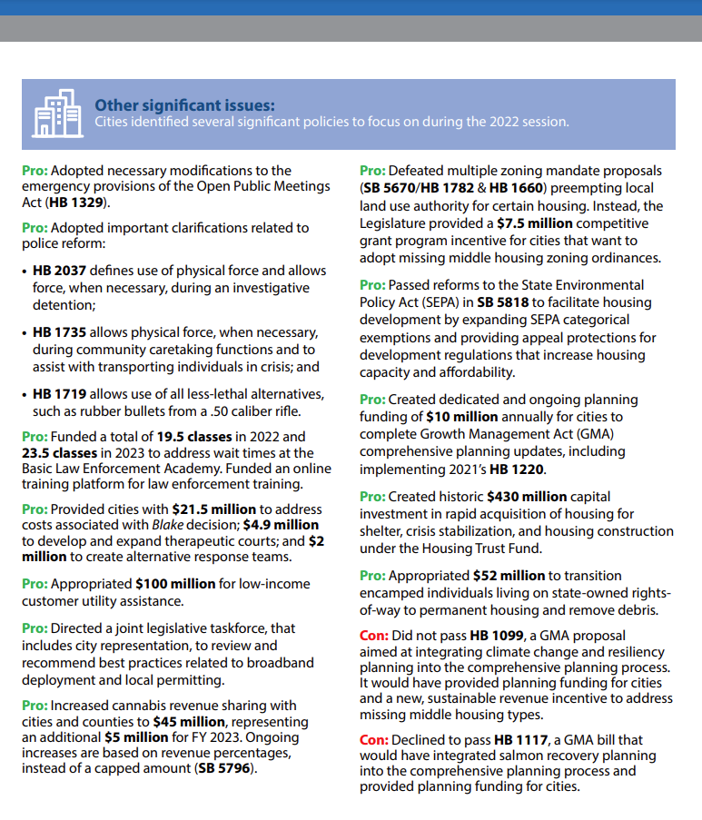
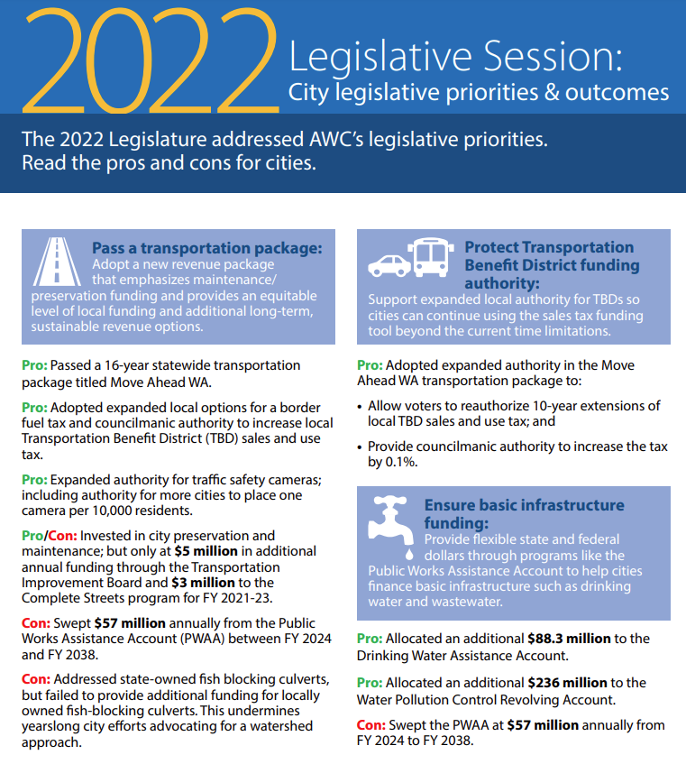

Slide 4
Cities’ Supplemental Budget Priorities
Fund the Public Works Assistance Account to address local basic infrastructure needs.
Fund cities in response to the Blake decision to address impacts in municipal courts and the need for additional diversion options.
Provide the Criminal Justice Training Commission funds to invest in law enforcement training needs.
Invest in funding need to support planning and Growth Management Act requirements.
Dedicate $100 million to provide utility assistance for residents impacted by the pandemic.
Support funds to repair or replace locally owned fish blocking culverts.
Invest in city transportation needs, particularly for preservation and maintenance.
Dedicate funding for rapid acquisition of affordable housing and other homeless support services.
Appropriate dedicated funds to the Local Records Grant Program to assist with public records management.
Fund any PERS 1 Pension COLA’s without impacting local government pension rates.

Slide 5
2022 Supplemental Budget Outcomes
Operating
Additional BLEA classes
Funding for Blake response
Transportation
Complete streets funding
Capital
Housing funding
Broadband
New GMA/planning funding
Utility assistance
Housing assistance
Additional cannabis revenue sharing
Additional TIB funding
Electrical vehicle infrastructure
Expanded Transportation Benefit District sales & use tax authority
PWAA sweep
Safe routes to schools funding
CERB funds
Additional Drinking Water Assistance Account funding
Additional stormwater grants
Weatherization for public buildings

Slide 6
HousIng & Homelessness
Passed:
HB 1643 – REET exemption for affordable housing sold to public entities or non-profits.
HB 1866 – Creating the Apple Health and Homes Act.
HB 2001 – Adds tiny home communities to affordable housing incentive program.
HB 2061 – Adds permanently affordable housing to the definition of “public improvements” under Community Revitalization Financing Act.
SB 5818 – SEPA appeal protections and expanded exemptions for certain housing-related actions.
SB 5868 – Expands use of rural counties public facilities sales and use tax to include affordable workforce housing infrastructure or facilities.

Slide 7
Housing & Homelessness
Did not pass:
HB 1782/SB 5670 – Middle housing mandate.
HB 1337, HB 1660, HB 1711 – Accessory dwelling units (ADUs).
HB 1981 – GMA planning omnibus bill focused on middle housing.
SB 5428 – SEPA exemption for temporary shelter sites.
SB 5662 – Intergovernmental coordination to address transitioning persons camped on state rights-of-way to housing.

Slide 8
Public Safety
Passed:
HB 1719 – Clarifies that law enforcement may use rifles, shotguns and any device deploying less than lethal munitions. “.50 caliber fix”
HB 1735 – Expands authority of law enforcement to use physical force in specific circumstances, such as for community caretaking or transporting for a mental health evaluation.
HB 2037 – Defines physical force, clarifies law enforcement can use force during an investigative detention AKA a “Terry stop.”

Slide 9
Transportation
Passed:
HB 2076 – Statewide regulations for Transportation Network Companies (TNCs).
SB 5687 – Permits cities to establish a 20-mph speed limit on non-arterial highways.
Did not pass:
HB 1595 – Authorizes cities to install signs on or near bridges to deter jumping.
HB 1605 – Creates a program to provide for improved safety on roadways to prevent vehicle lane departures*.
SB 5510 – Allows voters within a Transportation Benefit District (TBD) to reauthorize multiple extensions of a sales and use tax*.
*Incorporated into the Move Ahead WA transportation package.

Slide 10
Budget & Finance
Passed:
SB 5002 – Updates certain reporting requirements related to the State Auditor including removing annual reporting requirements on local tax levies and labor relations consultant fees and creates new obligations for reporting loss of funds or other illegal activity.
SB 5505 – Reinstating a property tax exemption for nonprofits where a portion of the property is used for a farmers’ market.
SB 5796 – Restructures the state’s cannabis revenue account including a change to the amount shared with cities and counties.
Did not pass:
HB 2018 – Creating a 3-day sales tax holidaY

Slide 11
Open Government
Passed:
HB 1329 – Requires public comment prior to final action and allows use of virtual meeting in emergencies and makes changes to notification requirements (incorporated HB 1056).
Did not pass:
HB 1056 – Updates the OPMA to allow use of virtual meetings during emergencies.

Slide 12
General Government
Passed:
HB 1630 – Restricts possession of weapons in certain locations including where public meetings are held.
SB 5583 - When redistricting, local governments must count individuals in state custody as residing at the person’s last known place of residence, rather than at the correctional, juvenile or involuntary behavioral health commitment facility.
Did not pass
HB 1727 - Concerning odd-numbered year elections
SB 5597 - Washington Voting Rights Act
SB 5584 - Permits use of ranked choice voting in local elections

Slide 13
HR & Labor Relations & Pensions
Passed:
HB 1701 – Providing for new benefit enhancement for LEOFF 2 members.
HB 1732 – Delays implementation of WA Cares long term care program.
HB 1733 - Creates new exemptions for to the WA Cares long term care program for out-of-state residents, certain veterans and military families, and non-immigrant foreign workers.
SB 5649 – Changes to the Paid Family Medical Leave program including addressing program solvency and expanding benefits during bereavement.
SB 5676 – Provides COLA to PERS plan 1 members likely creating a rate impact for PERS 2 employers.
SB 5761 – Requirements for including wage & benefit information on job postings.
Did not pass:
HB 1763 – Regarding recording of independent medical exams.
SB 5801 - Regarding attorney fees and costs for industrial insurance appeals.
HB 1837 – Eliminate the ban on L&I rulemaking on ergonomics.

Slide 14
Looking ahead to 2023
New mix of legislators
Expected issues for cities
Public Works Assistance Account funding
Middle housing mandate
Blake response – requesting data and feedback to inform future budget requests on impacts to cities and municipal courts.

Slide 15
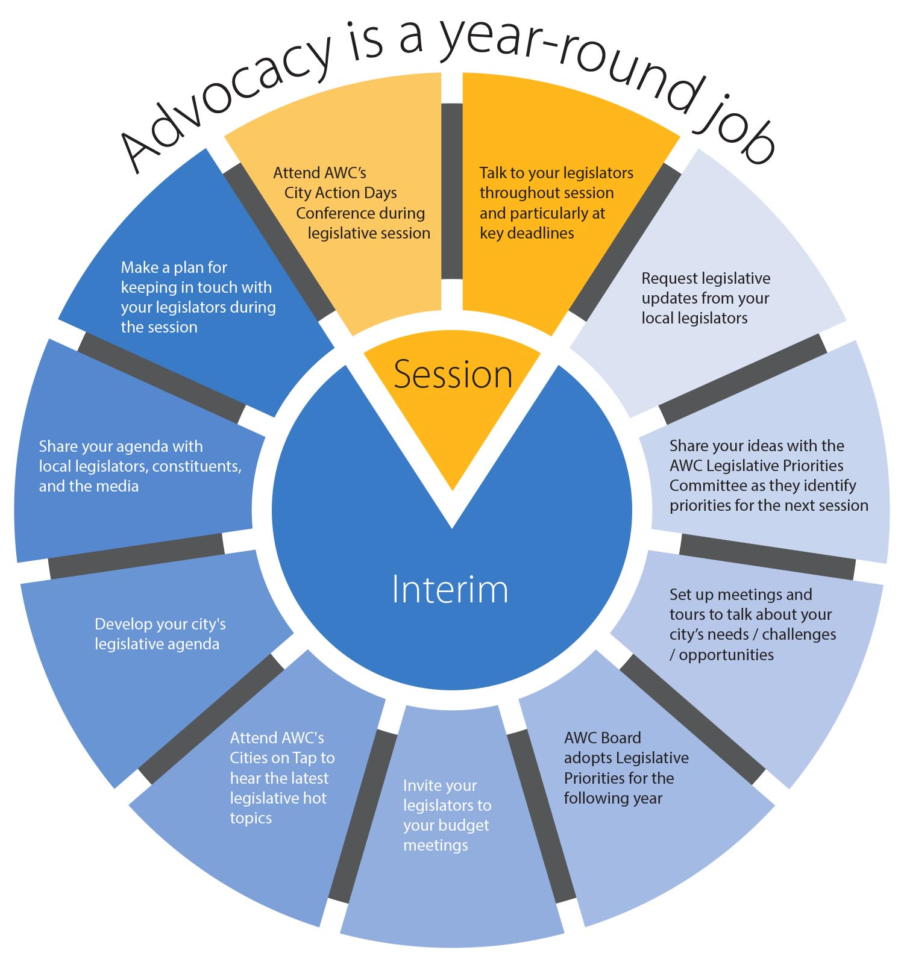
Notes:
Emma

Slide 16
Government Relations team
Candice Bock Director (360) 951-5390 Issue areas – Economic development; federal; finance; human resources, labor relations & pensions; open government Carl Schroeder Deputy Director (360) 485-7604 Issue areas – Environment & natural resources; housing & homelessness; land use & planning; Building codes Vacant Government Relations Advocate Issue areas – Cannabis; emergency management & cybersecurity; general government; human services & behavioral health; liability; open government; public safety & criminal justice Brandy DeLange Government Relations Advocate (360) 515-8360 Issue areas – Public works & infrastructure; telecommunications; transportation; utilities & energy Tonna Siegler Government Relations Assistant | Brianna Morin Legislative Policy Analyst Issue areas – Public works & infrastructure; telecommunications; transportation; utilities & energy Matt Doumit Legislative Policy Analyst Issue areas – Human resources; labor relations; pensions Vacant Legislative Policy Analyst Issue areas – Cannabis; economic development; emergency management & cybersecurity; general government; human services & behavioral health; liability; open government; public safety & criminal justice Shannon McClelland Legislative Policy Analyst Issue areas – Building codes; environment & natural resources; housing & homelessness; land use & planning Sheila Gall General Counsel Issue areas – Municipal finance & taxes Jacob Ewing Special Project Coordinator Issue area – American Rescue Plan Act (ARPA)
Notes:
Candice

