Slide 1
Puget Sound Finance Officers Association Municipal Finance Primer
Deanna Gregory and Toby Tobler
Pacifica Law Group LLP
August 11, 2021

Slide 2
Overview of Session
Introduction
Overview of Municipal Debt
Why issue debt?
Revenue options for financing capital projects
Key considerations
Other legal considerations
Roles and responsibilities of key participants
Bond issuance process
Documentation
After the Bond Issuance
Trends and Other Considerations
Questions?

Slide 3
Overview of Municipal Debt Financing – Big Picture
A Bond evidences an obligation to pay (e.g. a loan)
Structured to allow sale/placement with a wide array of investors
Public sale to ultimate investors on open market
Private placement with a bank (bank loan)
Secured by a pledge of tax collections or revenues
Issuer is obligated to repay principal of the bond, plus interest, on payment dates
Benefit
Receive project funding up front
Must be authorized by State law
May be issued as tax-exempt obligations
Interest paid to investor holding tax-exempt bonds is excludable from federal income taxation
Subject to federal tax law requirements that apply for the life of the bonds
Bonds are securities
Subject to federal securities laws

Slide 4
Overview of Municipal Debt Financing – Big Picture
Why local governments use debt financing
Time value of money
Borrowing funds allows projects to begin sooner than they would otherwise
Mitigates construction cost inflation, increased property costs, etc.
Allows for faster project delivery – more advantageous to beneficiaries of project
Intergenerational equity
Current users/beneficiaries of a project are also the ones who pay for related debt service
CPE Code # 1

Slide 5
Types of Debt and Common Financing Methods
General obligation debt
Infrastructure with general benefit to tax base
Unlimited tax general obligation (“UTGO”) (voter approved)
Limited tax general obligation (“LTGO”) (councilmanic, non-voter approved)
Revenue debt
Revenue generating assets (user fees, tolls, utility rates and charges)
Assessment bonds
Infrastructure with special benefit to property owners
Payable from assessments collected in designated area
Interfund Loans
Common Financing Methods
Public bond market
Bank financing (private placement or bank loan)
Seller/vendor financing
Local Option Capital Asset Lending (“LOCAL”) borrowing
State (PWTF, SRF, CREB) or Federal (USDA) loans

Slide 6
Key Considerations for Capital Financing
What is the State law authority?
What is the credit? What is pledged to pay the debt?
Excess property taxes, regular property taxes, sales and use taxes, TBD revenue, TIF revenue, utility revenues, other
What are the terms?
Interest rate, term, what are the needs of the issuer?
What approval is necessary?
Council/Board approval, voted/nonvoter approved, other requirements
Who are the bond(s) being sold to?
Public sale to ultimate investors on open market
Private placement with a bank (bank loan)
What is the federal tax treatment?
Bonds may be issued as tax-exempt or taxable obligations
Depends in part on use of asset financed/goals of the issuer

Slide 7
UTGOs: Key Features
Unlimited, Voter Approved
Consumes UTGO debt capacity for general purposes
UTGO debt capacity is greater than for non-voted general obligation bonds
For instance, for cities, limited to 2.5% of assessed value for general purposes
Only for capital purposes, other than replacement of equipment
60% voter approval
Validation requirement
Paid from excess property tax levy
Outside of statutory or constitutional limits on regular property taxes
Levy set at rate required to pay debt service
2.5% Assessed Valuation
Up to 1.5% can be issued without voter approval

Slide 8
UTGOs: Process
Council or Board must pass an election ordinance or resolution
Contents:
Proposes the form of the ballot measure requesting voter approval for the issuance of UTGO bonds and excess levies to pay debt service on the bonds
Describes the capital project to be funded and outlines the circumstances, if any, under which the project may be changed
Sets certain parameters for the bonds, including the maximum principal amount and term
The approved election ordinance must be filed with the county
Ballot may be submitted to voters no more frequently than twice a year
Election calendar contains filing requirements for election ordinance or resolution, plus
Explanatory statement
Pro/con committee appointments

Slide 9
LTGOs: Key Features
Limited (councilmanic) non-voter approved
Consumes LTGO debt capacity
For instance, for cities, within the 2.5% of assessed value for general purposes, the city may, without a vote of the electors, incur general obligation indebtedness in an amount not to exceed 1.5% of assessed value
Any municipal purpose
Pledge to levy regular (nonvoted) taxes as necessary to pay debt service within legal limits:
Statutory rate per thousand (e.g. for cities, $3.60/$1,000 AV)
Aggregate rate limit ($5.90/$1,000)
101% limit on increases in dollar amount of levy (Eyman limit)
Paid from general fund or other legally available revenues

Slide 10
Revenue Obligations: Key Features
Enterprise fund obligations
Water
Sewer/wastewater
Stormwater
Electric
Other revenue-producing assets
Can combine utilities for borrowing purposes
Pledge of net income of the enterprise
Bond owners have a statutory lien on net revenues
Parity lien protected through:
Rate covenant (1.2x or 1.25x or…)
Reserve fund requirement (if any)
Additional bonds test
Other covenants
CPE Code # 2

Slide 11
Other Legal Considerations: Federal Tax Requirements – Overview
Internal Revenue Code and regulations govern:
How Tax-Exempt Bond Proceeds Can be Spent
Use of Financed Assets
The Investment and Arbitrage of Bond Proceeds
Set expectations at closing:
Tax Certificate
Form 8038-G
Monitor for changes:
Post-Issuance Compliance Policy
Records retention
Tracking private and other use

Slide 12
Other Legal Considerations: Federal Tax Requirements – Overview
Bonds can be issued on a tax-exempt basis
Requirements applicable to use of facilities, and investment of proceeds
Governmental tax-exempt financing
Private use limited over life of bond issue
No more than 10% “Private Business Use”
“Private Business Use” means use (directly or indirectly) of a financed facility in a trade or business carried on by any person
Reasonable expectation to spend proceeds within 3 years of date of issuance
Limitations on reimbursement for prior expenditures
Reporting, documentation requirements different than state law public document retention laws
Post issuance compliance obligations

Slide 13
Practice Tips
Prior to issuance:
Review potential projects
Existing and planned contracts for private use
Avoid bond-financing projects that are primarily for the benefit of a private user
Plan for sources and uses

Slide 14
Additional Legal Requirements: Federal Securities Laws
Municipal bonds are exempt from registration
Tower Amendment; Securities Exchange Act of 1934
Limited SEC/MSRB regulatory or rulemaking authority
Subject to antifraud laws
Apply when issuers “speak to the market”

Slide 15
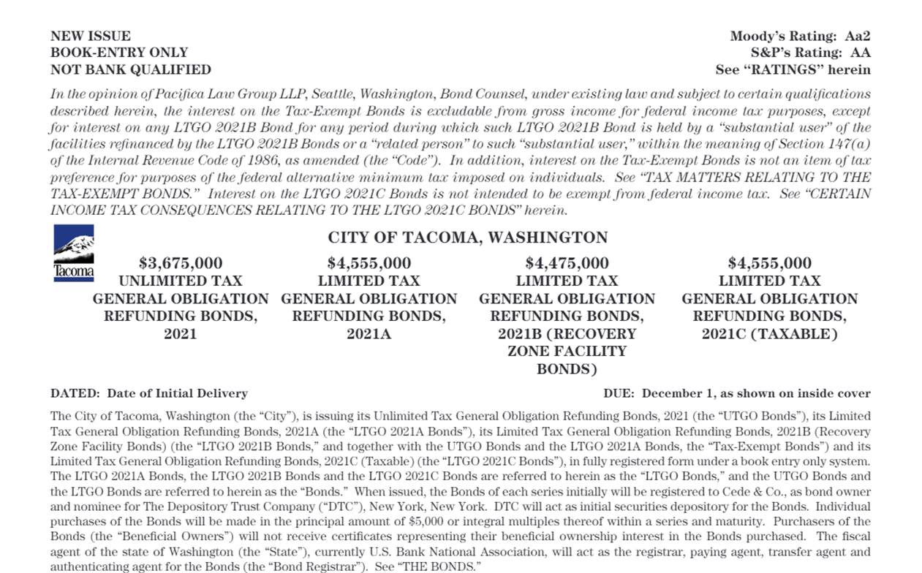
Federal Securities Laws
Relevant Documents (“Speaking to the Market”)
Initial Disclosure
Preliminary Official Statement and Final Official Statement
Other Types of Disclosure
Ongoing Disclosure Undertaking under SEC Rule 15c2-12
Issuer’s contractual undertaking to provide annual financial information and operating data and notice of certain listed events within 10 business days of the occurrence
Voluntary disclosure
Information intended (or reasonably expected) to be accessible to and relied upon by investors
Voluntary postings to EMMA (emma.msrb.org)
Website (e.g investor relations page)
Social media
Press releases, other public statements

Slide 16
Municipal Bonds; Antifraud Laws
Basic rule
Rule 10b-5 and Section 17(a) of the Securities Act
It shall be unlawful for any person…to make
any untrue statement of a material fact or
to omit to state a material fact necessary in order to make the statements made, in the light of the circumstances under which they were made, not misleading,
in connection with the purchase or sale of any security.
Case law defines materiality
There must be a substantial likelihood that a fact "would have been viewed by the reasonable investor as having significantly altered the 'total mix' of information made available”
In sum all communications to investors must be true, accurate and complete
Ongoing disclosure responsibilities
Policies and procedures

Slide 17
Putting the Lessons to Work
Best practices
Follow disclosure procedures to ensure accurate, complete, timely initial and ongoing disclosure
Procedural considerations:
Identify responsible individuals
Outline and follow process for preparing, reviewing and approving disclosure
Raise awareness level among participants and decision makers re level of disclosure required in a financing through periodic training
Other considerations:
Resolve or disclose material risks
Involve appropriate decision makers
CPE Code # 3

Slide 18
Key Participants
Key participants
Issuer staff, city/county attorney/general counsel
Bond counsel/tax counsel (represents the issuer)
Disclosure counsel, if any (may be Bond counsel; represents the issuer)
Municipal Advisor (fiduciary responsibility to issuer)
Purchaser of the debt
Underwriter – purchaser in a publicly sold transaction
Lender/bank – purchaser in a loan context
Underwriter/Lender’s counsel, if any, represents underwriter/lender
Other team members may include
Placement agent (for private placement or limited offering)
Bond Registrar/Paying Agent (typically state fiscal agent)
County (as treasurer of special purpose districts)
Verification Agent / Escrow Agent (for refundings)
Rating agency (for rated bonds)
Bond insurer (for insured bonds)
The Depository Trust Company (DTC) for uncertificated bonds

Slide 19
Bond Issuance Process
Document Development
Bond authorization
Bond ordinance or resolution
May authorize an individual or individuals to approve final terms of sale subject to certain parameters
Other documents may include
Ratings presentation
Preliminary Official Statement and Final Official Statement
Bond Purchase Agreement or loan documents
Transcript documents/closing certificates
Tax documents/IRS Forms
Escrow or Refunding Agreement
Legal opinions delivered at closing
Other Steps
Legislative authority of issuer authorizes sale of bonds
Other notices/approvals are obtained, if needed
Apply for and receive credit rating (if rated bonds)
Document review calls (walk through terms, covenants, security provisions/discuss disclosure)
Due diligence call
Publish “deemed final” Preliminary Official Statement (POS)
Price bonds and sign Bond Purchase Agreement or award sale to bidder
Publish final Official Statement
Parties sign closing, tax and other related certificates and certificates
Closing (bond and funds are delivered, opinions and certificates are released)

Slide 20
After the Bond Issuance

Slide 21
After the Bond Issuance
Post Issuance:
Tax Considerations
Have a Post Issuance Compliance Policy and follow it
Procedural considerations
Watch for unexpected changes in the use of bond proceeds/use of bond financed facilities
Monitor any private use
Vet proposed management or other use contracts and renewals for potential private use
Use “safe harbors” when possible
Securities Considerations
Follow disclosure procedures to ensure accurate, complete, timely initial, ongoing and any voluntary disclosure
Procedural considerations
Identify responsible individuals preparing, reviewing and approving ongoing disclosure
Calendar filing deadlines
Website refresh
Raise awareness through periodic training
Document document document and retain those documents
When in doubt, ask!

Slide 22
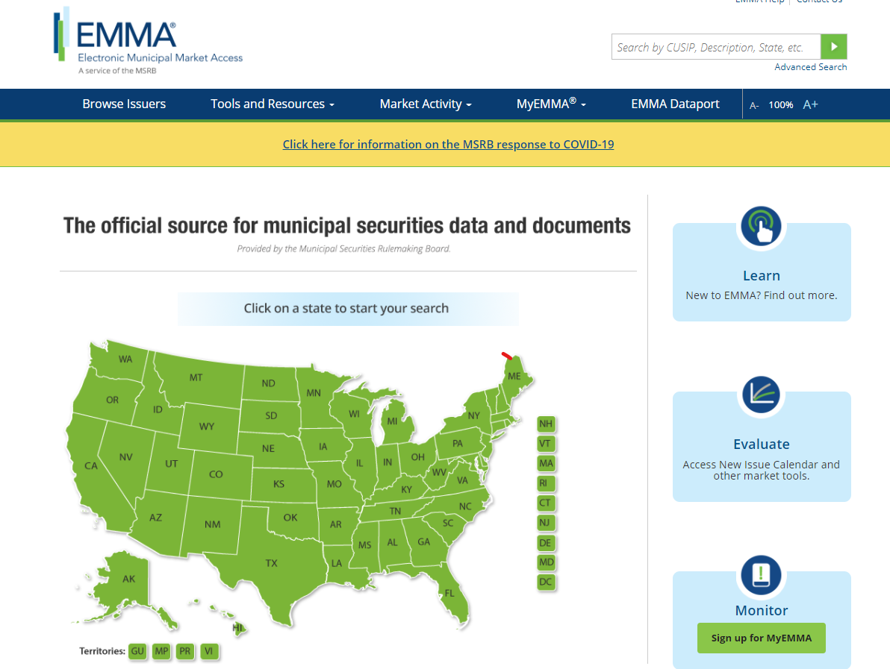
Ongoing Disclosure - https://emma.msrb.org/Home/Index

Slide 23
Ongoing Disclosure
Financial information and operating data
Notice of listed events
The Continuing Disclosure Agreements require the issuer to give notice of the following reportable events (except as set forth below) in a timely manner not more than ten (10) business days after the occurrence of the event.
Principal and interest payment delinquencies;
Non-payment related defaults, if material;
Unscheduled draws on debt service reserves reflecting financial difficulties;
Unscheduled draws on credit enhancements reflecting financial difficulties;
Substitution of credit or liquidity providers, or their failure to perform;
Adverse tax opinions, the issuance by the Internal Revenue Service of proposed or final determinations of taxability, Notices of Proposed Issue (IRS Form 5701-TEB) or other material notices or determinations with respect to the tax status of the Bonds, or other material events affecting the tax status of the Securities;
Modifications to the rights of Security holders, if material;
Optional, contingent or unscheduled bond calls other than scheduled sinking fund redemptions for which notice is given pursuant to Exchange Act Release 34‑23856, if material, and tender offers;
Defeasances;
Release, substitution, or sale of property securing repayment of the Securities, if material;
Rating changes;
Bankruptcy, insolvency, receivership or similar event of the issuer;
The consummation of a merger, consolidation, or acquisition involving the issuer or obligated party or the sale of all or substantially all of the assets of the issuer or obligated party, other than in the ordinary course of business, the entry into a definitive agreement to undertake such an action or the termination of a definitive agreement relating to any such actions, other than pursuant to its terms, if material;
Appointment of a successor or additional trustee or the change of name of a trustee, if material;
PLUS two new notice events effective in 2019

Slide 24
What are the additional notice events?
Notice event 15
Incurrence of a financial obligation of the obligated person
if material, or
Agreement to covenants, events of default, remedies, priority rights, or other similar terms of a financial obligation of the obligated person, any of which affect security holders
if material
Notice event 16
Default, event of acceleration, termination event, modification of terms, or other similar events under the terms of a financial obligation of the obligated person
any of which reflect financial difficulties

Slide 25
Definition of Financial Obligation
Financial obligations
The two new notice events both relate to “financial obligations”
Definition
The term financial obligation means:
(i) debt obligation;
(ii) derivative instrument entered into in connection with, or pledged as security or a source of payment for, an existing or planned debt obligation; or
(iii) guarantee of (i) or (ii)
So debt, swaps related to debt and guarantees of both are included
Bank loans, LOCAL loans, PWTF loans, capital leases
SEC Adopting Release notes that “the term ‘debt obligation’ generally should be considered to include lease arrangements entered into by issuers and obligated persons that operate as vehicles to borrow money”

Slide 26
Filing Notice of a Financial Obligation
Flexible format
The amendment allows issuers to file either a summary or copies of the transaction documents, so long as the material terms are included
The notice may be a summary that describes the “material terms.”
May instead file the transaction documents that include the material terms.
Confidential information “such as contact information, account numbers, or other personally identifiable information” may be redacted
When do we file?
Usually when incurred. A financial obligation “generally should be considered to be incurred when it is enforceable against an issuer or obligated person”
Not at the time of each draw
May be prior to closing (for example, execution of enforceable term sheet or forward swap)

Slide 27
Trends and Other Considerations: Refunding Options
Most debt can be paid off early or refunded (e.g. refinanced) with new debt
Overall debt service savings or to restructure
Long-term debt is typically sold with 10 year par call feature
Call protection for the first 10 years the debt is outstanding
Refunding options
Current refunding – issuing new refunding bonds and using the proceeds to pay off outstanding bonds within 90 days of the call date
Advance refunding – issuing new debt and paying off old debt more than 90 days prior to the call date
Tax law change – cannot advance refund outstanding tax-exempt debt with new tax-exempt debt
Exception for refunding tax-advantaged bonds (e.g. build America bonds)
Options available
Refund outstanding tax-exempt debt with new taxable debt
Other options
Use available cash for refunding
If combined with a new money bond issue = tax considerations
Forward delivery sale
Parties agree to issue/purchase bonds when refunded bonds are currently callable
Considerations – change in tax law, change in credit rating, documentation requirements

Slide 28
Trends and Other Considerations: Financing Tools
American Rescue Plan Act of 2021
$1.9 trillion relief package was passed in mid-March. Includes direct funding for American cities and counties in response to the COVID-19 pandemic
Direct recipients will receive first tranche is available now. Second tranche will arrive in 2022.
Funds received under the 2021 Act may be used for authorized purposes relating to mitigating the fiscal effects of the COVID-19 pandemic, including responding to the public health emergency, providing governmental services to the extent of reduced revenues, and making certain infrastructure investments, among other purposes
See PSFOA website (July) (http://www.psfoa.org/meetinghandouts.html)
Infrastructure Investment and Jobs Act (2021)
Senate passed approximately $1 trillion infrastructure package earlier this week
Investment in roads, bridges and rail
Certain bond provisions, e.g. related to broadband infrastructure
Now moves to House
Stay tuned
CPE Code # 4

Slide 29
Trends and Other Considerations: Financing Tools
Tax Increment Financing - HB 1189
Authorizes local governments to designate tax increment financing areas and to use increased local property tax collections to fund public improvements
Public improvements include street and sidewalk improvements, utility improvements, parking, terminal, and dock facilities, park and ride facilities or other transit facilities, park and community facilities and recreational areas, brownfield mitigation; eligible costs include energy efficiency projects, affordable housing, childcare facilities, maintenance and security, and historic preservation costs
The bonds are paid from increased property taxes in the TIF area generated by rising property values resulting from the public improvements
TIF bill includes a variety of procedural requirements
size, scope, allowable uses of TIF generated incremental increase in regular property taxes and more
A sponsoring jurisdiction may create only two, non-overlapping increment areas that are active at any time, and the increment area (or both areas if there are two) may not have an assessed valuation of more than $200 million or more than 20 percent of the sponsoring jurisdiction's total assessed valuation.
The increment areas are subject to a 25 year sunset date
https://www.pacificalawgroup.com/wp-content/uploads/2021/05/Washington-Legislative-Updates-2021-5-11-21.pdf
http://lawfilesext.leg.wa.gov/biennium/2021-22/Pdf/Bills/Session%20Laws/House/1189-S.SL.pdf#page=1

Slide 30
Trends and Other Considerations: Disclosure
SEC continues to focus on municipal market
A caution regarding the scope of the antifraud requirements
In February 2020 the SEC Office of Municipal Security (OMS) released a Staff Legal Bulletin summarizing existing law regarding the application of the antifraud requirements to public statements by issuers and borrowers
Any public statement (at least by officials who may be viewed as having knowledge regarding the financial condition and operation of an issuer) that is reasonably expected to reach investors is subject to the antifraud requirements
COVID impacts and response
Disclosure in offering documents of impacts and response to COVID-19 continues to evolve
2020 Statement from SEC Encouraged Voluntary Disclosure
Encouraged voluntary disclosure of COVID-19 impacts and seeks to provide some assurances to issuers and borrowers in making a voluntary disclosure during time of uncertainty

Slide 31
Trends and Other Considerations: Disclosure
Hot topics
Risk disclosure
Highlighting key issues for a potential investor to consider and focus on when determining whether to purchase the securities
Tailored, concise, and address the specific risk being described
Examples
Impacts of and response to COVID-19 and other pandemics/emergencies
Climate change and other environmental risks
Cybersecurity
Disclosure of conflicts of interest
“Green Bonds” and other Environmental, Social and Governance Bonds
Bond issues highlight environmental (or “green”), social or other benefits to attract investors
ESG market continues to grow
ESG and sustainable investing assets in the United States have grown from approximately $2 trillion in 2012 to over $17 trillion 2020 (Forum of Sustainable and Responsible Investment, 2020 Report)
https://www.pacificalawgroup.com/wp-content/uploads/2021/05/Social-and-Municipal-Bonds-ESG-Disclosure-5-24-21.pdf
https://www.pacificalawgroup.com/wp-content/uploads/2021/05/Social-Justice-Muni-Bonds-Activist-Investing-4815-1135-9948-v.1.pdf

Slide 32
Wrap Up
Questions?
Comments?
Deanna Gregory
Deanna.Gregory@pacificalawgroup.com
Stacey Lewis
Stacey.Lewis@pacificalawgroup.com
Toby Tobler
Tobias.Tobler@pacificalawgroup.com
206.245.1700
www.pacificalawgroup.com
A Note: This presentation is for informational purposes and does not provide legal advice. It is not intended to be used or relied upon as legal advice in connection with any particular situation or facts.

