Slide 1
2021 Legislative Session Wrap-Up
PSFOA
July 14, 2021

Slide 2
AWC’s Government Relations Team
Candice Bock Government Relations Director Issue areas: economic development; federal; finance & budget; human resources, labor relations & pensions; open government Brandy DeLang Government Relations Advocate Issue areas: Public works & infrastructure; energy; telecommunications; transportation; utilities Carl Schroeder Government Relations Advocate Issue areas: building codes; environment & natural resources; housing & homelessness; land use & planning; Sharon Swanson Government Relations Advocate Issue areas: cannabis; emergency management & cybersecurity; general government; human services & behavioral health; liability; open government; public safety & criminal justice Brianna Morin Government Relations Assistant | Maggie Douglas Legislative Policy Analyst Issue areas: energy; finance & budget; public works & infrastructure; telecommunications; transportation; utilities Matt Doumit Legislative Policy Analyst Issue areas: human resources; labor relations; pensions Jacob Ewing Legislative Policy Analyst Issue areas: cannabis; economic development; emergency management & cybersecurity; general government; human services & behavioral health; liability; open government; public safety & criminal justice Shannon McClelland Legislative Policy Analyst Issue areas: building codes; environment & natural resources; housing & homelessness; land use & planning Emma Shepard Strategic Content Analyst

Slide 3
2021 Legislative Session
105-day session (January – April)
Newly elected legislators
16 House members
4 Senators
Budgets
Virtual session
Notes:
New legislator training with WSAC on 12/8 about 30 participants

Slide 4
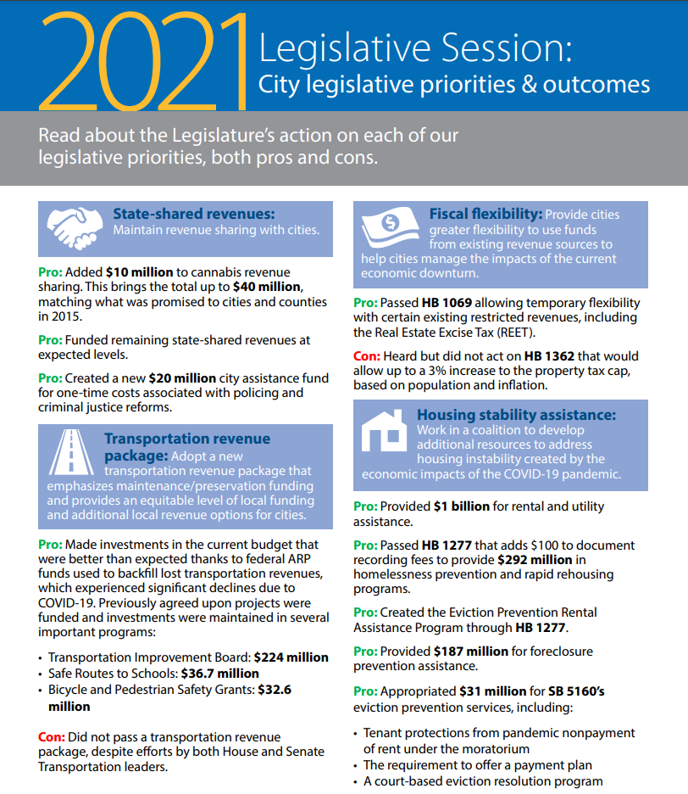
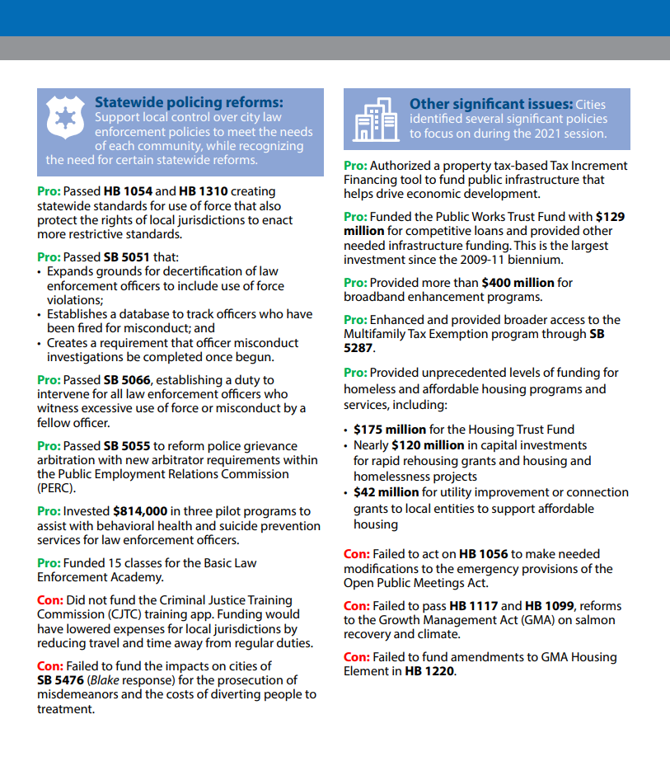
AWC’s 2021 Legislative Priorities & Outcomes

Slide 5
BIennial budget highlights
Operating:
State shared revenues including full funding of cannabis revenue
Capital:
PWTF increased to $129 million
Transportation:
$20 million assistance to cities for police reform costs
Rental & utility assistance, foreclosure & eviction prevention funding
Establishes Office of Independent Investigations
Funding for Blake response – no direct city funding
$400 million in new funding for broadband expansion
Energy efficiency upgrades for public buildings
Increase in Housing Trust Fund
Investments in low-income housing and shelters
Significant revenue shortfall
Two studies; JTC City Transportation Equity study & City-owned Fish Passage Barrier Identification
Funds previously agreed upon projects
Maintains funding for several programs; TIB, Safe Routes to Schools; Bicycle and Pedestrian Safety Grants
No new funding for FMSIB in addition to prohibiting calls for projects
*No Transportation Revenue Package
Funding for fish passage barriers

Slide 6
Budget & finance
Passed:
HB 1069 – Gives local governments a variety of fiscal flexibility tools like more REET flexibility, reduces restrictions on use of special sales taxes for specified projects and programs, increases time a utility lien can be applied after an emergency lien moratorium is lifted.
HB 1332 – Requires county treasurers to grant a deferral of 2021 property tax payments for certain distressed businesses via establishment of a payment plan.
SB 5096 – Imposes a 7% capital gains tax beginning January 1, 2022.
HB 1189 – Authorizes local governments to designate tax increment financing areas and to use increased local property tax collections to fund public improvements.
Did not pass:
SB 5188 – Creates a state public financial cooperative (aka state bank) that can issue low interest debt to local governments and finance infrastructure and development projects.
HB 1362 – Changes the 1% property tax revenue growth cap to a rate based on population changes and inflation, capped at 3%.
HB 1421 – Prohibits cities from collecting unpaid or delinquent charges from a property owner when the account is in a tenant’s name.

Slide 7
Economic developmenT
Passed:
HB 1189 – Tax Increment Financing
HB 1287 – Mainstreet Program

Slide 8
Public safety & criminal justice
Passed:
SB 5476 – Addressing State v. Blake by reducing penalty for knowing possession of drugs to gross misdemeanor, requires diversion to treatment, establishes plan for resentencing and recommending future substance abuse recovery services.
HB 1348 – Allows individuals to maintain Medicaid status for the first 29 days of incarceration. Requires local jails to make reasonable efforts to collaborate with MCOs for care coordination activities, improving health care delivery, and release planning for individuals.
SB 5119 – Requires local jails to conduct investigations into unexpected deaths that occur within their correctional facilities.
HB 1320 – Modernizes the process for civil protection orders. AOC will provide recommendation of changes by June 30, 2022.

Slide 9
Housing & homelessness
Passed:
HB 1070 – Adds “acquisition” and “emergency, transitional, and supportive housing” to uses of Affordable Housing and Related Services Tax
HB 1108 – Foreclosure assistance
HB 1220 – Emergency shelter/housing zoning preemption; Commerce to provide housing needs inventory*
HB 1236 – “Just cause” eviction reform
HB 1277 – $100 added to doc recording fee for housing and homelessness program funding
HB 1335 – Property owner notification of racial deed restrictions
SB 5160 – Tenant protections due to pandemic
SB 5235 – Prohibits owner occupancy regulation of ADUs unless short-term rental; and unrelated persons
SB 5287 – Expands and extends Multi-Family Property Tax Exemption Program
* Also included GMA Housing Element amendments but not funded in enacted budget

Slide 10
Housing & homelessness
Did not pass:
HB 1157 – Establishing a REET density incentive zone option; originally included planning for missing middle housing
HB 1232 – Planning for “plexes” in Housing Element of GMA
SB 5312 – Planning grants for transit-oriented development for cities increasing housing capacity

Slide 11
Transportation
Passed:
HB 1091 – Low Carbon Fuel Standard; tied to transportation revenue package
SB 5126 – Cap & Invest; tied to transportation revenue package
City transportation equity study
City-owned fish passage barrier study
Did not pass:
Transportation revenue package
HB 1523 – TBD sales and use tax authority renewal

Slide 12
Infrastructure and public works
Passed:
HB 1457 – Installation of broadband facilities along highways
HB 1336 – Expanded retail broadband authority
SB 5383 – Limited expansion of retail broadband authority
PWTF, Remedial Action Grants, and Stormwater Assistance
Did not pass:
Dedicated assistance for arrearages incurred during utility late fees and shutoff moratorium
Final budgets included approximately $1 billion for rental and utility assistance, but did not provide guidance on fund distribution

Slide 13
Police reform
Passed:
HB 1054 – Restricts certain police tactics and equipment from use in law enforcement.
HB 1310 – Creates new use-of-force standards for police, including requiring officers to use the least amount of force necessary and reserving lethal force only to protect themselves or others from imminent threat.
SB 5066 – Requires police to intervene and report the use of excessive force by a fellow officer.
SB 5051 – Increases police oversight by expanding background checks for police candidates, expanding conduct that can result in an officer’s decertification, reporting of discipline and separations to CJTC, and makes complaints/investigations and discipline decisions publicly available.
SB 5055 – Establishes specialized law enforcement grievance arbitrator roster at PERC and requires their use in police grievance arbitrations.
SB 5263 – Preserves felony bar defense for the general public; however, it now includes a specific provisions for law enforcement officers.
HB 1267 – Establishes the Office of Independent Investigations within Governor’s Office for the purpose of investigating deadly force incidents involving peace officers.

Slide 14
Police reform
Did not pass:
HB 1202 – Limits qualified immunity for officers and increased employers’ liability for injuries caused by the actions of a law enforcement officer.
HB 1203 – Requires cities to establish citizen oversight boards over police departments that have at least 15 police officers.
SB 5134 – Eliminates grievance arbitrations for law enforcement and prohibits certain police practices and policies from being included in CBAs.
HB 1507 – Creates a new unit within the Attorney General’s Office to carry out independent prosecutions of law enforcement.

Slide 15
OpEn government
Passed:
SCR 8402 – Ensures that the emergency orders, including those regarding meetings under the OPMA, remain in place until the COVID-19 emergency is lifted and are no longer subject to periodic extensions.
Did not pass:
HB 1056 – Updates the OPMA to allow use of virtual meetings during emergencies.
HB 1329 – Requires public comment prior to final action.

Slide 16
Human resources & labor relations
Passed:
HB 1073 – Provides alternative Paid Family & Medical Leave eligibility for people whose work hours were impacted by COVID-19 shutdowns.
HB 1323 – Makes changes to the state’s long term care program including an opt-out deadline of November 1, 2021.
SB 5097 – Expands PFML definition of “family member” and requires ESD to analyze program demographic data and report to Legislature.
SB 5115 – Creates workplace infection presumption for frontline workers during health emergencies, and requires employers to report infection rates to L&I.
SB 5254 – Requires employers to allow the voluntary use of PPE during health emergencies.
SB 5061 – Lowers unemployment insurance tax rates for employers, improves benefits, and adds flexibility to UI program in response to COVID-19 and future emergencies.
Did not pass:
HB 1076 – Creates a private right-of-action allowing plaintiffs to sue in name of the state to enforce alleged employment violations (Qui tam actions).
SB 5102 – Permits workers to record/have witness at IME exams and limits number of IME exams per workers’ comp claim.
SB 5137 – Suspends workers’ comp COLA until 2022 and caps future COLA at 3%.

Slide 17
Overview of Long-Term Care Services Act Effective January 1, 2022
To provide eligible Washington state residents a modest lifetime long term care benefit of $36,500 ($100/day).
Funded by a new mandatory payroll tax of 0.58% on all W-2 wage earners
Tax assessed regardless of age or income
No cap on taxable income
Benefit
Guaranteed issue with no health underwriting
Washington resident
Paid tax 3 of past 6 years or 10 years consecutively
Benefit is payable upon loss of 3 of 10 activities of daily living
Tax exemption: Enrollment on a qualified Long Term Care policy prior to November 1
Policy in place by October 1
Employee applies for exemption between October 1, 2021 – December 31, 2022

Slide 18
AWC Trust – Alternative LTC Coverage
Permanent Life Insurance with Long Term Care Rider (Trust only)
Life Benefit –$25k-$150k
LTC Benefit – 4% of the life benefit, ranging from $1k-$6k per month.
Cost - Based on age, level of benefit.
Underwriting – No medical underwriting required, all employees will be eligible for coverage
Employer & employee communications plan
Monthly newsletter articles – For Your Health
Employer webinar – June 14 (recorded)
Employee communication & webinars – August
Non-Trust employers:
Individual coverage unavailable due to overwhelming demand of LTC carriers

Slide 19
PensionS
Passed:
SB 5021 – Eliminates impact of COVID-19 work stoppages and shutdowns on public employee pensions.
SB 5367 – Automatic refunds of contributions to unvested public retirement accounts.
Did not pass:
SB 5453 – Merging LEOFF 1 and TRS 1 plans.
HB 1565 – Authorizes a 1.5% COLA increase for PERS 1, paid for by 0.04% supplemental employer contribution.

Slide 20
General government
Passed:
SB 5013 – Gives jurisdictions more time to submit and implement redistricting plans based on updated census data.
HB 1016 – Makes Juneteenth (June 19), which celebrates the end of slavery in the U.S., a state legal holiday.
Did not pass:
HB 1156 – Authorizes use of ranked choice voting in local government elections.
HB 1341 – Abolishes the professional rescuer doctrine, allowing first responders to sue for on-the-job injuries and potentially increasing public employer liability.
HB 5155 – Starts interest running on a tort judgment from the date that the cause of action accrues rather than the date the judgment is entered.

Slide 21
Federal update
American Rescue Plan – passed
$1.9 trillion relief package that was passed in mid-March. Includes direct funding for American cities in response to the COVID-19 pandemic, up to $1.1 billion for Washington cities.
Cities will receive first tranche is available now. Second tranche will arrive in 2022.
Entitlement cities will receive funds directly from Treasury. Non-entitlement cities will receive funds through the state.
Entitlement cities can apply now for ARPA funds through Treasury
Cities have until Dec. 2024 to obligate funds, Dec. 2026 to spend funds
American Jobs Plan – proposed infrastructure plan

Slide 22
ARPA Funding
How can funds be spent?
Support public health expenditures
Address negative economic impacts caused by public health emergency (public assistance)
Replace lost public sector revenue
Provide premium pay for essential workers
Invest in water, sewer, and broadband infrastructure

Slide 23
ARPA Funding
Remember:
Still a lot of unanswered questions
Federal funds available for a variety of programs
Don’t spend all your money right away
Collect community input
Document, document, document
Keep your congressional delegation in mind

Slide 24
ARPA Funding
Contact
Resources
Treasury
SLFRP@treasury.gov
(844) 529-9527
AWC
Peter King | peterk@awcnet.org
Jacob Ewing | jacobe@awcnet.org
Treasury ARPA Webpage
NLC Resources
MRSC Resources
AWC Webpage
Has your city adopted an ARPA spending plan? Please share it with AWC.

Slide 25
Looking ahead to 2022
60-day session
Election year
Federal funding & supplemental budgets
Transportation package?
Continued remote access?
Planning funding?

Slide 26
Questions?

