Slide 1
Reducing PCI Scope PSFOA, 09 October 2019
Notes:
Introductions:

Slide 2
Confirmed Data Breaches
Total number of breaches continues to increase year over year
1,632 breaches in 2017 set a new record high
Data breaches in 2018 down 8%
1,244
109% increase!
0 200 400 600 800 1000 1200 1400 1600
Notes:
Since 2005, the Identity Theft Resource Center (also known as the ITRC) has tracked and compiled statistics on data breaches. We took a look at their 2015 through 2018 reporting and found some interesting information.
Confirmed data breaches were on the rise from 2015 to 2018. The number of incidents tracked in 2017 hit a record high of 1632!! - a 109% increase since 2015. However, in 2018, they went down by about 23%.
.

Slide 3
Records Stolen
More than 1 trillion records stolen between 2015-2018
126% increase!
0 50M 100M 150M 200M
Notes:
But that didn’t stop the overall impact to the consumer. Although the number of data breach incidents decreased, the number of actual sensitive consumer records compromised did not. There was a marked increase of over 126%.!
It was found that hacking came in first as a form of data breach tactic involved in the 2018 increase. In second, was Unauthorized access, and third, Accidental Exposure.

Slide 4
Customer Levels & Compliance Validation
Qualification | Requirements
Level 1 Customers processing over 6 million Visa or MasterCard transactions annually (all channels) | Annual Report on Compliance (ROC) Annual Attestation of Compliance (AoC) Annual ISA training certification for self-assessment Quarterly Network Scans by an Approved Scanning Vendor
Level 2 Customers processing 1 million to 6 million Visa or MasterCard transactions annually (all channels) | Annual Report on Compliance (ROC) or Self-Assessment Questionnaire (SAQ) Annual Attestation of Compliance (AoC) Annual ISA training certification for self-assessment Quarterly Network Scans by an Approved Scanning Vendor
Level 3 Customers processing 20,000 to 1 million Visa or MasterCard e-commerce transactions annually | Annual Self-Assessment Questionnaire (SAQ) Annual Attestation of Compliance (AoC) Quarterly Network Scans by an Approved Scanning Vendor
Level 4 Customers processing less than 20,000 Visa or MasterCard e-commerce transactions and all other Customers processing up to 1 million transactions annually | Annual Self-Assessment Questionnaire (SAQ) Annual Attestation of Compliance (AoC) Quarterly Network Scans by an Approved Scanning Vendor

Slide 5
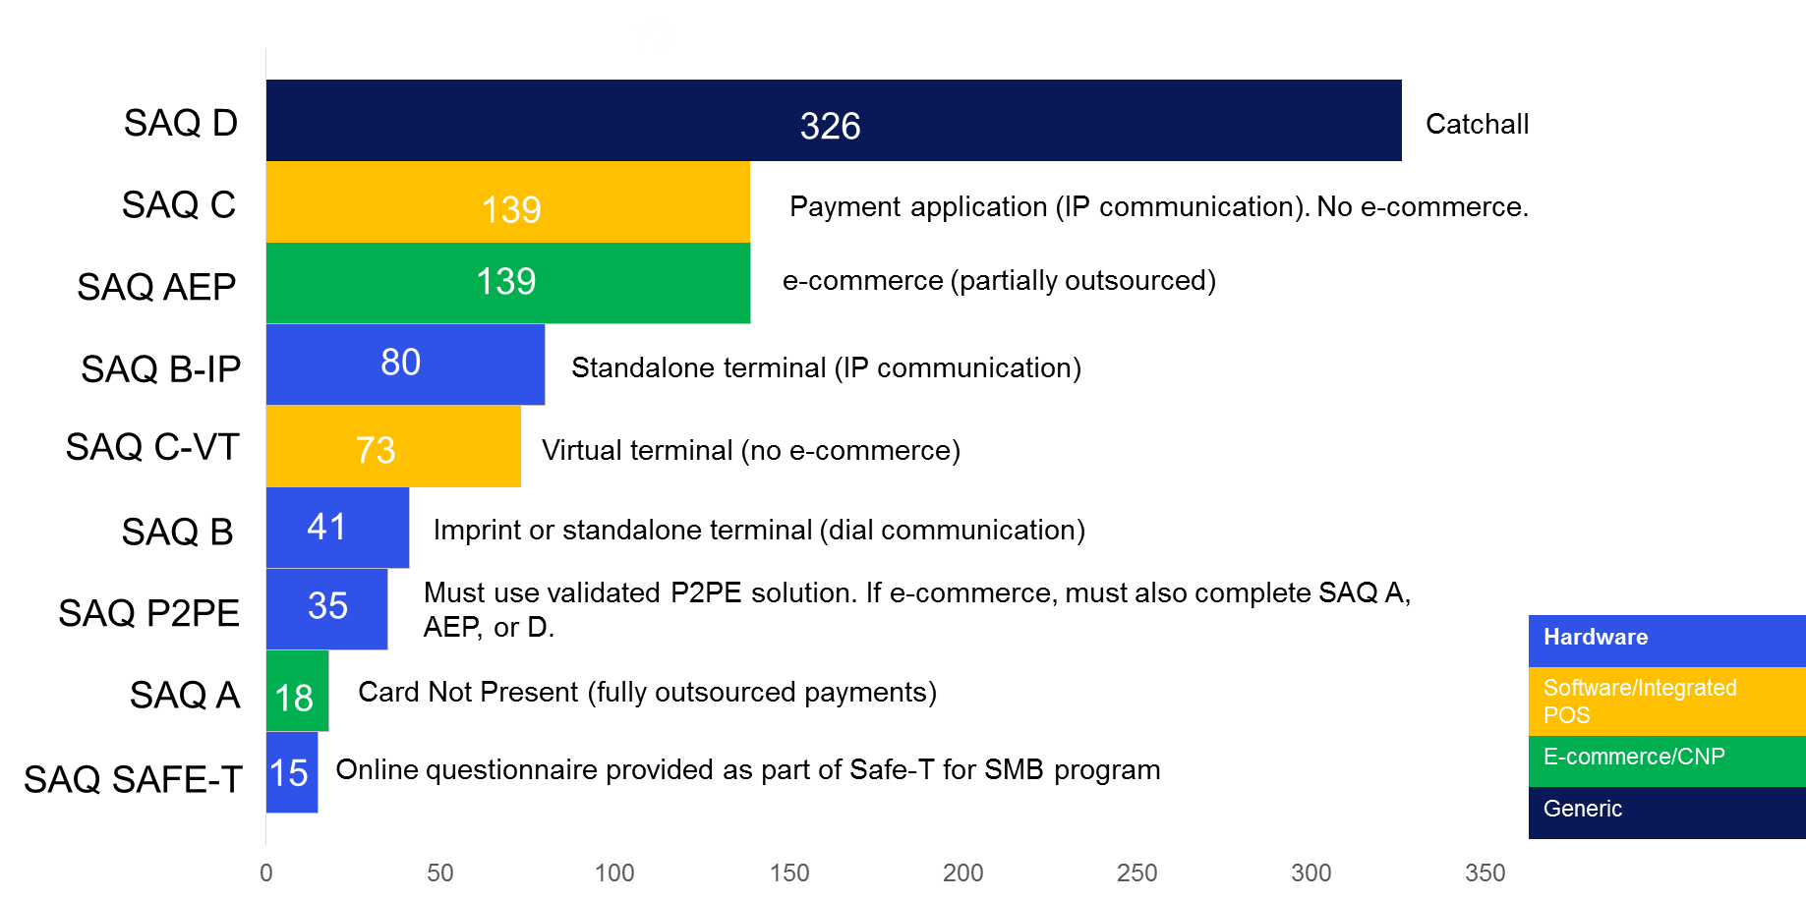
PCI DSS Compliance is Tough
# Questions
Notes:
The PCI Data Security Standard (DSS) is a baseline for security. All companies who process, store, and/or transmit payment cards must be in compliance with the standard at all times. What is more important is that companies annually validate their compliance.
Deciding which Self-Assessment Questionnaire (SAQ) to complete can prove to be difficult. The more complex your method of payment acceptance, the more complex the questionnaire.
So how can Elavon help navigate the complexities of data security and assist ensuring that the data you accept today is useless to criminals?

Slide 6
Layered Security
EMV
Point-of-Sale card authentication
ENCRYPTION
In-transit protection
TOKENIZATION
Protects during use and at rest
Notes:
Your sites are always vulnerable – there’s no question about that. Uncovering the vulnerabilities is critical to implementing the highest possible security controls to reduce the likelihood of a data breach. Furthermore, if a breach were to occur, you want to ensure that you have done everything possible to reduce the chances that your valuable, sensitive information is captured by crooks.
Elavon built our SAFE-T Security Solutions from the ground up, with security and compliance in mind.
Security experts have long advocated a layered approach as a best practice, as no one layer is a silver bullet of protection. Safe-T follows that layered approach.
Our Safe-T solutions provide three security technologies that protect every aspect of the payment system simultaneously.
EMV (Europay, MasterCard and VISA) helps to verify if a card is valid.
Tokenization protects transaction data in use and at rest.
Encryption protects card data in transit (while moving through the processing system).

Slide 7
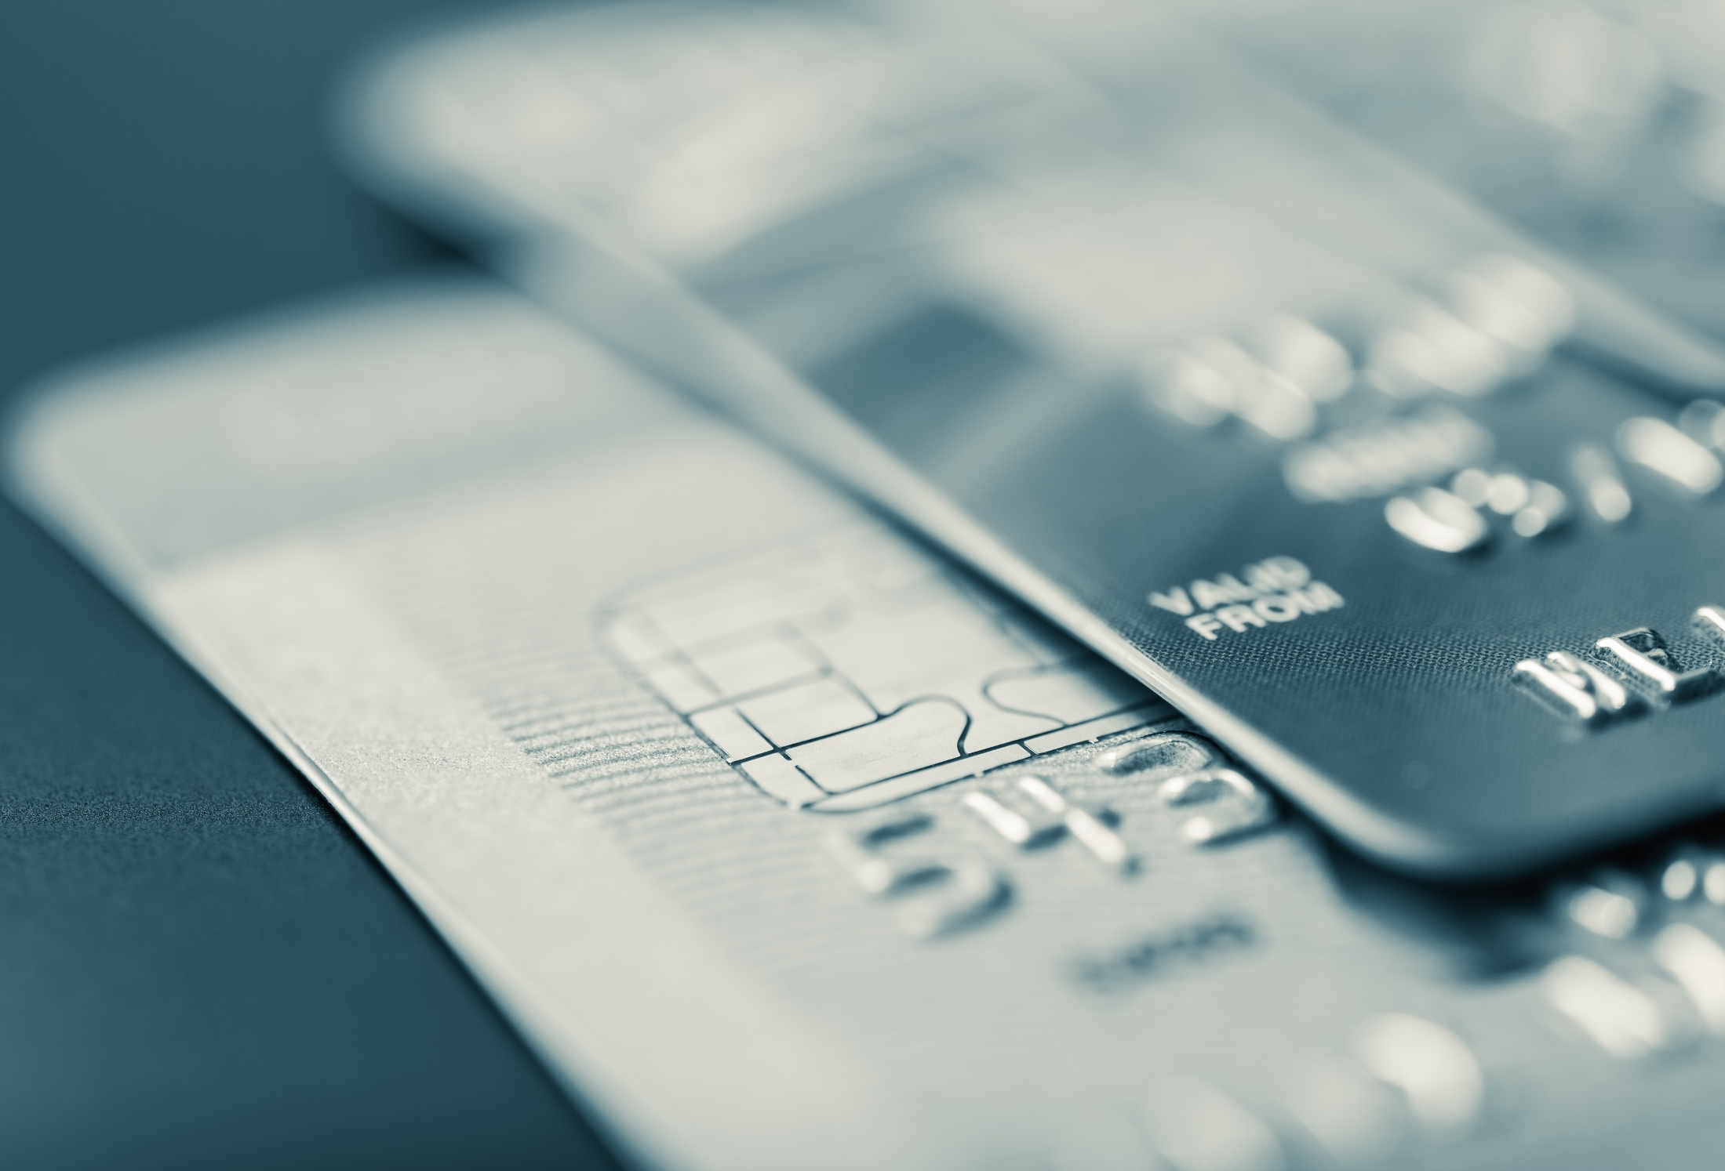
EMV
EMV (Europay, Master-card and VISA) helps to verify that a card is not counterfeit.
Notes:
EMV terminals reduce the risk of accepting counterfeit cards, as they verify both the card and the cardholder.
Cardholders have fewer reasons to worry about the security of their payment information with EMV.

Slide 8
EMV: TRUE vs FALSE
TRUE
Mitigate counterfeit fraud at POS
Protects against counterfeiting cards
FALSE
Mandated to merchants
Protects against card-not-present fraud/ecommerce
Creates a different POS experience
Prevents data breaches
Always requires a PIN
Eliminates the need for a magnetic stripe
The Path to Secure Payments

Slide 9
Encryption
An additional layer of encryption ensures that all activity is protected in transit.
Notes:
Encryption is an additional layer that ensures all activity is protected in transit.
From the moment a payment card is swiped, dipped or tapped at a POI device, encryption protects card data and personal information from fraudsters as it travels across various systems and networks until decrypted at Elavon’s secure data center.

Slide 10
Tokenization
Tokenization replaces payment card data with a unique token ID.
Eliminates the possibility of stolen payment data since it no longer exists in your environment.
Notes:
It is not enough to protect sensitive data. It’s best to make it less attractive to hackers.
Tokenization converts or replaces card data with a unique token ID to be used for repeat transactions.
This eliminates the possibility of having card data stolen because it no longer exists within your payment processing environment.
Tokens can reside on your POS/PMS and can be used to make adjustments, add new charges, make reservations, perform recurring transactions, or perform other transactions (in use) without having to touch the actual cardholder data elements again.

Slide 11
73
73
Safe-T Reduces PCI SAQ by More than 80%
# Questions
SAQ D
326
Catchall
SAQ C
139
Payment application (IP communication). No e-commerce.
SAQ AEP
139
e-commerce (partially outsourced)
SAQ B-IP
80
Standalone terminal (IP communication)
SAQ C-VT
73
Virtual terminal (no e-commerce)
SAQ B
41
Imprint or standalone terminal (dial communication)
SAQ A
18
Card Not Present (fully outsourced payments)
SAQ SAFE-T
15
Online questionnaire provided as part of Safe-T for SMB program
Notes:
Safe-T for SMB can dramatically reduce the number of SAQ questions.
But the Safe-T for SMB SAQ is only available through the PCI Compliance Manager online portal when you implement Safe-T for SMB throughout your payment environment.

Slide 12
Solution Models
Solutions | Who performs the work? | Future proofing
Fully Integrated | Merchant or POS Vendor | High degree of difficulty for developer
Stand alone terminals | Terminal provider (usually Acquirer) | Subject to Terminal provider resources
Semi-integrated | Shared with the Payment Application provider | Development responsibility can be shifted to Application provider
Confidential
Notes:
Which solution model best fits your business? This is definitely not a “one size fits all” situation. And you may want to consider a change, if it makes life easier?
In each, consider -
Who performs the work? What is the Level of Effort?
For example, With a fully integrated solution, the burden of development, including EMV functionality, falls to the POS/PMS Vendor or Merchant. The LOE is very high. Plan on a longer timeline to completion.
Future Proofing – staying prepared!
With a semi-integrated solution or stand-alone terminals, the burden can be placed on the provider to ensure that you are ready for the newest payment technology and your EMV delivery is up-to-date.

Slide 13
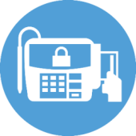
Fully Integrated Solution
Acquirer
Issuer 1
EMV
NFC
ENCRYPTION
TOKENIZATION
Issuer N
POS
Workstation
OR
Encrypting
Pin-Pad
Gateway
Issuer N
Payment Application is hosted at the POS
Acquirer N
Notes:
This is a high-level example of a fully-integrated environment.
Fully Integrated: This is a common model today. You may have the payment functionality built into your register or workstation. Your cashier selects the payment option and swipes the card on the keyboard or the card is swiped on a pin-pad that sends the data back to the register.
An EMV project in this environment will require modifications to the POS/PMS Software, as well as the swipe device. Keep in mind, if you develop your own payment application for EMV
You or your vendor will need to care for the appropriate processing steps in the communication between the chip and the kernel operating in the terminal;
You will want to ensure that the payment application is as isolated as possible from other POS functions. Otherwise, any change to your POS/PMS could result in a requirement to re-certify for EMV.
You or your vendor will need to be prepared to manage updates, as modifications to processing rules arise.

Slide 14
Stand-Alone Terminal Solution
Acquirer
Issuer 1
EMV
NFC
ENCRYPTION
TOKENIZATION
Issuer N
CSR
Stand-alone PIN pad EMV and Encrypting Payment Device
OR
Payment Application is hosted on the stand-alone terminal.
Gateway
Issuer N
POS
Workstation
Acquirer N
Notes:
Stand-Alone terminals are probably the easiest option to implement. The terminals are not connected to your POS/PMS software and act independently.
While having the payments processing operate outside of the PMS/POS can cause reconciliation challenges, but implementation can be as easy as swapping an outdated terminal for a new device. You can also find devices in this category that communicate via Bluetooth and Cellular communications. In addition, many now come equipped to accept a variety of contactless payments or mobile wallets.

Slide 15
Semi-Integrated Solution
Acquirer
Issuer 1
EMV
NFC
ENCRYPTION
TOKENIZATION
POS
Encrypting Payment Device
OR
Issuer N
Payment Application is hosted at the Terminal
(Encrypting Payment Device)
Gateway
Issuer 1
Acquirer N
Notes:
This model is somewhere in-between the last two.
Semi-integrated models can offer a great deal of protection, while maintaining the consolidated reporting and reconciliation that helps with reconciliation and back-office processes. The payment application can reside outside of your POS/PMS, and in some cases, even transmit payment data to the processor without sending data to your software or register, until after that card data has been converted to a token.
In this diagram, the payment application is hosted on the pin-pad terminal, where encryption can also be occurring. The transaction is sent directly to the gateway or acquirer, avoiding having data travel back through the point-of-sale. The transaction is decrypted, authorized and returned to the pin-pad terminal with a token in place of the card data. That transaction is then sent to the POS/PMS so that the cashier can complete the transaction and the result can be recorded for reporting and reconciliation.
Modifications were made to the POS to interface with the pin-pad terminal. In many models, future updates that are needed on the payment application and/or terminal can be managed remotely by your solution delivery partner.

Slide 16
Which Solution Fits Your Environment?
Solutions | Ease of Use | Maintenance / Ownership
Fully Integrated | Generally Easy, if designed to Merchant requirements | Significant effort on Merchant (POS Vendor)
Stand alone | Requires dual entry of all credit card payments accepted | Minimal effort on Merchant; falls to Terminal provider
Semi-integrated | Generally Easy, retains single transaction entry to system | Moderate effort on Merchant, Vendor, Shared
Notes:
Fully Integrated Payment Solution
Requires strong IT and development support. The work can become continuous, when you consider future update maintenance.
Often, the application is easier to use, as it was defined to your requirements for delivery.
Stand-Alone terminals are usually delivered with a “generic” application. It is not designed to your requirements, but it is often designed with “simplicity” in mind. Also, you can defer as much of the maintenance and future proofing to your terminal provider as you feel best for your business;
Semi-integrated. Some IT and development support will be required to interface with the external payment application and pin-pad terminal. The POS/PMS application can still be delivered according to your design, and the payment application burden can be deferred to your solution provider – especially the EMV delivery and certification burden!
EMV is becoming increasingly available in every point-of-payment acceptance, including mobile devices, which I did not include in this session. As you evaluate your payment environment needs, look for solutions that will also function across multiple payment channels, if your business is taking advantage of all the new technology available.

Slide 17
A thought…something you may be thinking
PCI Non Validated
Reduces your PCI scope yet has not been validated by a P2PE QSA
PCI Validated Solutions
Meaning that a combination of secure devices, applications, and processes that encrypt payment card data from the point it is used at a point of interaction (POI) device until it reaches a secure point of decryption.
PCI P2PE Solutions are validated by a specially-trained P2PE QSA as meeting the rigorous security requirements of the PCI P2PE Standard. List of the are below
https://www.pcisecuritystandards.org/assessors_and_solutions/point_to_point_encryption_solutions

Slide 18
Maximize Your Effort
Security
Eliminate storing card holder data within your environment
Reduce PCI Compliance Burdens
Reduce PCI exposure from POS
Future Proof and Liability Shift
Seek a solution that is EMV, contactless and mobile ready
Reduce time and effort expended on PCI compliance
Reduce Vendor and Payment Complexity
Remote updates using PCI versions
Seek a solution that fits your POS/Vendor
Notes:
Finally, make the most of your project. This is one of those times that “while you have the patient open”, what can you do to upgrade your payment environment. [click]
lets consider 4 compelling benefits
Top of the list and by far the #1 benefit is Security – if you haven’t yet implemented encryption, consider that as a top priority.
By implementing the EMV and layered security, customers will be able to eliminate storing sensitive card holder data within their POS or PMS environment, protecting data in transit, data at rest and against card fraud.
[click]
Regards PCI Compliance
By removing cardholder data from the POS or PMS, the reduced exposure streamlines much of the PCI compliance process as it relates to resource time and effort. There are payment applications that can reside outside of your POS/PMS that will help you to achieve this goal.
[click]
A 3rd key benefit is the Future Proofing and Liability Shift that this brings.
Both magnetic strip and EMV (CHIP and PIN) cards can be supported, providing coverage for the scheduled 2015 liability shift when businesses will become liable for fraudulent card transactions if they are not EMV compliant. You may want to discuss your Mobile Wallet or contactless payment strategy at this point also.
One desire for many customers is to reduce the complexity of establishing and maintaining their payment environments.
Look for a strong solution partner.
With financial strength and stability to back your solution. Elavon is owned by US Bank which has a 70 billion dollar market capital and Oracle/MICROS has over 4.3 billion market capital. Bottom line, a compelling solution from seriously established payment vendors.

Slide 19
Questions?

