Slide 1
2019 Legislative Update
Puget Sound Finance Officers
July 10, 2019
Candice Bock
AWC Government Relations Director

Slide 2
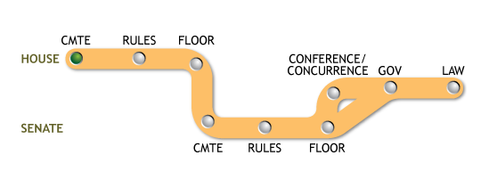
2019 Session Overview
105 days – January 14 to April 28
Large democratic majorities
Biennial budget for 2019-21
Culvert decision U.S. v Washington
Education funding
School employee’s health care system
Behavioral health system reforms
Trueblood settlement

Slide 3
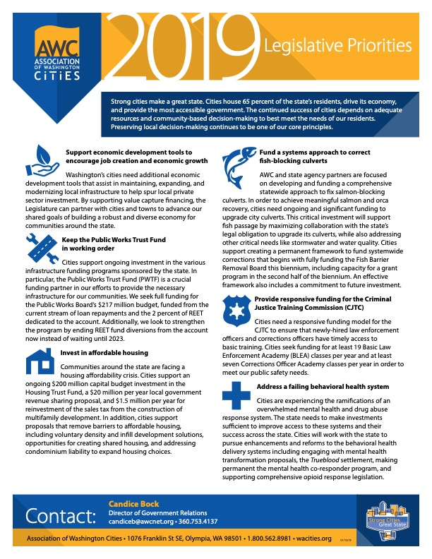
Cities’ Legislative Agenda

Slide 4
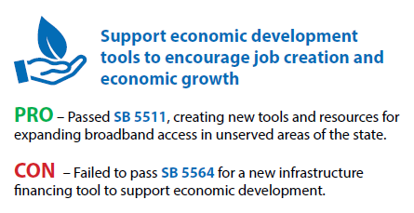
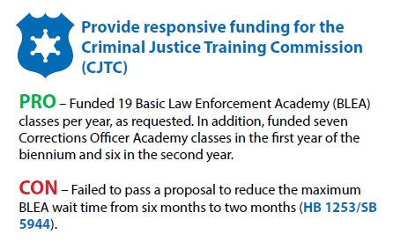
Legislative outcomes

Slide 5
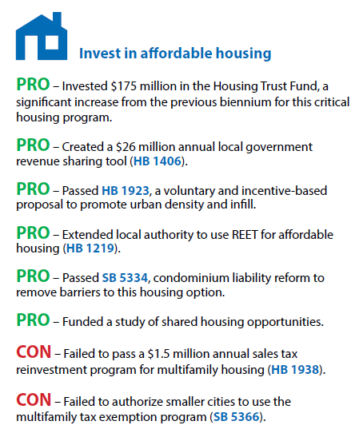
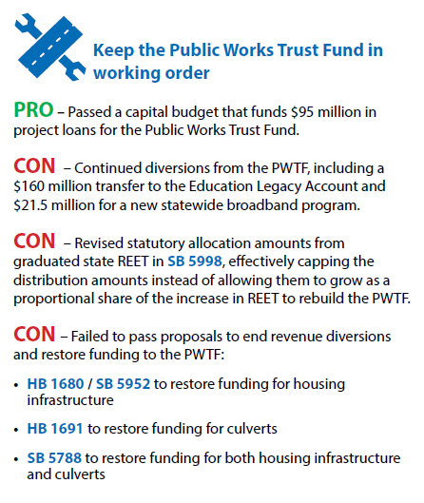

Slide 6
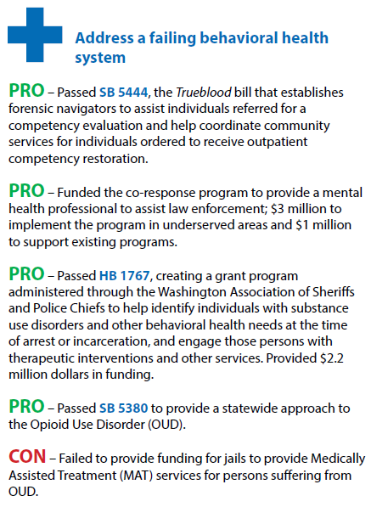
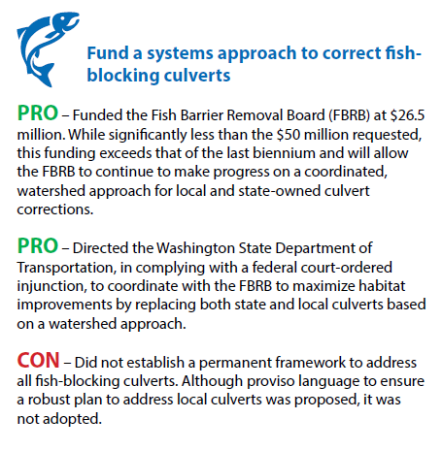

Slide 7
OFM 2019-2021 Budget Overview (January 2019)
2017–19 BUDGET
MAINTAIN SERVICES
AT CURRENT LEVELS
$2.375B
$4.125B
$675M
$600M
$400M
$350M
$400M
$900M
$400M
$500M
COMPENSATION, CASELOAD
& OTHER
K-12
CARRY-FORWARD
& MAINTENTANCE-
LEVEL COSTS
$44.6B
COLLECTIVE BARGAINING AGREEMENTS
UNFUNDED REQUESTS
SEBB
FIXES & MORE *
BEHAVIORAL HEALTH
NEW K-12 ENHANCEMENTS
OTHER POLICY ADDS
HIGHER ED & EARLY LEARNING
*FIXES & MORE INCLUDES COURTS/LEGAL/MANDATORY, DEBT SERVICE
November Revenue Forecast
$50.2B
3

Slide 8
State Budget
$52.8 Billion Operating Budget
$5.07 Billion Capital Budget
$9.98 Billion Transportation Budget
Positive revenue forecast
$554 million
Graduated REET
(SB 5998)
$244 million
B&O tax increase on financial institutions
$133 million
Closing tax preferences
$59 million
Hazardous Substance Tax (MTCA) increase
$165 million
B&O tax surcharge for higher education & workforce training

Slide 9
Finance Bills
SB 5581 – Sales tax administration changes implementing South Dakota v Wayfair – Passed
Makes changes to Mainstreet Fairness Act to align sales tax collection requirements with U.S. Supreme Court decision South Dakota v Wayfair for internet and remote sellers
HB 1403 – Local B&O tax apportionment – Passed
Implements recommendations of service apportionment task force created by HB 2005
Requires cities to update model B&O tax ordinance and implement changes by January 1, 2020
HB 1059 – Annual B&O tax filing deadline – Passed
Changes filing deadline for B&O tax annual filers to April 15
Delays implementation for cities with local B&O taxes to 2021 filing for 2020 taxes
SB 5894 – Firefighters pension levy – Passed
Clarifies that cities may continue levy even if all pre-LEOFF beneficiaries are deceased
Revenue must first be used to cover medical benefits for LEOFF 1 retirees and then for other municipal purposes
Levy expires when no longer have LEOFF 1 retiree medical obligations

Slide 10
Finance Bills (cont)
HB 1798 – Short term rentals - Passed
Requires reporting of taxes by short term rentals if not collected by a marketplace facilitator
SB 5272 – E911 tax - Passed
Increases maximum tax rate for voter-approved local sales and use tax for emergency communications
HB 2145 – Property tax limit – Did not pass
Would have increased property tax limit from one percent to a limit of three percent or inflation

Slide 11
Human Resources, Labor Relations & Pension Bills
Initiative 1000 - Affirmative action initiative - Passed
The initiative does not contain mandates but instead amends current law to allow state and local governments to create programs to remedy discrimination against disadvantaged groups.
HB 1087 – Public long-term care insurance - Passed
Creates the Long-Term Services and Supports Trust Program which will provide long-term care insurance to Washington employees. Beginning Jan. 1, 2022, employees in Washington will be assessed a premium of 0.58 percent of their wages. Beginning Jan. 1, 2025, eligible recipients will receive benefits up to $36,500, and the benefit is adjusted for inflation.
HB 1575 – Legislature's response to Janus - Passed
Requires that an employee's request to revoke authorization for dues deductions must be in writing and submitted by the employee to the union in accordance with the terms and conditions of the dues authorization.

Slide 12
Affordable Housing
HB 1406 – Local sales tax option for affordable housing - Passed
Creates a new local option sales tax credited against state sales tax that creates a new sales tax revenue sharing between the state and local governments to invest in locally prioritized housing efforts
SB 5383 - Tiny house communities - Passed
Authorizes cities to adopt ordinances regulating tiny house communities, including through use of the binding site plan method
Prohibits ordinances that prevent entry or require removal of a tiny house with wheels used as a primary residence in a manufactured/mobile home community
HB 1923 – Density - Passed
Intent to increase urban residential capacity, density, and affordable housing by incentivizing city decisions related to density. Original bill included density mandates and preemption of local decision-making. Final bill creates incentives for density near transit and grant program for cities that undertake additional planning.
SB 5334 – Condo liability reform - Passed
Changes the implied warranties for the construction of a condominium and provides liability protections for homeowner association members
SB 5812 - Accessory dwelling units – Did not pass
Would have created guidelines for city policies around permitting accessory dwelling units (ADU)

Slide 13
Public Works and Contracting Bills
SB 5418 – Public works bid limits - Passed
Raises bid limits for cities and towns:
$116,155 or more and involve more than one craft or trade for code cities, second class cities, and towns and $150,000 for first class cities; or
$75,500 or more and involve a single craft or trade
Second-class cities may award competitive public works contracts to the lowest responsible bidder or to bid that meets responsible bidder criteria and within five percent of lowest bid
Increases small works roster alternative bid process limit from $300,000 to $350,000
SB 5958 - Cooperative purchase “piggybacking” - Passed
Clarifies existing law allowing all public agencies to utilize cooperative purchasing procurement contracts to make purchases from any publicly noticed and competitively awarded cooperative purchasing contract
HB 1295 – Design-build bidding process - Passed
Changes the public works design-build bidding process, including:
The limits for projects to be eligible for design-build are decreased from $10 million to $2 million
Work order amounts are increased from $350,000 to $500,000
Number of job orders that may be awarded increased from two to three
Job orders may be used by any public entity

Slide 14
Behavioral Health & Homelessness Bills
SB 5444 – Trueblood settlement - Passed
Provides for competency evaluations and process for competency restoration to provide for timely evaluations of in-custody individuals
Establishes forensic navigators to aid with treatment and competency restoration
Expands police authority to divert an individual to treatment instead of criminal prosecution
HB 1767 – Law enforcement grant program - Passed
Establishes law enforcement grant program to expand alternatives to arrest and jail
Mental health field response grant program – included in budget
Budget funds $4 million to expand program to place social workers with police to divert individuals from criminal justice system
HB 1591 - Rights of persons experiencing homelessness – Did not pass
Would have established rights related to subsisting or eating in public spaces for those experiencing homelessness and would have provided they could not be prosecuted criminally for exercising these rights when the person has no reasonable alternative, with intent to codify Martin v. Boise

Slide 15
Transportation, Micro-mobility & Technology
I-976 - $30 license fees – No legislative action, on November 2019 ballot
Initiative to legislature considered during session
Repeals transportation benefit district license fee authority
Impacts Sound Transit funding and directs retirement of debt
HB 1772 – Scooters - Passed
Establishes a regulatory framework for motorized foot scooters and motorized scooter share companies
HB 1325 – Personal delivery robots - Passed
Establishes a regulatory framework for the operation of personal delivery devices on sidewalks and in crosswalks
Maintains local government authority to regulate
SB 5376 - Washington Privacy Act – Did not pass
Establishes notice and opt-out requirements for use of personal data similar to EU’s privacy rules
Restricts use of facial recognition technology to engage in surveillance of individuals in public spaces, unless it is in support of law enforcement activities and under a warrant or emergency

Slide 16
Criminal Justice Bills
SHB 1064 – Police use of force - Passed
Modifies I-940 approved in November 2018 regarding use of deadly force
Identical to changes in 2018’s HB 3003, which courts found invalidly amended I-940
Removes the subjective portion of the standard for police use of deadly force and retains the objective reasonable officer test
Clarifies duty to render first aid
SSB 5380 – Medication assisted treatment in jails – Passed, but not funded
Requires jails to provide medication assisted treatment to those with opioid use disorders in certain circumstances
SB 5605 - Vacating cannabis misdemeanor offenses - Passed
Allows a person convicted of a misdemeanor marijuana offense to apply to the sentencing court to vacate the record of conviction

Slide 17
General Government
SB 5163 - Wrongful injury or death - Passed
Expands tort liability for cities by:
Removing dependency requirements for claimants
Allowing parents or siblings to bring action for adult children over age 18, if no spouse or children
Expanding damages
Making changes retroactive
HB 1667 – Public records reporting – Passed
Streamlines and clarifies reporting metrics in 2017’s ESHB 1594 and removes sunset for local records grants
HB 2020 – Exempting names in employment investigation records – Passed
Exempts names of complainants, accusers, and witnesses in employment discrimination investigations from public disclosure until the investigation is complete, unless the person consents to disclosure

Slide 18
General Government
SB 5266 - Voting Rights Act elections - Passed
Clarifies that all council seats up for election when redistricting under the Voting Rights Act
SB 5652 - Personal belongings disposal in impounded vehicles - Passed
Removes local law enforcement as a custodian of unclaimed belongings
Requires personal belongings storage request form for items held at the registered tow truck operator’s (RTTO) place of business for 30 days (60 days at owner’s request)
Belongings are subject to sale or auction after 30-60 days
SB 5024 – Transparency of utility districts – Did not pass
Requires municipal utilities and utility districts to indicate the utility tax rate and how it is applied in:
regular billing statements;
their website; or
billing insert, mailer, or electronic communication to customers once a year or within 30 days of rate changes

Slide 19
Looking ahead to 2020
Election year – Presidential, State-wide offices, House, half of the Senate
Short 60 day session
Supplemental budgets
Advocacy for 2020 starts now!
Need tips for what to do – AWC Advocacy Pocket Guide
AWC’s 2020 Legislative agenda setting process starts now
Latest updates - wacities.org/advocacy/news
Candice Bock
AWC Government Relations Director
candiceb@awcnet.org
wacities.org

