Slide 1
The Multigenerational Workforce –
“You do the Math!”
Puget sound Finance Officers Association
December 7, 2018
Rebecca Crichton,
Executive Director
Northwest Center for
Creative Aging

Slide 2
Culture
What is Culture?

Slide 3
What is Culture?
Culture – the behaviors, beliefs, values, attitudes and assumptions held by a group of people.
Culture is passed along by communication and imitation from one generation to the next.
A culture is a way of life of an interacting group of people.

Slide 4
We don’t see our own culture
We don’t know how multicultural we are.
Fish don’t know they swim in water.

Slide 5
The Lenses we look through
We are all cultural beings. We look through cultural lenses at ourselves and each other.
Most of us are not aware we are as culturally influenced as we are.

Slide 6
What we see
When we meet someone for the first time, what four things do we notice instantly – usually unconsciously - in what order?

Slide 7
We see
Color
Gender
Age
General Appearance

Slide 8
Stereotypes & Generalizations
How Stereotypes hurt -
  Apply to everybody in a group
  Usually judgmental
  Meant to exclude
  Used to ‘assess’ others
Generalizations can be helpful –
  Help us understand patterns
  Learn about individual
  Agreed to by most members of the group
  Allows ‘access’ to a group

Slide 9
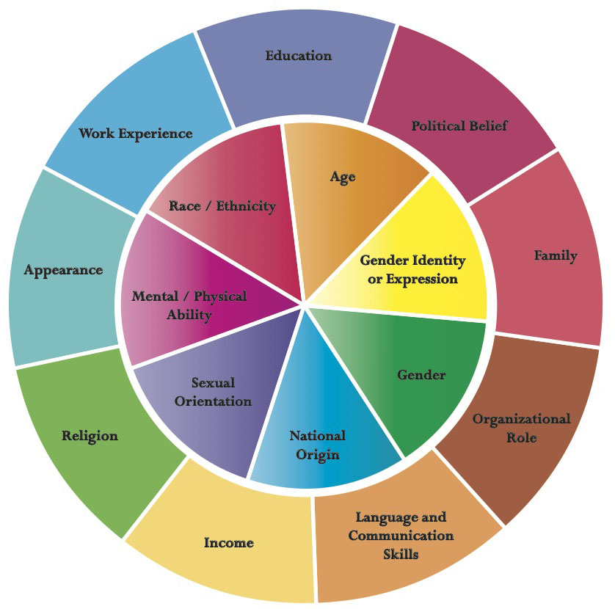
Diversity Wheel

Slide 10
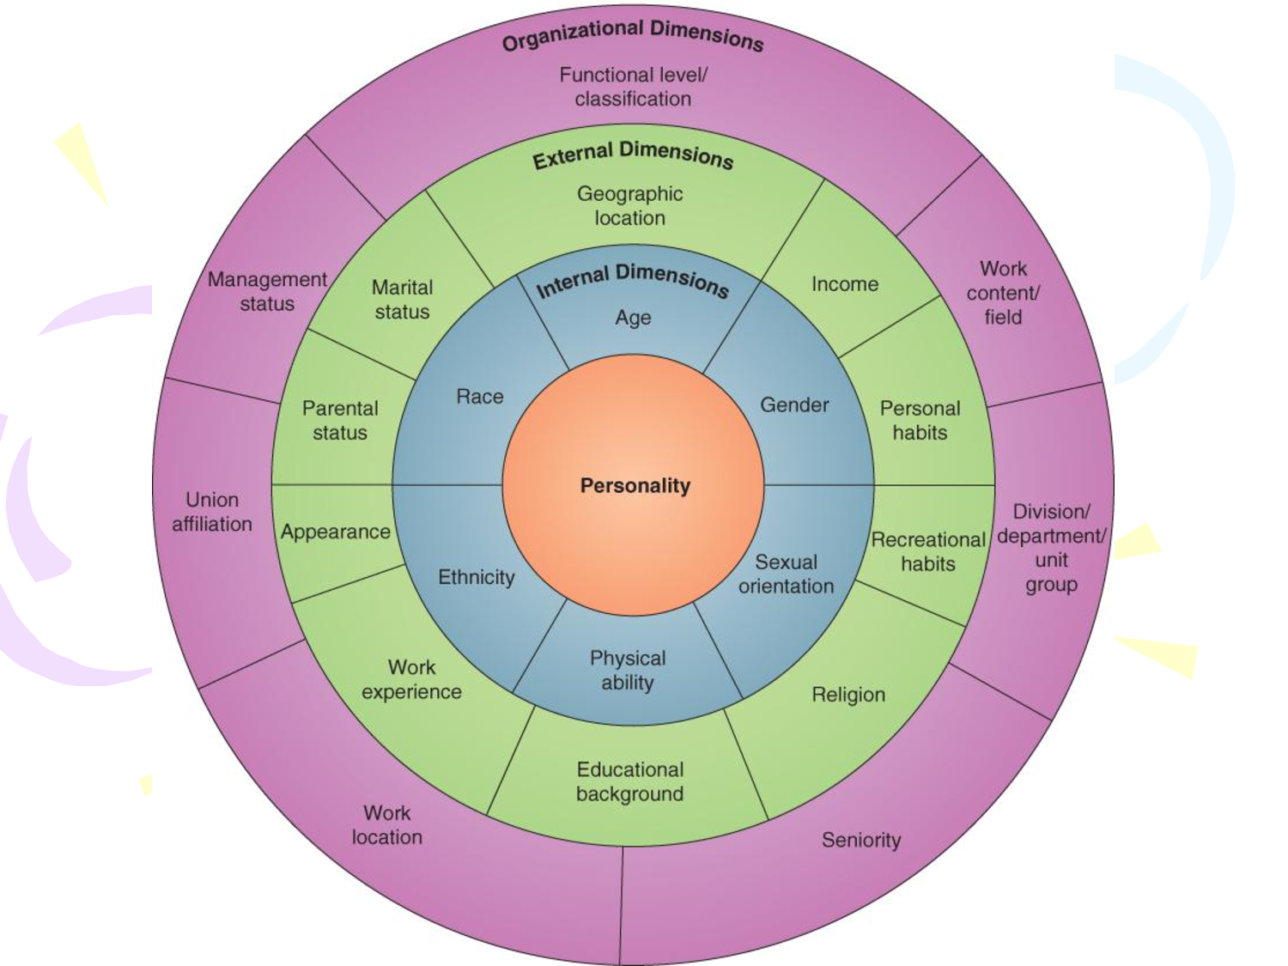
Diversity Wheel – Another Version

Slide 11
Personality
The center of the wheel –what are some of the things we consider to be our personalities?
Extroversion/Introversion
Risk taking/careful
Independent/Group oriented
Emotional/Even tempered
Intense/laid back
Many more depending on which of the many assessments you look at

Slide 12
The Internal Dimensions
What do you notice about the internal dimensions?
What do they have in common?

Slide 13
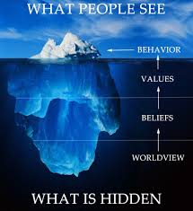
The Iceberg Model

Slide 14
Above the waterline:
Physical Characteristics
Language
Behaviors
Communication Styles
“Energy”

Slide 15
Below the Waterline:
Values
Beliefs
History/Experience
Assumptions
Cultural and Familial Constructs
Your emotions and state of mind

Slide 16
We all do it!
We judge ourselves by our intentions. We judge others by their behavior.

Slide 17
Age – 2 Aspects
The developmental phase or stage someone is – Toddlers, Teens, Thirty-something, Retirees, etc.
Our age cohort – the historical period we were born and grew up in

Slide 18
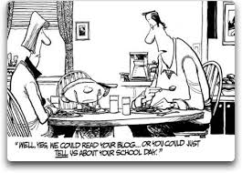
Can you relate?

Slide 19
The Generations -
1925-1945 – The ‘Greatest Generation’, The Veterans, The Traditionalists, The Matures
1946-1965 – The Boomers
1966 – 1980 – Gen X
1981 – 2000 – Gen Y, the Millennials
(1997/2001 - ?? – Gen Z, Internet Generation, Homeland Generation, Google Generation

Slide 20
We’re all Agist
What words/concepts do you have about the other generations?
    The ‘Greatest’ Generation
    The Boomers?
    Gen X
    Millennials

Slide 21
Perceptions/Stereotypes
How is your generation perceived by others: media, government, health care industry, other generations? What words do they apply?
How do you want to be perceived by others?
How can that happen?

Slide 22
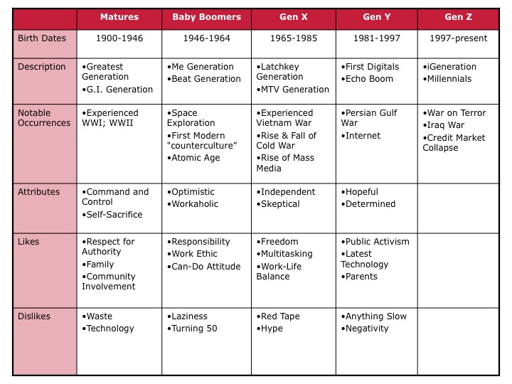
Some Generational Differences

Slide 23
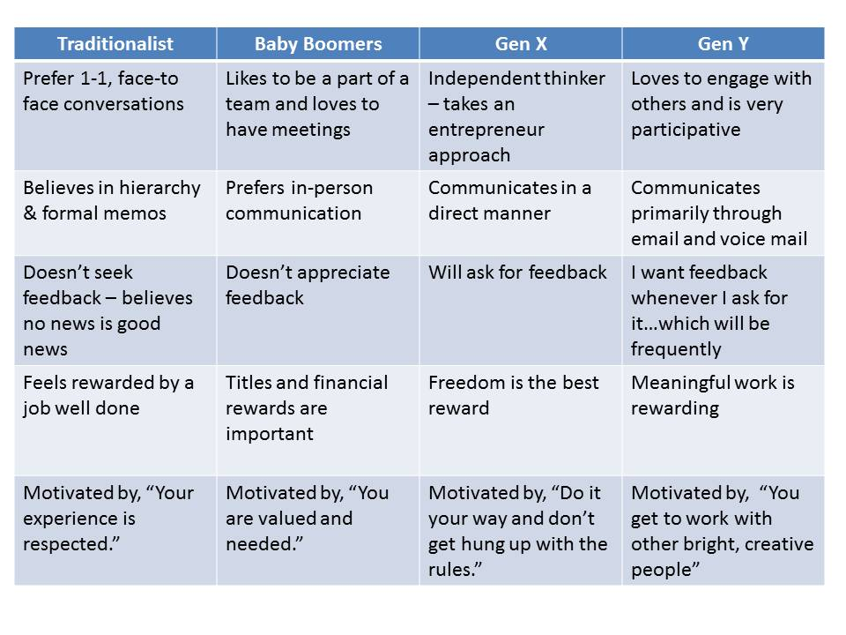
More Gen. Differences

Slide 24
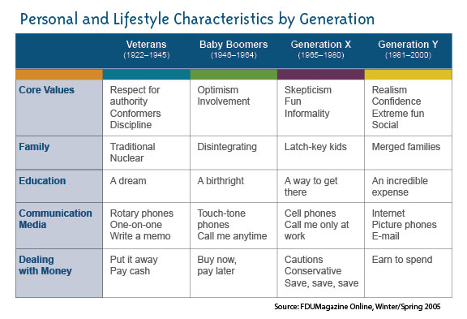
Still More Generational Differences

Slide 25
Technology and the Generations
Digital Natives vs. Digital Immigrants
Technology and our work
Technology and our Relationships
Technology and our Politics
Technology and our Money

Slide 26
History and You
At your tables, spend 5 minutes sharing the historical event(s) that were most significant in your own life development?
Someone report out what was said.
We’ll see what shows up…

Slide 27
You do the Math!
When someone asks you how old you are, answer by saying:
“I was born in…… pause and then say, “You do the math!”
(Most people won’t do the math!)
It places you in history, gives you credit for the years you’ve lived, not just whatever the particular age means to the person who asked.

Slide 28
The Multicultural You!
Culture – the behaviors, beliefs, values, attitudes and assumptions held by a group of people.
Culture is passed along by communication and imitation from one generation to the next.
A culture is a way of life of an interacting group of people.

Slide 29
Take Away
What did you learn?

