Slide 1
FileLocal Save Time, Increase Compliance!

Slide 2
Table of Contents
FileLocal Mission
What is the FileLocal Agency
How does the FileLocal Portal Work
FileLocal Basics
New City Onboarding Options
Key New City Onboarding Activities
Contact Information

Slide 3
What is the FileLocal Mission
Streamline Business Licensing and Tax Processing for both Businesses and Cities

Slide 4
What is the FileLocal Agency
Interlocal Agency created by four partner cities – Bellevue, Everett, Seattle, and Tacoma
Agency’s Role
New City Implementations
Partner City and Business Adoption
Vendor Management
Portfolio Management
Problem Management

Slide 5
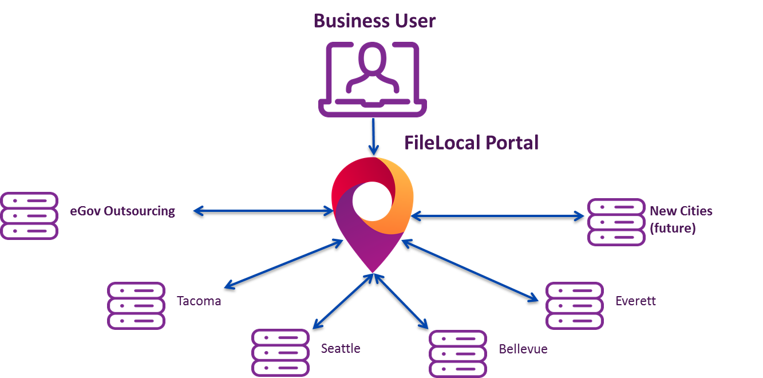
How does the Portal Work
Notes:
Business User – Portal – Standard Information shared across cities – City Specific Information – Licensing and Taxes

Slide 6
FileLocal Basics
Account Setup
General Business License
Renewal of Business License
Payment of Various Taxes – B&O, Admissions, Gambling, Occupational Utility, Parking
Nightly Batch Processing
Researching Prior Filings

Slide 7
Basics of FileLocal for Business
Account Setup
Contact Information, including email verification
Business Information and Locations
City License Account Numbers
Forms they are required to file
Notes:
1. Shared Standardized Information, 2. City Specific Information – City Specific Licensing, Renewals and Taxing,

Slide 8
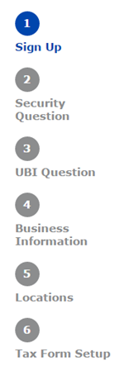
Account Setup
Account Setup is guided, quick, and thorough, adjusting questions based on responses.
Enter User information and email
Confirm email and enter security questions
Enter UBI-16 or confirm Not Required
Enter Business Information for Main and Corporate Locations. Enter existing licenses by City
Enter any additional business Locations and their licenses
Set up any required Tax forms

Slide 9
Basics of FileLocal for Business
2. General Business License Application
Questions are pre-filled when possible
Questions are City specific

Slide 10
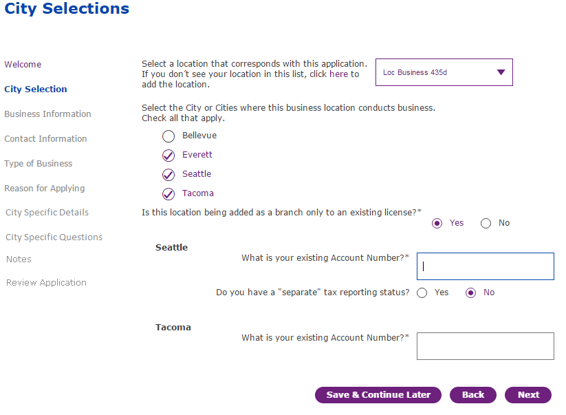
New City added here.
Apply for all Cities at once!

Slide 11
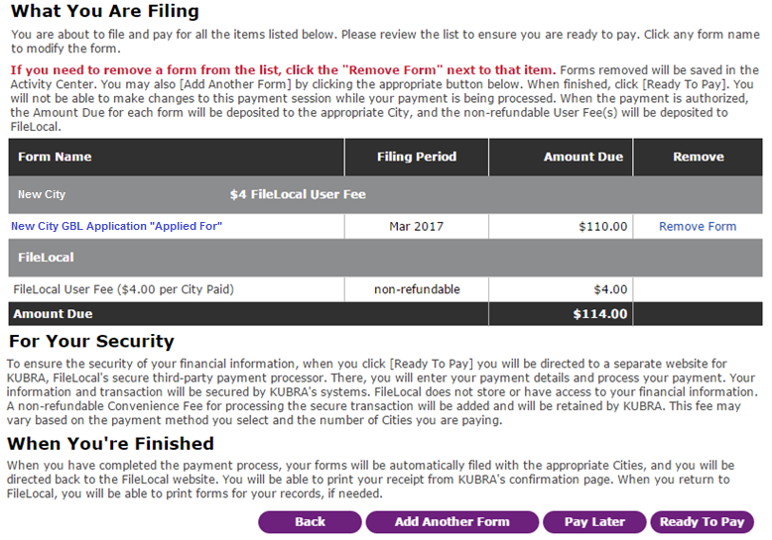
Allows other forms to be paid together.
Notes:
Cost $4 per city, ACH Charge $1, Credit Card 3% Kubra/Chase Paymentech 2 days turn to City’s Bank

Slide 12
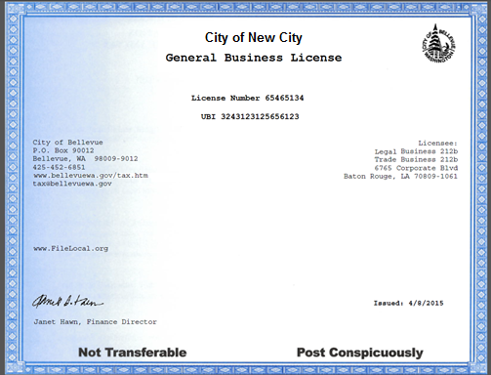
General Business License Printing
Once paid, the Business can print a copy of the Application.
Once approved, by the City, the License can be printed. This is verified each time it is printed.
Notes:
License Availability – Dependent on the City – automatic or manual approval

Slide 13
Basics of FileLocal for Business
3. Renewal General Business License
Fee-based questions
Informational/compliance questions
Notes:
City Specific Renewals

Slide 14
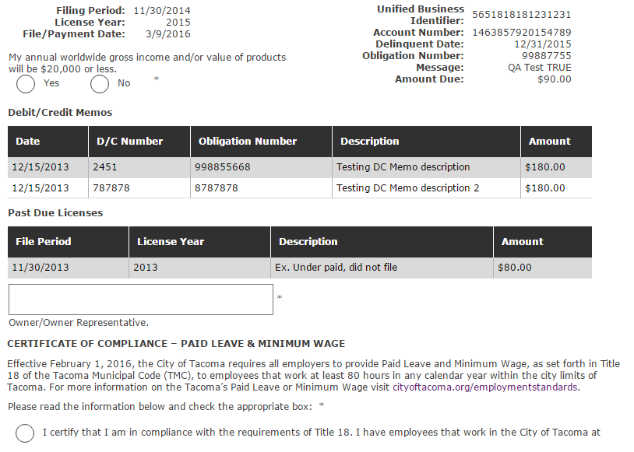
General Business License Renewals

Slide 15
Basics of FileLocal for Business
4. Payment of Various Taxes
Admissions
Gambling
Occupational Utility
Parking
B&O
Notes:
All 4 Cities – all taxes supported

Slide 17
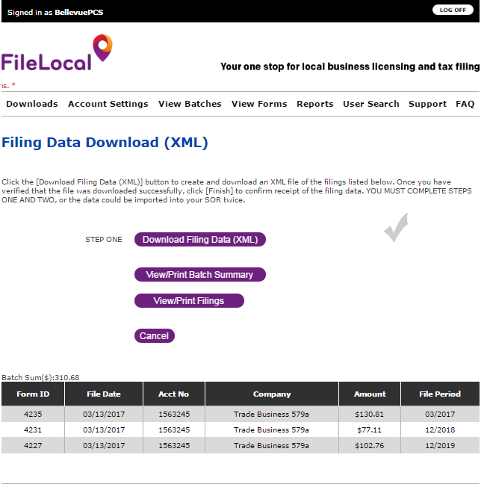
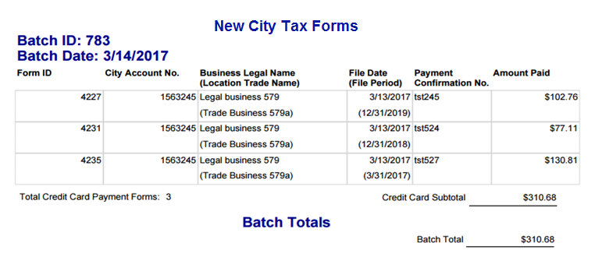
Basics of FileLocal for Business
5.Batch Processing
Nightly Batch Creation/Download

Slide 18
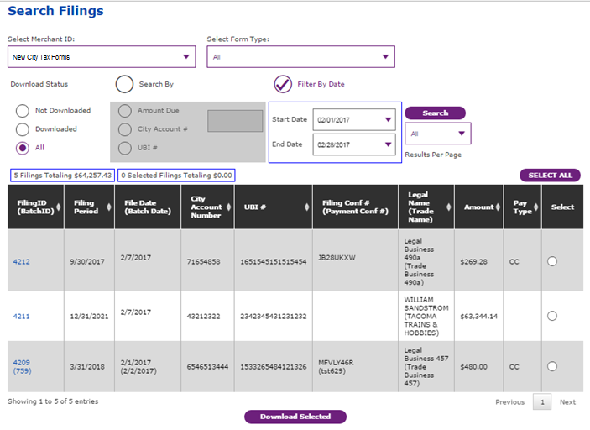
Basics of FileLocal for Business
6. Research Past Filings

Slide 19
New City Implementation Options
Option A – Standard Integration
Option B – eGov System Of Record Integration
Option C – Standardized City Template
Option D – Administration/Outsourcing
Notes:
Standard Integration - Web Service Integration with City’s SOR, eGov SOR – Web Service Integration with new eGov-SOR, Standardized City Temple – Standardized Deployment Licenses, Renewals, Taxes – no Web Services, Administration/Outsourcing – eGov Administers process

Slide 20
New City Implementation Options
Similarities for Option A – Option D
General Business Licensing
General Business Licensing Renewals
Gross Receipts Tax Collection
B&O, Parking, Utility, Gambling, Admissions, etc.
Differences for Option A – Option D
Setup Flexibility – city specific tax and license questions, web service calls
City Administration of Taxes
Notes:
Standard Integration - Web Service Integration with City’s SOR, eGov SOR – Web Service Integration with new eGov-SOR, Standardized City Temple – Standardized Deployment Licenses, Renewals, Taxes – no Web Services, Administration/Outsourcing – eGov Administers process

Slide 21
Key New City Onboarding Activities
Preadmission Meeting with the City
Agency/System Overview
Implementation Options
Onboarding Schedule/Fees
Agency Yearly Fee Schedule
Onboarding City Type
Executive Board Approval
Notes:
Onboarding Schedule/Fees is Option Dependent, Agency Yearly Fees - % of transactions vrs. all city Transactions, Onboarding City Type – Principal or Subscriber, Executive Board Approval - Supermajority

Slide 22
Contact Information
For more information
Contact Kevin Fitzpatrick, FileLocal Program Manager
Kevin.Fitzpatrick-FLO@seattle.gov
206-233-2513.
Operations Policies and Procedures
Notes:
Questions

