Slide 1
Partnering with Business Licensing Service (BLS) Patti Wilson & Eric Jones

Slide 2
BLS Mission
Provide a one-stop customer service center to quickly and efficiently issue business licenses required by law.

Slide 3
Combined Licensing
One application per business
One license document with listed endorsements
One annual renewal payment
Local regulation
Public records retention
Notes:
BLS is a combined licensing concept
90% of users apply for and renew their licenses online and pay via credit card, debit card, or e-check
Support more than 300 license types
$19 per license application
One application per location
Endorsements are printed as line items on the business license document
BLS prints and mails licenses weekly
Can’t wait? Businesses and city staff can print their license from a PDF
$11 renewal fee per location
SYNC UP for all endorsements
Annual renewal → make one payment for all endorsements
Local regulatory control → setting fees and rules for zoning, safety, etc.
License records
Partners can print on-demand “public records” reports

Slide 4
BLS Partners

Slide 5
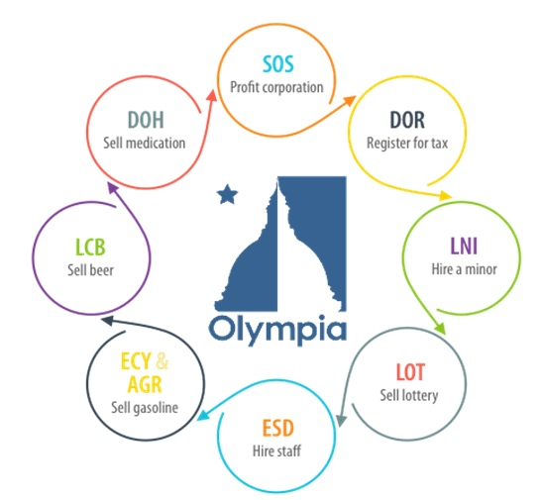
Joint Application Process
An Olympia convenience store submits its online BLS application

Slide 6
What does BLS provide?
Intake applications and renewals
Print & mail licenses
Collect & distribute fees
Offer on-demand reporting
Handle customer service
Support compliance for partners

Slide 7
Fee Types
Flat fees
Reduced-fee and exempt
Employee fee range
Head counts (FTE)
Nonprofit
Home Occupation
Rental units

Slide 9
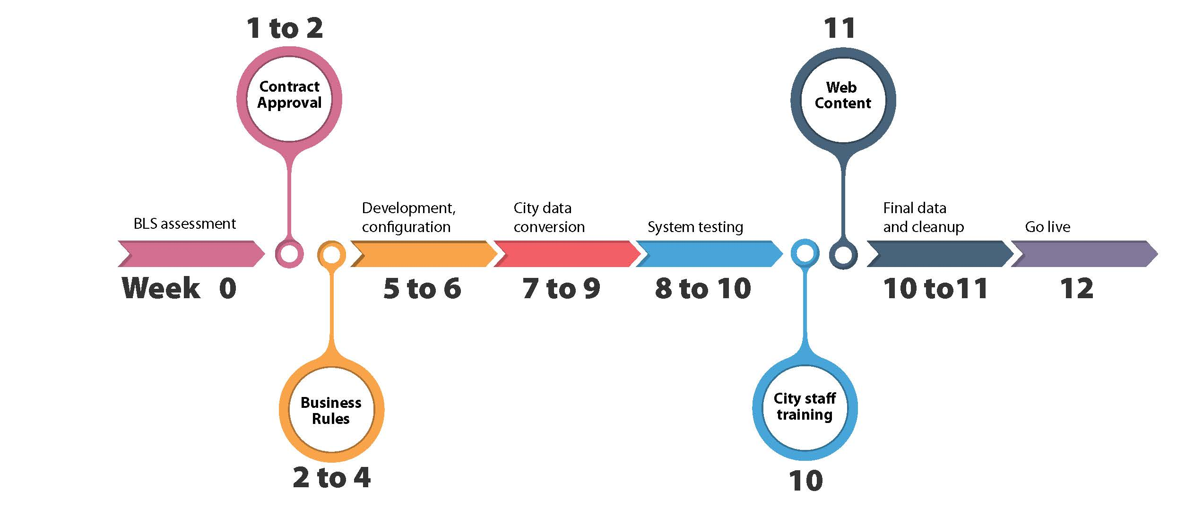
9

Slide 10
Citypartners.dor.wa.gov

Slide 11
Contact
Patti Wilson Local Government Liaison PattiW@dor.wa.gov Eric Jones Business Licensing Service EricJ@dor.wa.gov
360.705.6777 citypartners.dor.wa.gov

