Slide 1
Business tax and licensing simplification An Overview of EHB 2005
Puget Sound Finance Officers Association
June 14, 2017
Peter King, AWC

Slide 2
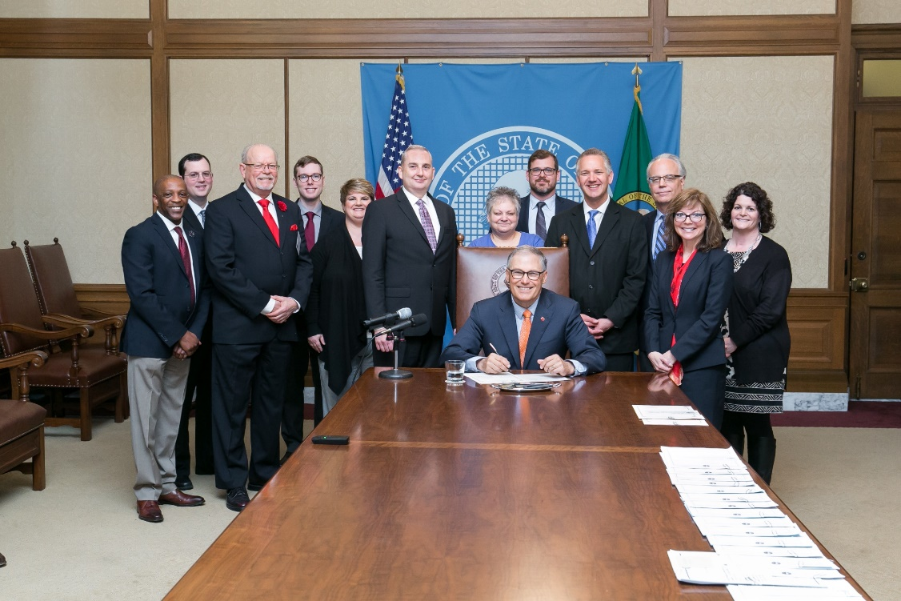
Business license and tax simplification – EHB 2005
2016 9-member task force on city business licenses and taxes
EHB 2005 signed into law on May 5
1. Business licensing “one-stop”
portals - BLS or FileLocal
2. Model business license - threshold
3. B&O tax service apportionment
task force
Effective date: July 23, 2017

Slide 3
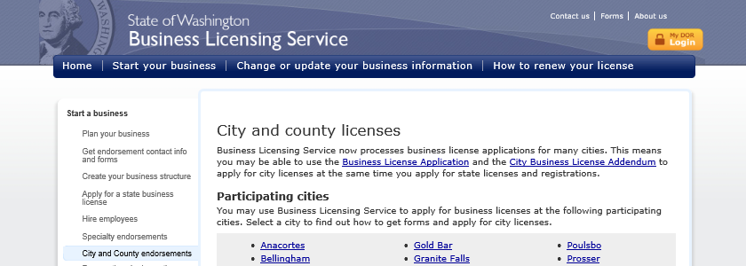
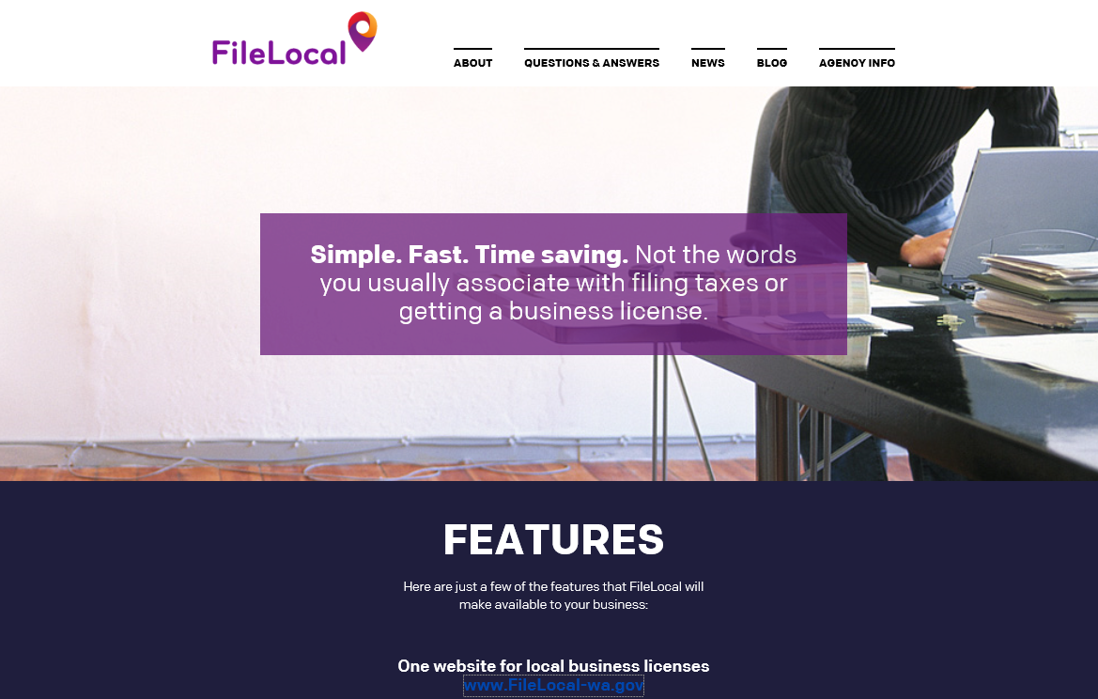
Business license and tax simplification – EHB 2005
Requires cities to partner with state business license system within
5 years or FileLocal by 2020
By 2022, if funded; or
Six per year 2018-2022, remainder by 2027,
if funding not provided
Exception if participate in FileLocal by 7/1/20

Slide 4
Business license and tax simplification – EHB 2005
Delays
Three year delay if fiscal or technical hardship
Department of Revenue may delay if insufficient funds, unforeseen circumstances, or DOR determines delay necessary.
Implementation plan
Developed by DOR every two years
Priority for cities already in queue
Administrative provisions for cities partnered with BLS
75 day notice for changes to licenses

Slide 5
Business license and tax simplification – EHB 2005
2. Model business license
Uniform definition of engaging in business and business license threshold
AWC workgroup required to complete model by July 1, 2018
Implemented by all cities by January 1, 2019
May not be updated more frequently than every four years

Slide 6
Business license and tax simplification – EHB 2005
3. Task force on city B&O tax service income apportionment
two-factor formula and administration
Two-factor apportionment required by RCW 35.102.130, effective in 2008
Seven member task force
1 Department of Revenue, non-voting chair
3 Cities with local B&O taxes
3 Business representatives
Report by October 2018 with recommended
changes to RCW 35.102.130

Slide 7
Questions?
Peter King
AWC Chief Executive Officer
peterk@awcnet.org
Notes:
Patti Wilson Bio:
Patti Wilson is the Local Government Liaison and Customer Service Advocate for the Washington State Department of Revenue. She manages local government relations and serves as their primary point of contact. In addition, she manages the Department’s customer-focused service program.
Patti Wilson has worked for the Department for over 27 years. During her career with the Department, Patti has held several positions including excise tax examiner and manager of the Unclaimed Property program’s internal operations. Patti represents the Department on the Community Economic Revitalization Board (CERB).
She received her degree in accounting from the University of Puget Sound. Currently, she is working a temporary job assignment managing the Business Licensing Services Partnership Services team.
Kevin Fitzpatrick bio:
Kevin Fitzpatrick joined FileLocal as Program Manager in April 2016. He brings with him both a breadth of management experience and a business owner’s perspective. Kevin started his career in public accounting. He has an extensive background in the design, development and deployment of Finance and Operational Systems, holding various management positions (Global Operations, Global Project Management, Global Services and Global Finance) for a number of Fortune 500 companies in the high tech industry. As a small business owner, Kevin operated a group of successful dry cleaners in the Boulder, Colorado area.
Kevin received his Bachelor of Business Administration (Accounting) from the University of Notre Dame Mendoza College of Business.

